Slide 1


The Outdoor Ethics & Conservation Subcommittee: Who’s Who and What We Do
Outdoor Ethics Virtual Roundtable
NOTE: This session will be recorded and posted on outdoorethics-bsa.org. Youth, please turn off your cameras. Thank you!

Slide 2
Your feedback is a gift…to yourself and others
Whether you’re attending live or watching the recording, your input directly shapes future roundtables.
Please take just a minute and give us your feedback at
https://forms.gle/RPdLxP4eiDXh5Qpk8
Thank you!

Slide 3
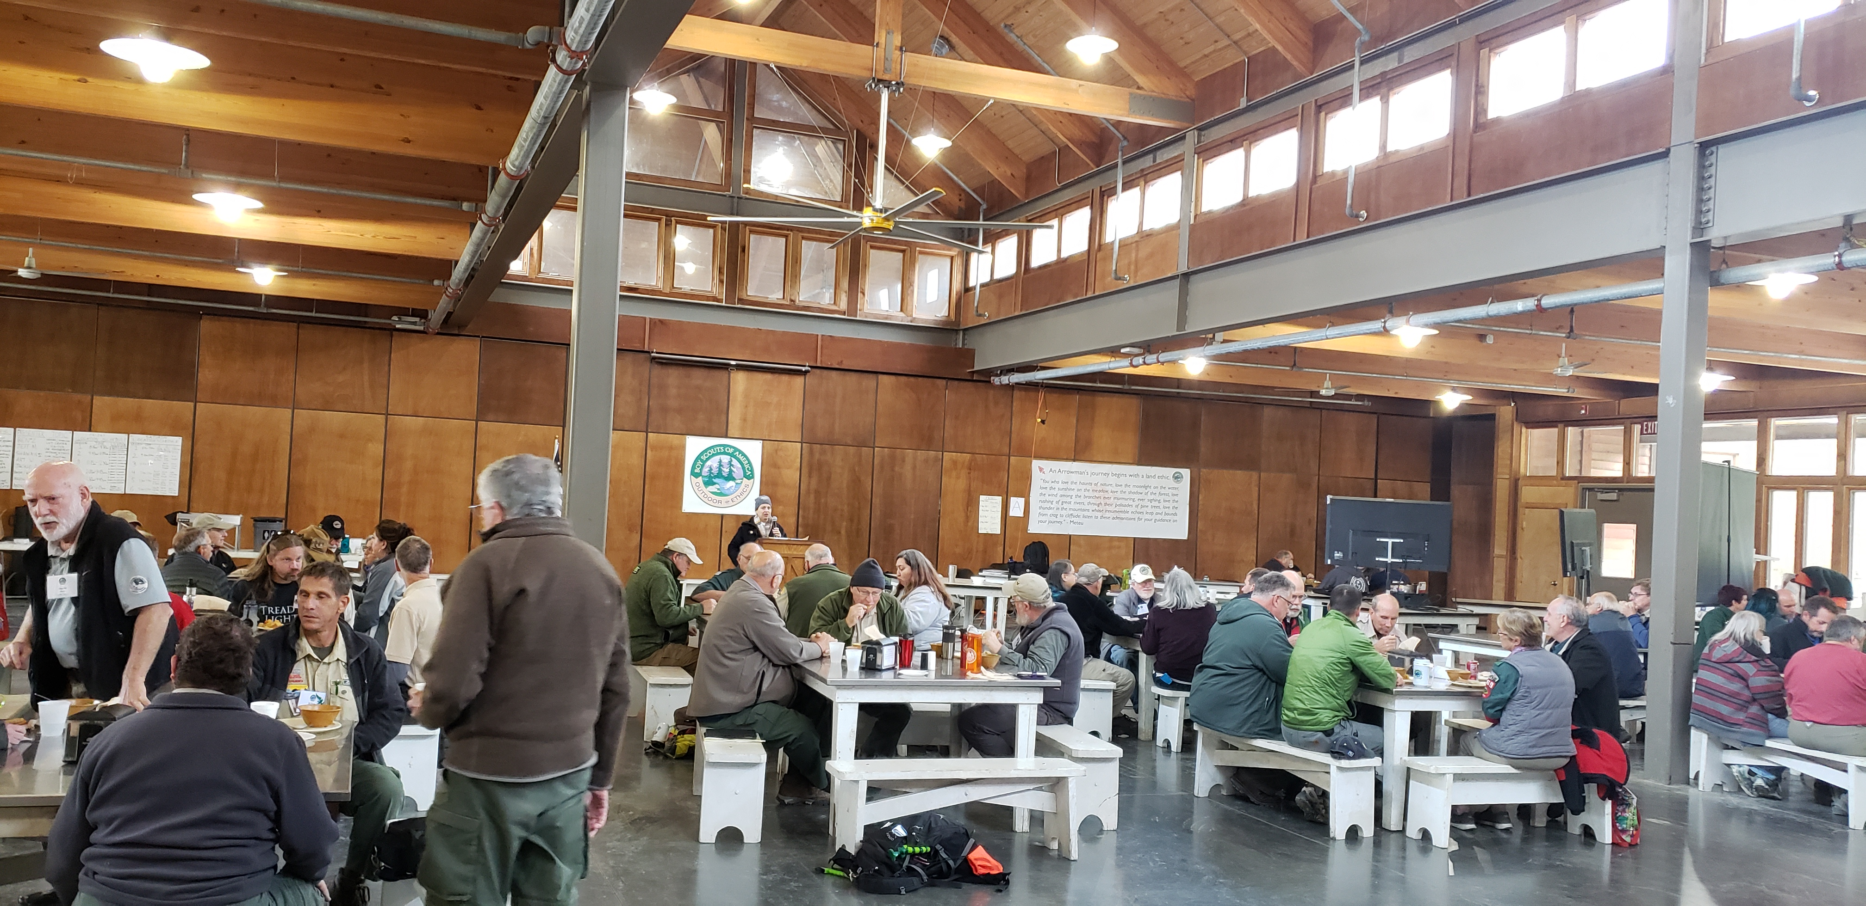
Save the Date!!
Join us for the 2022 National Outdoor Ethics & Conservation Conference
November 10-13
Bert Adams Scout Camp, Covington, Georgia

Slide 4
Agenda
7:00 CST – Welcome
-Pledge of Allegiance
- Scout Oath and Law
- Outdoor Code
– Safety Moment – Annual Health and Medical Record
– Who’s Who and What We Do
– Q & A
8:30 – Adjourn

Slide 5
Questions
Please use the chat function to ask your questions.
We will answer them periodically throughout the presentation and afterwards.

Slide 6

I pledge allegiance to the Flag of the United States of America, and to the Republic for which it stands, one Nation under God, indivisible, with liberty and justice for all.
Notes:
This message is one parents want to hear. At the end of the day, we want them to feel comfortable enrolling their kids in our programs where they know they are receiving the type of education and training to help them become the best version of themselves.

Slide 7

SCOUT OATH
On my honor I will do my best
to do my duty to God
and my country and to obey the Scout Law;
to help other people at all times;
to keep myself physically strong,
mentally awake, and morally straight.
Notes:
The guiding principles are fantastic, but how do we achieve this? Through the aims and methods of Scouting.

Slide 8

SCOUT LAW
A Scout is…
Trustworthy, Loyal, Helpful, Friendly,
Courteous, Kind, Obedient, Cheerful,
Thrifty, Brave, Clean, Reverent.
Notes:
This is why we’re all here, so lead with this. Keep it simple.

Slide 9

Outdoor Code
As an American, I will do my best to
Be clean in my outdoor manners,
Be careful with fire,
Be considerate in the outdoors and
Be conservation-minded.
Notes:
These are the principles that define who we are as an organization and will help us to provide guidance to the youth in our programs. They have stood the test of time and will continue to provide guidance for us and for the youth we serve for generations to come.

Slide 10
Safety Moment – Michelle Bierstedt

Slide 11
Annual Health and Medical Record Safety Moment
For Everyone’s Safety
For all scouting participants –youth and adults

Slide 12
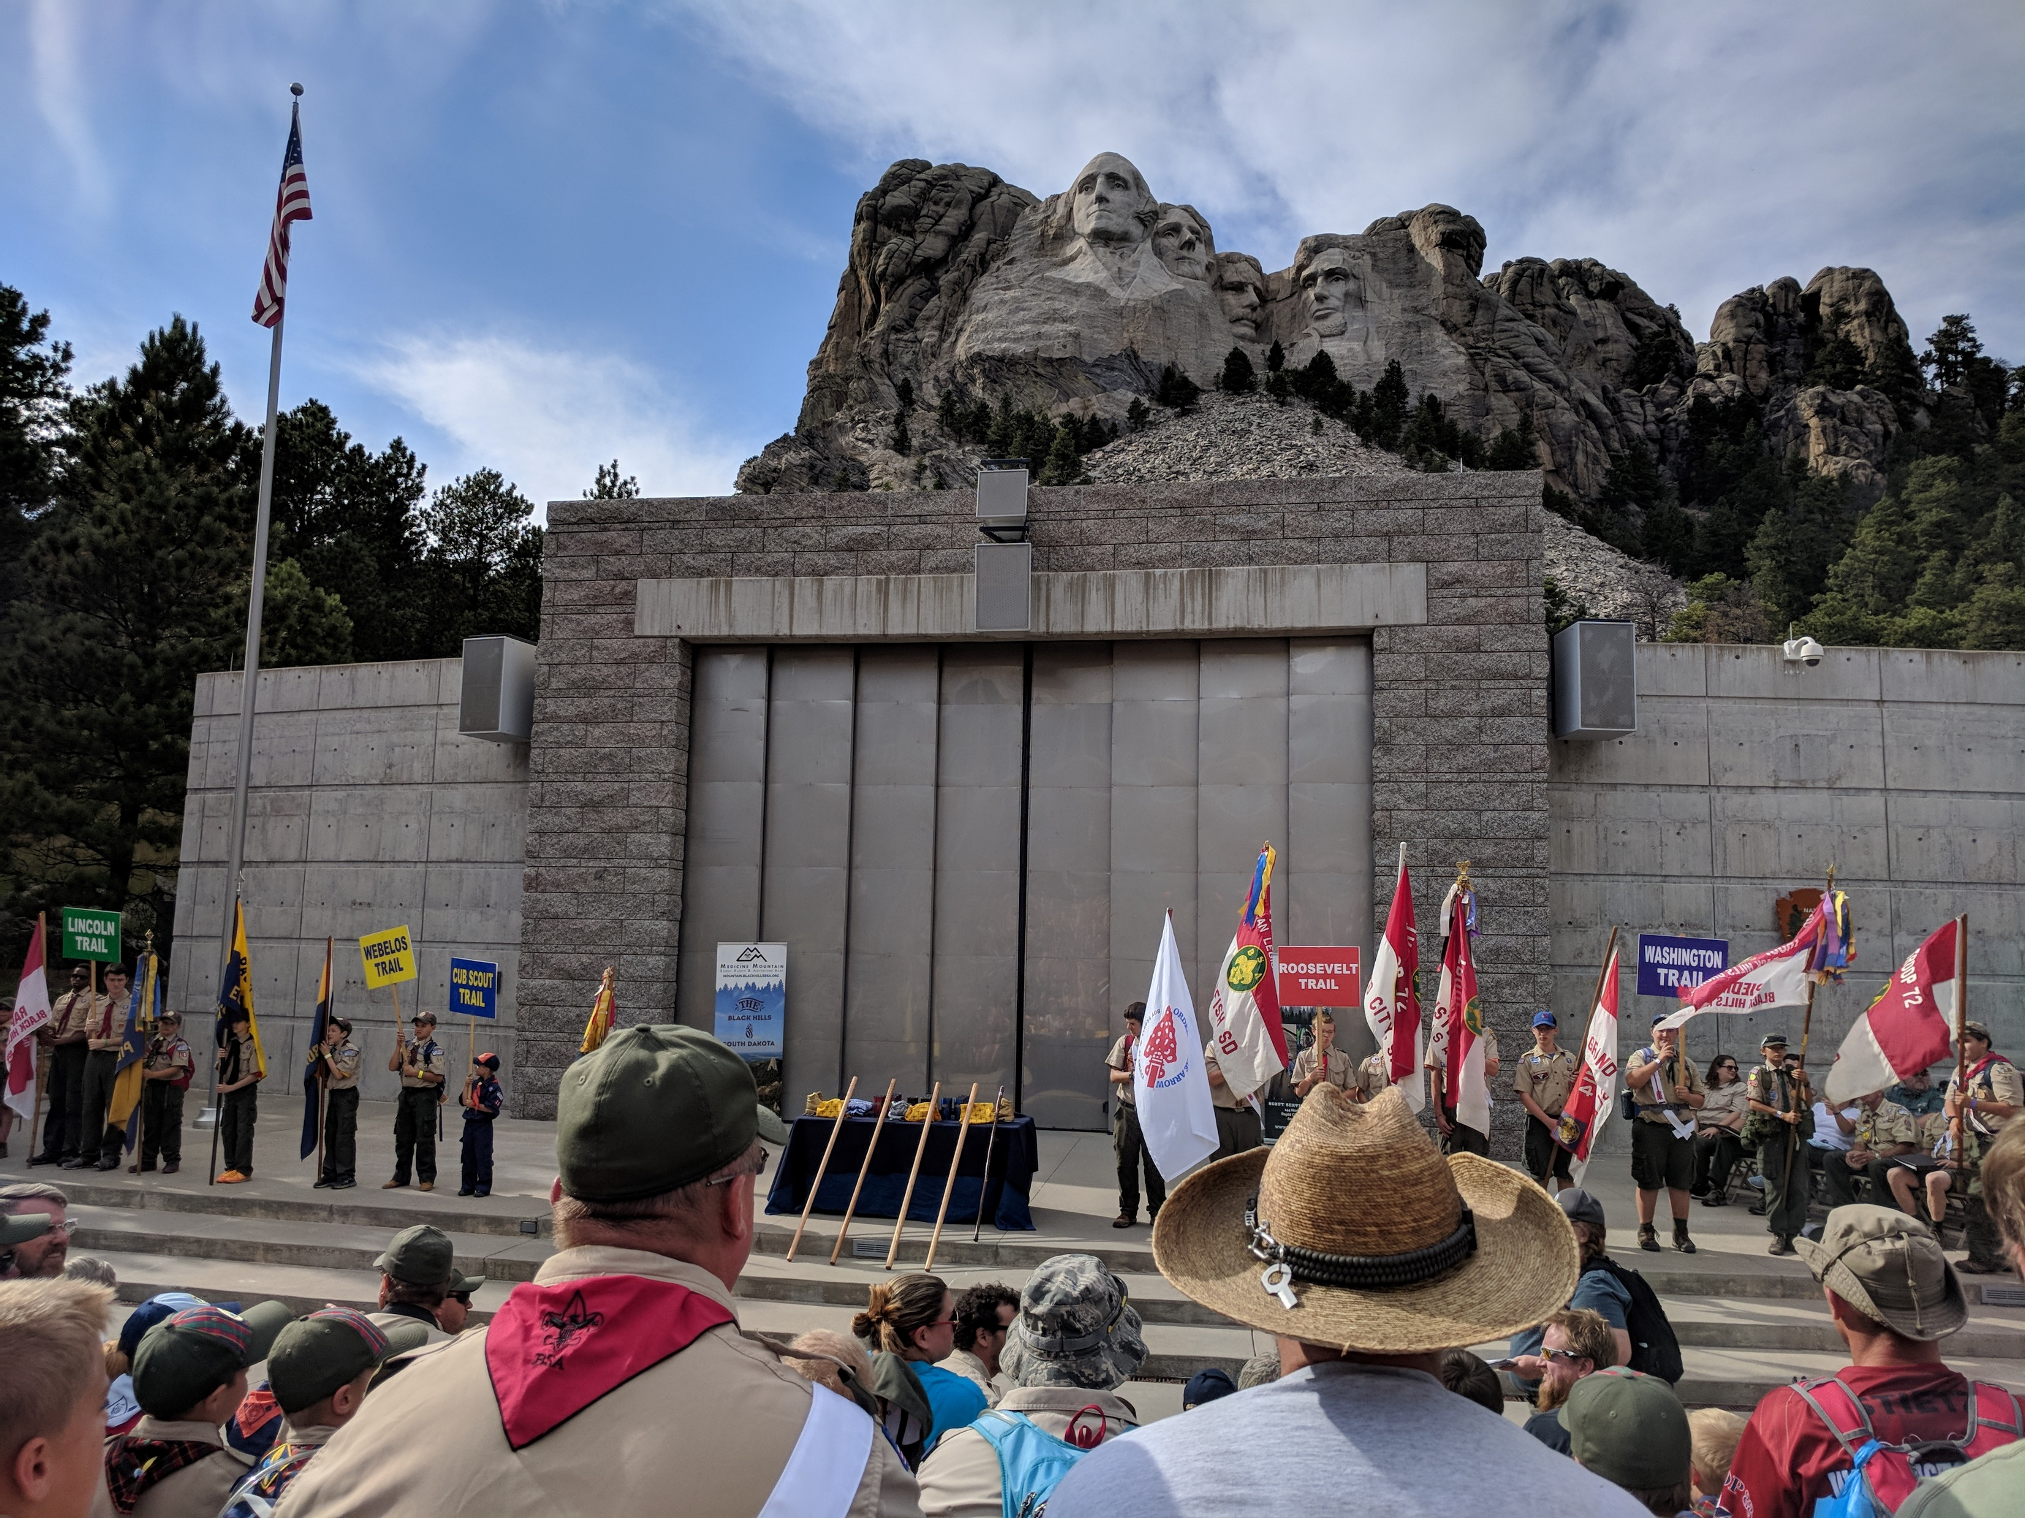
The Scouting adventure, camping trips, high-adventure excursions, and having fun are important to everyone in Scouting—and so is your safety and well-being. Completing the Annual Health and Medical Record is the first step in making sure you have a great Scouting experience.
A slip, a fall, heat exhaustion, a heart attack …do you know who will need medical attention? Be safe ---be sure all participants from the Lions to the Adults have a medical record available at events. This includes day events, overnight camps, trainings, OA, Jamboree and high adventure.
https://www.scouting.org/health-and-safety/safety-moments/annual-health-and-medical-record/

Slide 13
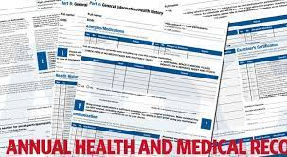
Update Annually
Part A – Informed Consent
Part B- General Health History
Part C- Pre-participation Physical (for events over 72 hours)
High Adventure Risk Advisory –for high adventure activities such as Philmont, Sea Base, Northern Tier, and Summit
https://filestore.scouting.org/filestore/HealthSafety/pdf/680-001_instruction.pdf?_gl=1*vmbeib*_ga*MjAxODI1NjgwNy4xNjMxNzIzNDU0*_ga_20G0JHESG4*MTYzODY4MzQ4NS4xOS4xLjE2Mzg2ODM3MjQuNDE.

Slide 14
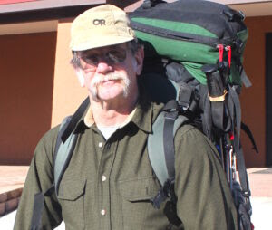

In memory of our dear friend Dan Howells
Please consider a gift to the Dan Howells Memorial fund.
https://lnt.org/give/other-ways-to-give/dan-howells-memorial-fund/

Slide 15
OE & Cons Zones
Good Evening OE Enthusiasts
Outdoor Ethics Manager-East Division
Marshall Berger

Slide 16
16

Slide 17
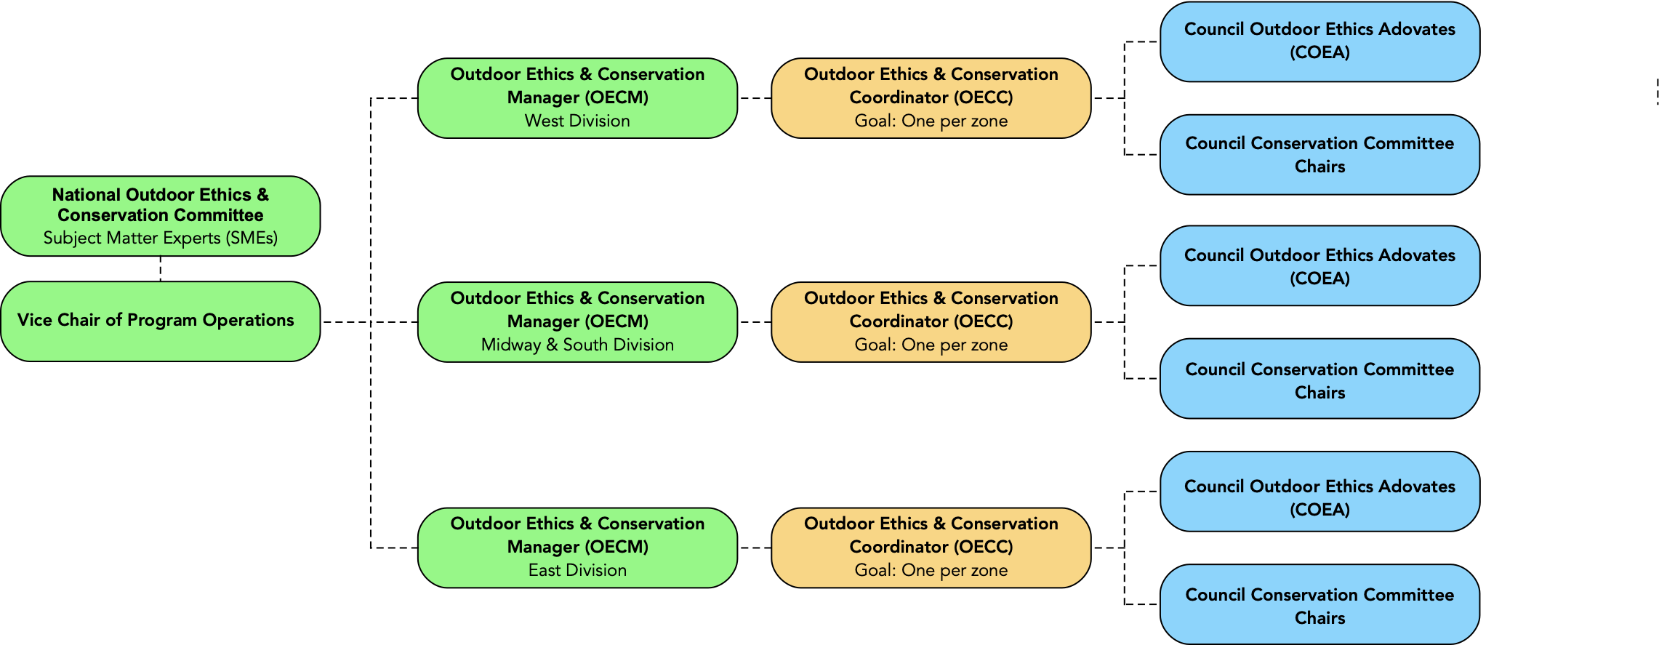
OE & Cons Program Operations

Slide 18
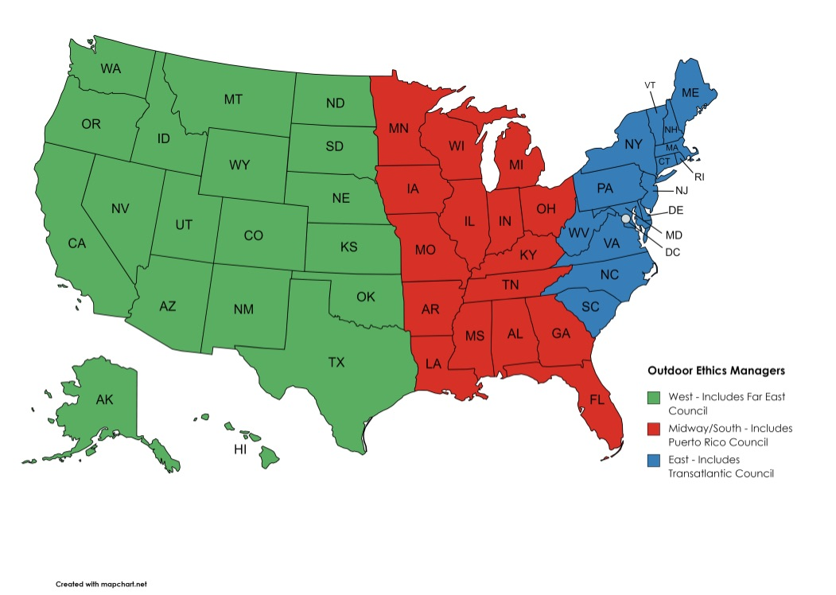
OE & Cons Divisions

Slide 19
O E & Con Zones
East Division
15 states
D.C.
Transatlantic
80 councils

Slide 20
OE & Cons Zones
Zone E1
Maine:
Pine Tree
Katahdin Area
New Hampshire:
Daniel Webster
Vermont:
Green Mountain
Rhode Island: Narragansett

Slide 21
OE & Cons Zones
Zone E1 (cont)
Massachusetts:
Heart of New England
Mayflower
Western Mass
Spirit of Adventure
Cape Cod & the Islands
Connecticut:
Connecticut Rivers
Connecticut Yankee
Housatonic
Greenwich
Transatlantic

Slide 22
OE & Cons Zones
Zone E2
New York:
Theodore Roosevelt Five Rivers
Greater New York Seneca Waterways Baden Powell Allegheny Highlands Longhouse Iroquois Trails Suffolk County Twin Rivers
Greater Niagara Frontier Rip Van Winkle Leatherstocking Greater Hudson Valley

Slide 23
OE & Cons Zones
Zone E3
New Jersey:
Northern New Jersey
Patriots Path
Jersey Shore
Garden State
Monmouth
Delaware:
Del-Mar-Va
Maryland:
National Capital Area
Baltimore Area

Slide 24
OE & Cons Zones
Zone E3 (cont)
Pennsylvania
Chester County
Cradle of Liberty
Minsi Trails
Northeastern Pennsylvania
Washington Crossing

Slide 25
OE & Cons Zones
Zone E4
Pennsylvania:
French Creek Westmoreland-Fayette
Chief Cornplanter Susquehanna
Bucktail Pennsylvania Dutch
Moraine Trails Laurel Highlands Juniata Valley Hawk Mountain
New Birth of Freedom Mason Dixon

Slide 26
OE & Cons Zones
Zone E5
Virginia:
Shenandoah
Virginia Headwaters
Heart of Virginia
Colonial Virginia
Tidewater
Blue Ridge Mountains
West Virginia:
Ohio River Valley
Mountaineer
Buckskin

Slide 27
OE & Cons Zones
Zone E6
North Carolina:
Old North State Daniel Boone
Occoneechee Piedmont
Tuscarora Cape Fear
East Carolina Mecklenburg
Central North Carolina
Old Hickory
South Carolina:
Palmetto Coastal Carolina
Pee Dee Area Blue Ridge
Indian Waters

Slide 28
Thank you
Marshall Berger
srteleman@gmail.com

Slide 29

Distinguished Conservation Service Award
Ted Weiland
Midway/South Division Manager
National Outdoor Ethics and Conservation Subcommittee

Slide 30
My Background
Associate Professor of Chemistry at Kirkwood Community College in Cedar Rapids, IA
Leave No Trace Master Educator
Former Central Region Representative Hornaday Awards
Former conservation staff at Northern Tier and Philmont
Key Volunteer – Order of the Arrow Outdoor Programs Subcommittee

Slide 31
Role on the Committee
Midway/South Division Manager
To help support Outdoor Ethics & Conservation Coordinators who oversee Zones
Also work with Council Outdoor Ethics Advocates and Council Conservation Committees with issues that arise
Helping councils find resources and support training events that occur

Slide 32
Midway/South Zones
Zone 1
Minnesota & Wisconsin
Zone 2
Iowa, Missouri, Arkansas
Zone 3
Louisiana & Mississippi
Zone 4
Alabama & Georgia
Zone 5
Florida Puerto Rico
Zone 6
Illinois
Zone 7
Michigan & Indiana
Zone 8
Ohio
Zone 9
Tennessee & Kentucky

Slide 33
Distinguished Conservation Service Award
Check out this promotional video!
https://vimeo.com/642453504
This recognition is for those youth who complete 2 conservation based service projects and the other appropriate requirements.
https://www.scouting.org/outdoor-programs/conservation-and-environment/conservation-awards-and-recognitions/bsa-distinguished-conservation-service-award/

Slide 34
DCSA Adviser Training Now Available!
Find it on my.scouting.org
https://training.scouting.org/learning-plans/1800
Takes 3 to 4 hours
Great way to prepare yourself to help young people work on this worthy award
***Coming Soon*** Council Conservation Committee Training

Slide 35
My Contact Information
Ted.Weiland@gmail.com

Slide 36
Chandra Clark
Western Division

Slide 37

Western Division
19 States and Pacific
79 councils

Slide 38
W-1
12 Councils
Alaska
Pacific
Washington
Oregon

Slide 39
W-2
10 Councils
Northern California
Hawaii

Slide 40
W-3
6 Councils
Idaho
Montana
(Wyoming)
Colorado

Slide 41
W-4
8 Councils
Utah
Nevada
Arizona
New Mexico
Texas (El Paso)

Slide 42
W-5
10 Councils
Southern California

Slide 43
W-6
11 Councils
North Dakota
South Dakota
Nebraska
Kansas

Slide 44
W-7
10 Councils
Southern Texas

Slide 45
W-8
12 Councils
Oklahoma
Northern Texas

Slide 46
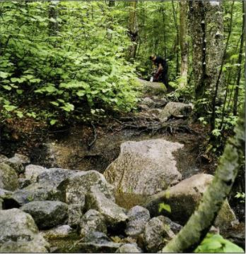

Leave No Trace
Master Educator Courses
Council Hosted vs. High Adventure Base
Weeklong vs. Split Weekend
Trek Course vs. Non-Trek Course

Slide 47
2022 Leave No Trace Master Educator Courses
Illowa Council hosting at Camp Loud Thunder
March 18th – 20th (Friday to Sunday) &
April 7th – 10th (Thursday to Sunday)
Non-Trek Course
Division: Midway & South
Visit Calendar at http://www.outdoorethics-bsa.org/training/me_courses.php

Slide 48
2022 Leave No Trace Master Educator Courses
Baltimore Area Council hosting at
Broad Creek Memorial Scout Reservation
April 29th – May 1st (Friday to Sunday) &
May 12th – 15th (Thursday to Sunday)
Backpacking Trek Course & Canoeing Trek Course
Division: East
Visit Calendar at http://www.outdoorethics-bsa.org/training/me_courses.php

Slide 49
2022 Leave No Trace Master Educator Courses
Grand Canyon Council hosting at Camp Geronimo
May 17th to 22nd (Tuesday to Sunday)
Hiking Trek Course & Non-Trek Course
Division: West
Visit Calendar at http://www.outdoorethics-bsa.org/training/me_courses.php

Slide 50
2022 Leave No Trace Master Educator Courses
Northern Tier High Adventure Base
August 14th to 20th (Sunday to Saturday)
Canoeing Trek Course
Division: Midway & South
Visit Calendar at http://www.outdoorethics-bsa.org/training/me_courses.php

Slide 51
2022 Leave No Trace Master Educator Courses
Philmont High Adventure Base
October 7th – 12th (Friday to Wednesday)
Backpacking Trek Course & Non-Trek Course
Division: West
Visit Calendar at http://www.outdoorethics-bsa.org/training/me_courses.php

Slide 52
2022 Leave No Trace Master Educator Courses
Be sure to check the calendar for updates as additional course come online.
http://www.outdoorethics-bsa.org/training/me_courses.php

Slide 53
How to Host a
Leave No Trace
Master Educator Course
Information is available on the Outdoor Ethics & Conservation Committee’s website:
http://outdoorethics-bsa.org/training/MEcourseHosting.php
or reach out to your Division Manager

Slide 54
Outdoor Ethics & Conservation Coordinator
Welcome to the OECC Team
Paula Boothe
Vice Chair – Program Operations

Slide 55
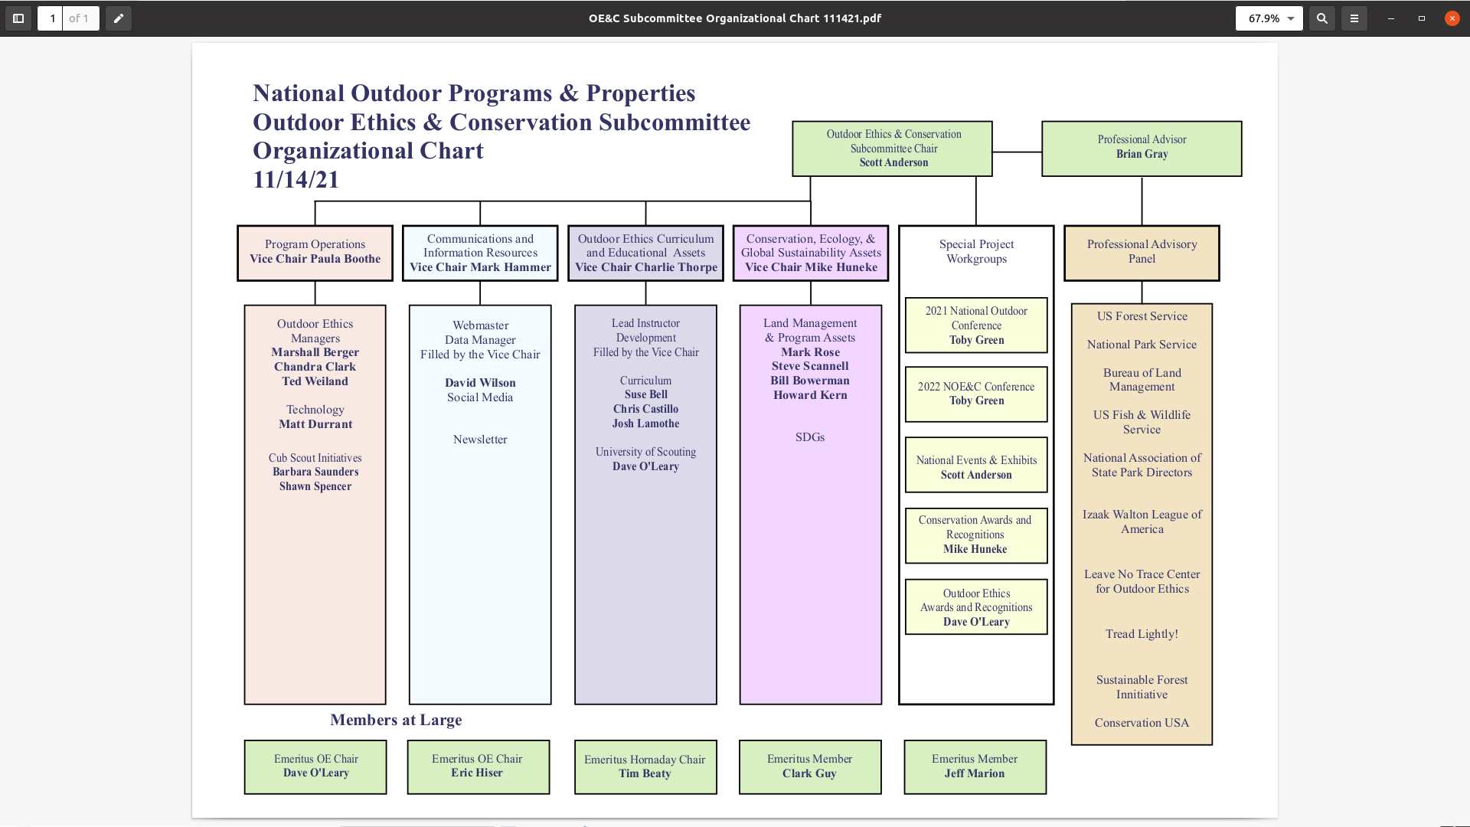

Slide 56
A Workgroup is a small group of volunteers, led by a committee member, that focuses on a specific need or topic. Workgroups allow our committee to use the expertise of Scouting volunteers to help accomplish our goals.
Program Operations
2 Workgroups in Operation
Round Table
Family Adventure Camp

Slide 57
Outdoor Ethics Conservation
Three Divisions:
East- 6 zones;16 states, plus Transatlantic;
79 councils
Midway/ South- 9 zones;16 states, plus
Puerto Rico ; 87 councils
West- 8 zones;19 states, plus Far East;
79 councils

Slide 58
Division Managers

Slide 59
Division Managers
Your Manager is your friend!
Ready to Help !
Marshall Berger
Ted Weiland
Chandra Clark

Slide 61
Your Outdoor Ethics & Conservation Coordinator
Is here to help (in the works)
First choices Your
Council Outdoor Ethics Advocate
Council Conservation Committee
More Information outdoorethics-bsa.org

Slide 62
Reporting
We had a Roundtable on Reporting!
It’s that time again. Whether you are the Council Outdoor Ethics Advocate or not It’s good for you, your council and the BSA.
OutdoorEthics-BSA.org/AnnualReport/

Slide 63
Outdoor Ethics Conservation
Questions?
Thank you
Next month
A Committee! A Committee! I Need A Committee!
Or Do I?
January 12, 2022

Slide 64
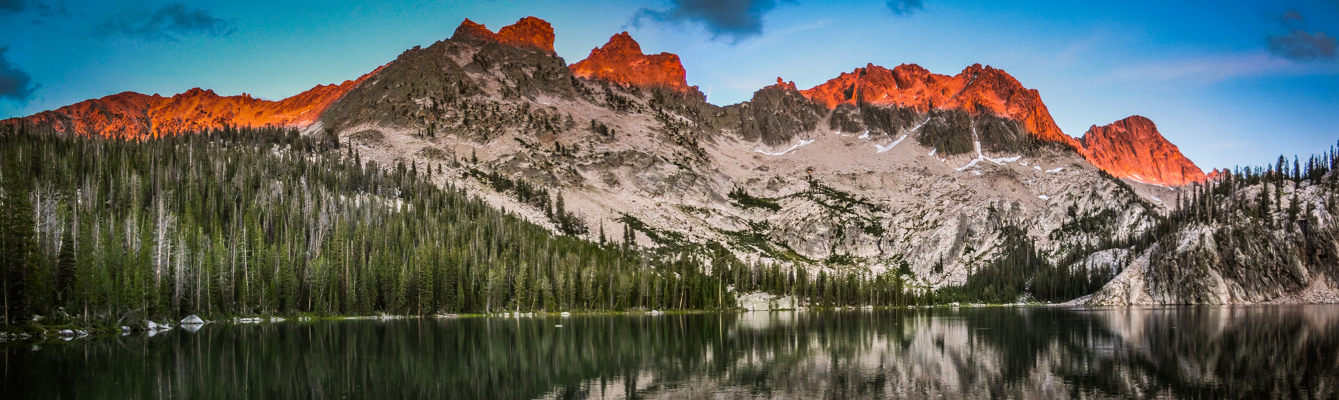
Thank you for joining us!
Please remember to fill out the roundtable evaluation at https://tinyurl.com/OECCRT. The link is also in the chat.
. The link is also in the chat.

