Slide 1


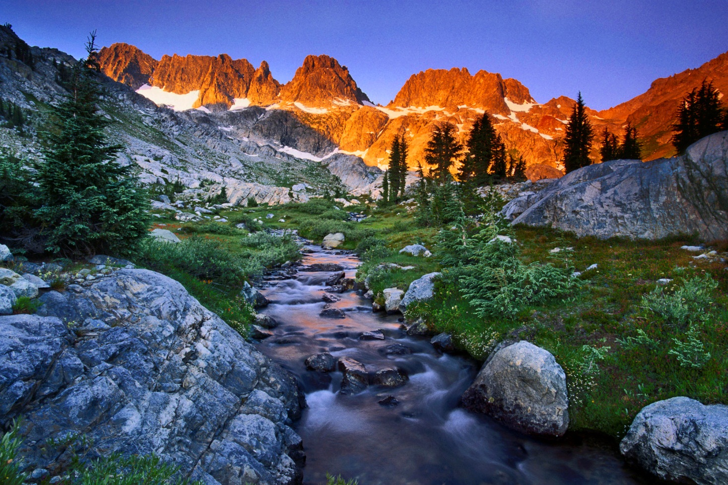

Outdoor Ethics
& The Order of the Arrow

Slide 2

GOALS
The goal of this BSA Outdoor Ethics presentation is to reaffirm the concept of Outdoor Ethics and its skills and activities for the Order of the Arrow.
As the servant leaders of Scouting, our Arrowmen can teach youth and adults at all program levels to understand how we can care for the land and be better stewards of our camps and the properties we use.
We can consciously seek ways to enhance our use of camps for our ceremonies and fellowships while taking care to minimize our impact on the land.

Slide 3
Learning Objectives
By the end of the session you should have:
Knowledge of the BSA Outdoor Ethics program which includes the Outdoor Code, Leave No Trace, Tread Lightly! and the Land Ethic.
Understand the importance of outdoor ethics in outdoor activities.
Learn how we can better care for our camps and ceremonial sites by using the principles of outdoor ethics as we develop new sites and conduct our induction and fellowship weekends.

Slide 4
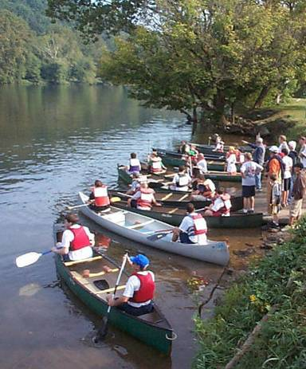

Importance
BSA in the outdoors by the numbers (as of 12-31-16):
> 4 million members, 275 councils, 138,000 units
50K troops & 17K crews = 300,000 weekend trips
10K weekend multi-group trips
5K week long trips
1K week long multi-group trips
Estimated annual outdoor BSA use of public/private lands:
Over 10 million user days!
Increasing visitation
= Increasing impacts?
Notes:
Individual impacts may not seem to make much of a difference; however, when you look at the cumulative effects of millions of visitors, the impacts are huge.

Slide 5
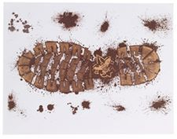
Big Footprint
Notes:
The BSA puts more people in the outdoors than any other non-government organization in the world. We have a special obligation to minimize our impacts.

Slide 6
IMPACTS IMPACTS IMPACTS IMPACTS IMPACTS

Slide 7
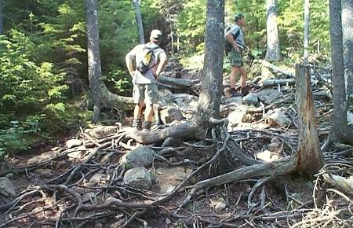
Vegetation Impacts
Vegetation loss
Spread of
non-native species
Tree damage

Slide 8
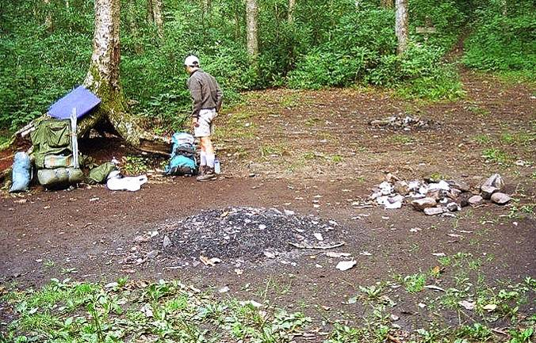
Soil Impacts
Soil compaction
Soil erosion
Loss of organic litter

Slide 9
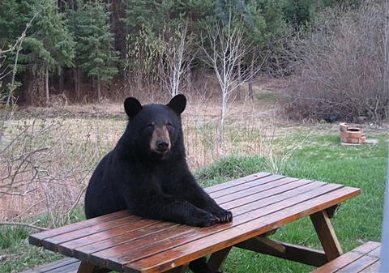
Wildlife Impacts
Disturbance of wildlife
Altered behavior
Reduced health & reproduction

Slide 10
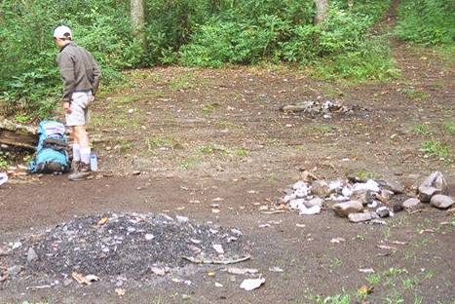
Campfire Impacts
Sterilize Soil
Fire Stains & Nubbins
Ecosystem Zapper
Universal Garbage Can

Slide 11
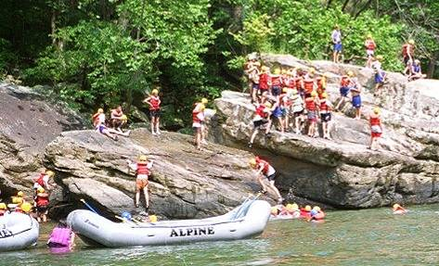
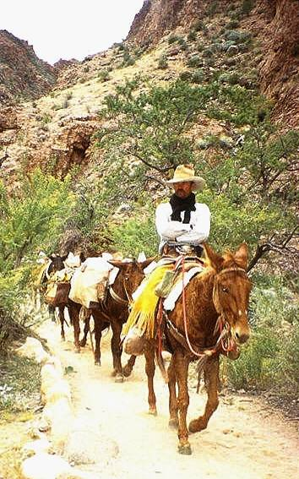
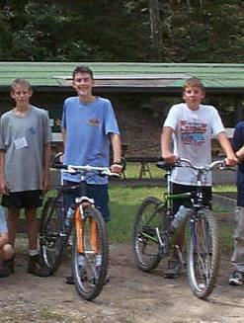
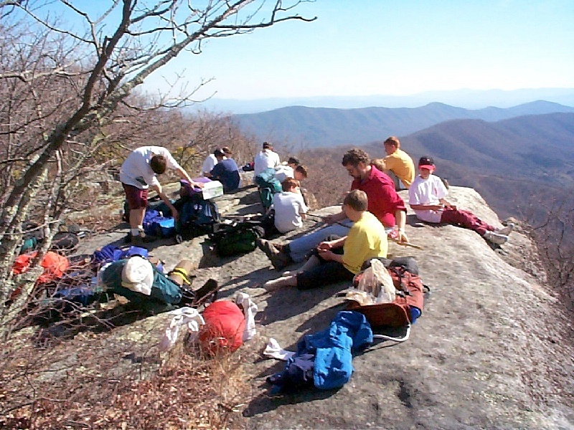
Social Impacts
Crowding
Conflicts
Noise

Slide 12
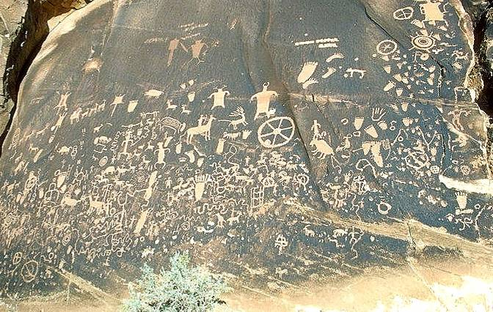
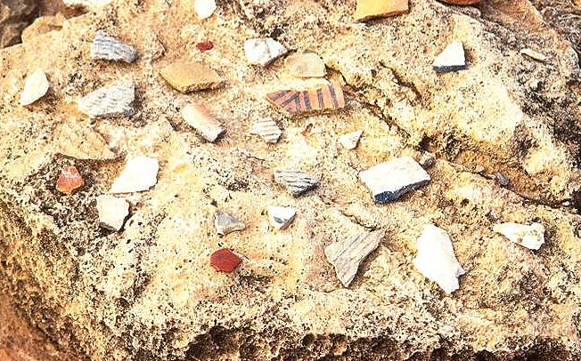
Cultural Resource Impacts
Theft of artifacts
Damage to historic structures
Damage to cultural features

Slide 13

Common perceptions by Federal land management agencies about BSA units on federal land:
Kids out of control
Too much noise
Group sizes too big
Camping skills badly out of date
Inappropriate play damages the backcountry
Don't keep appointments to do service work
Completely soak up popular campsites or shelters
Unskilled campers using areas that call for expert skills
Using inappropriate areas (hi-use, fragile) to train new campers
and on and on and on...

Slide 14

The BSA is the elephant in the woods
Can Arrowmen help reduce these impacts?

Slide 15
Our Native American Connection
“Treat the earth well. It was not given to you by your parents –it was loaned to you by your children.”
Native American proverb

Slide 16
Meteu tells us the Mighty Chieftain’s story
“You who love the haunts of nature,
Love the moonlight on the water,
Love the sunshine on the meadow,
Love the shadow of the forest
Love the wind among the branches
Ever murmuring, ever sighing
Love the rushing of great rivers . . . .”

Slide 17
Order of the Arrow Scouting’s National Honor Society
Purpose
As Scouting’s National Honor Society, our purpose is to:
Recognize those who best exemplify the Scout Oath and Law in their daily lives and through that recognition cause others to conduct themselves in a way that warrants similar recognition.
Promote camping, responsible outdoor adventure, and environmental stewardship as essential components of every Scout’s experience, in the unit, year-round, and in summer camp.
Develop leaders with the willingness, character, spirit and ability to advance the activities of their units, our Brotherhood, Scouting, and ultimately our nation.
Crystallize the Scout habit of helpfulness into a life purpose of leadership in cheerful service to others.

Slide 18
So what is an Ethic?
What does ethics mean?
How can we become a more ethical person?
Notes:
moral principles that govern a person's behavior or the conducting of an activity.
the branch of knowledge that deals with moral principles.
Ethics is concerned with distinguishing between good and evil in the world, between right and wrong human actions, and between virtuous and nonvirtuous characteristics of people.
In its most basic terms, ethics is the science of making a decision….how can I make ethical decisions when I am in the outdoors or as I live my life?

Slide 19
So what is an Ethic?
The Obligation
The Admonition

Slide 20
Here’s Another Ethic
BSA’s Outdoor Code

Slide 21
Outdoor Code
As an American, I will do my best to:
Be clean in my outdoor manners
We will clean up after ourselves using pack it in, pack it out techniques. We avoid leaving graffiti, fire rings, camp gadgets, and other signs of our presence.
Be careful with fire
Fire is an important tool, but not only can it be devastating if it gets out of hand, it can also, with current use be damaging to the land. We must therefore think about the need for fire, how best to use it, and how to minimize its impacts.
Be considerate in the outdoors
We will think about others as well as ourselves and how our presence impacts them. We think about not just our impact on other humans, but also on wildlife and the environment.
Be conservation minded
We will think about our impacts on the environment. We will take steps to correct and redress damage to the environment.
Notes:
What is Outdoor Ethics you may ask?
- Ethics is what you do when no one is watching.
- The body of moral principles or values governing or distinctive of a particular culture or group.
“…ethics is what you do in the dark, before the game warden shows up, before someone tells you to shape up! Shame is what you feel when they catch you doing something wrong; guilt is what you feel when you do something you know is wrong, period. One requires law enforcement. The other requires only the presence of that still, small voice…”- Paul Quinnett
Building upon this foundation, the Cub Scout, Boy Scout, Varsity Scout, Venturing, and Sea Scout programs all include outdoor stewardship and care for the environment, as part of their programs. Through the Outdoor Code we can take responsibility for our own impacts. We can provide leadership to those around us to reduce their impacts by making good choices. Together, we can preserve and conserve our rich environmental heritage.
History of Outdoor Code and Outdoor Ethics in Scouting
In the late 1800s and early 1900s, United States embraces the “Conservation Movement”
1871 – Fish & Wildlife Service created
1872 – First National Park (Yellowstone)/ General Mining Law Past
1877 – Desert Land Act passed
1891 – First National Forest
1905 – U.S. Forest Service established
1910- Boy Scouts of America is formed
1910 – The Great Fire
1911 - Handbook for Boys
In 1917, the William T. Hornaday established the Wildlife Protection Medal, awarded to individuals for protecting wildlife.
1936 – Boy Scouts take over the Wildlife Protection Medal and rename it the Hornaday Award.
1944 - Scouting adopted the “Wilderness Code of Conduct” for use of backcountry
1944 – Smokey Bear is introduced by the US Forest Service to introduce fire safety
1946 – Bureau of Land Management is formed
1948 – Boy Scouts adopts the Outdoor Code
1949 – Aldo Leopold publishes “The Sand County Almanac”
1952 – Wildlife MB; Soil Management MB
1954 – Conservation Good Turn
1960’s – Forest Service creates “Leave No Trace”
1970 – Honda introduces the 3-wheel ATV / Used in Bond movie “Diamonds are Forever”
1971 – Woodsey Owl is introduced by the US Forest Service to promote environmental protections
1982 – Suzuki introduces the 4-wheel ATV
1985- “Tread Lightly” created by the Forest Service
1990 – TREAD Lightly! becomes a non-profit organization
1993 – Leave No Trace Center is established
2008 – TREAD Lightly! Awarded a Hornaday Gold Award by BSA
2012 – Leave No Trace Task Force becomes Outdoor Ethics Task Force and adopts a new logo

Slide 22

The BSA Outdoor Ethics program exemplifies
“Self Reliance and Service”
that have been a hallmark of Scouting and the Order of the Arrow.

Slide 23


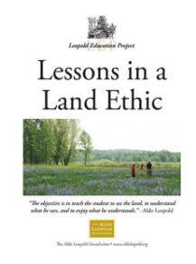
Outdoor Ethics Components
 | Leave No Trace | Primary Set of Principles
 | TREAD Lightly! | Primary Set of Principles for Mechanized Activities
 | The Land Ethic | Spirit of Conservation and Environmental Stewardship
Notes:
In scouting we have had an Outdoor Ethic since the late 1940’s we call it the Outdoor Code. We have not had the programs to make the Outdoor Code come alive until now.
The Outdoor Code, supported by the Principles of Leave No Trace, supplemented by Tread Lightly! principles and by the Land Ethic, represents an integrated Outdoor Ethic that is true to Scouting’s history and tradition of service.
Scouts and Venturers who embrace the Outdoor Code often find that they wish to give back and help protect the environment that has given them so much. Some may find that they are "wild with love for the green outdoors—the trees, the tree-top singers, the wood-herbs, and the nightly things that left their tracks in the mud," in the words of Ernest Thompson Seton, the first Chief Scout. These Scouts and Venturers have begun to feel what Aldo Leopold called the "Land Ethic." The Land Ethic extends our concern beyond our fellow Scouts and Venturers, our families and friends, and even humanity itself to the entire environmental community of which we are a part—the deserts, forests, fish, wildlife, plants, rocks, oceans, and web of life encompassing them—what Leopold called "the Land."
Outdoor ethics is not just for youth. Adult volunteers are encouraged to seek training in basic outdoor skills and even take specialized courses. Many councils have Outdoor Ethics advocates who provide leadership to their local units in learning and practicing good outdoor ethics.

Slide 24
Leave No Trace
Plan Ahead and Prepare
Travel and Camp on Durable Surfaces
Dispose of Waste Properly
Leave What You Find
Minimize Campfire Impacts
Respect Wildlife
Be Considerate of Other Visitors
Notes:
Leave No Trace
Instilling values in young people and preparing them to make moral and ethical choices throughout their lifetime is the mission of the Boy Scouts of America. Leave No Trace helps reinforce that mission, and reminds us to respect the rights of other users of the outdoors as well as future generations. Appreciation for our natural environment and a knowledge of the interrelationships of nature bolster our respect and reverence toward the environment and nature.
The Principles of Leave No Trace
Leave No Trace is an awareness and an attitude rather than a set of rules. It applies in your backyard or local park (Front Country) as much as in the backcountry. We should all practice Leave No Trace in our thinking and actions--wherever we go.
Leave No Trace provides a framework for outdoor recreation decision making, which is summarized in the following seven principles:
-Backcountry
Plan Ahead and Prepare: Poorly prepared people, when presented with unexpected situations, often resort to high-impact solutions that degrade the outdoors or put themselves at risk. Proper planning leads to less impact.
Travel and Camp on Durable Surfaces: Damage to land occurs when surface vegetation or communities of organisms are trampled beyond repair. The resulting barren area leads to unusable trails, campsites and soil erosion.
Dispose of Waste Properly: Though most trash and litter in the backcountry is not significant in terms of the long term ecological health of an area, it does rank high as a problem in the minds of many backcountry visitors. Trash and litter are primarily social impacts which can greatly detract from the naturalness of an area. Further, backcountry users create body waste and waste water which requires proper disposal according to Leave No Trace.
Leave What You Find: Leave No Trace directs people to minimize site alterations, such as digging tent trenches, hammering nails into trees, permanently clearing an area of rocks or twigs, and removing items.
Minimize Campfire Impacts: Because the naturalness of many areas has been degraded by overuse of fires, Leave No Trace teaches to seek alternatives to fires or use low-impact fires.
Respect Wildlife: Minimizing impact on wildlife and ecosystems.
Be Considerate of Other Visitors: Following hiking etiquette and maintaining quiet allows visitors to go through the wilderness with minimal impact on other users.
-Frontcountry
Know Before You Go
Stick to Trails and Camp Overnight Right
Trash your Trash and Pick Up Poop
Leave It as You Find It
Be Careful with Fire
Keep Wildlife Wild
Share Our Trails and Manage Your Pet
To learn about Cub Scout age activities and the kid’s Leave No Trace Principles, go to the PEAK website at lnt.org/teach/peak
For more information and some activities, refer to Boy Scouts of America’s Teaching Leave No Trace.(21-117)
Training continuum of Leave No Trace
Leave No Trace Master Educator
Leave No Trace Trainer
BSA Leave No Trace 101
Awareness
Leave No Trace and how it applies to the Outdoor Code:
The Principles of Leave No Trace provide a strong, science-based set of tools to apply the Outdoor Code to Scouting’s fundamental outdoor activities
Provide a way to translate the aspirational goals of the Outdoor Code into concrete actions on the land
This practical guidance is of tremendous importance to our youth and leaders

Slide 25

TREAD Lightly!
Travel responsibly
Stay on designated roads, trails and areas.
Cross streams only at designated fords
Respect the rights of others
Yield the right of way to those passing you
Educate yourself
Use maps and regulations from public agencies
Avoid sensitive areas
Stay on designated routes, avoid meadows & wetlands
Do your part
Model appropriate behavior, dispose of trash responsibly
Minimize the use of fires
Repair degraded areas
TREAD Lightly! focuses on people that use or are affected by motorized and mechanized vehicles
https://www.treadlightly.org/
Notes:
Tread Lightly!
An Overview of Tread Lightly!
Tread Lightly! is a national nonprofit membership based organization with a mission to promote responsible recreation through education. Launched as a public awareness program in the mid-1980s by the U.S. Forest Service, management of the program was transitioned into the private sector through a Memorandum of Understanding in October, 1990. Tread Lightly!’s educational message, along with its training and restoration initiatives are strategically designed to instill an ethic of responsibility in outdoor enthusiasts and the industries that serve them.
The program is long-term in scope with a goal to balance the needs of the people who enjoy outdoor recreation with our need to maintain a healthy environment. Tread Lightly! offers unique programs and services designed to help remedy current recreation issues.
The TREAD Principles:
Travel -Responsibly on land by staying on designated roads, trails and area. Go over, not around, obstacles to avoid widening the trails. Cross streams only at designated fords. when possible, avoid wet, muddy trails. On water, stay on designated waterways and launch your watercraft in designated areas.
Respect the Rights of Others including private property owners, all recreational trail users, campers and others so they can enjoy their recreational activities undisturbed. Leave gates as you found them. Yield right of way to those passing your or going uphill. On water, respect anglers, swimmers, skiers, boaters, divers and those on or near shore.
Educate -Yourself prior to your trip by obtaining travel maps and regulations from public agencies. Plan for your trip, take recreation skills classes and know how to operate your equipment safely.
Avoid -Sensitive Areas on land such as meadows, lake shores, wetlands and streams. Stay on designated routes. This protects wildlife habitats and sensitive soils from damage. Don’t disturb historical, archeological or paleontological sites. On water, avoid operating your watercraft in shallow waters or near shorelines at high speeds.
Do -Your Part by modeling appropriate behavior, leaving the area better than you found it, properly disposing of waste, minimizing the use of fire, avoiding the spread of invasive species and repairing degraded areas.
To learn about Lightfoot and TREAD Lightly! for Cub Scouts, visit TL! Kids at http://tlkids.org/.
Training Continuum of TREAD Lightly!
Master Tread Trainers
Tread Trainers
Awareness
TREAD Lightly! And how it applies to the Outdoor Code:
Scouting’s activities and youth demand for dynamic and relevant program require us to address mechanized recreation (mountain cycles, motor driven “toys”)
This is Tread Lightly!’s focus
The activity based pamphlets and videos provide readily accessible guides to ethical decision making and skills for the recreational equipment Scouts use
Tread Lightly adds to our understanding of outdoor ethics with its focus on
-Educate yourself
-Do your part—which echoes Scouting’s tradition of service

Slide 26

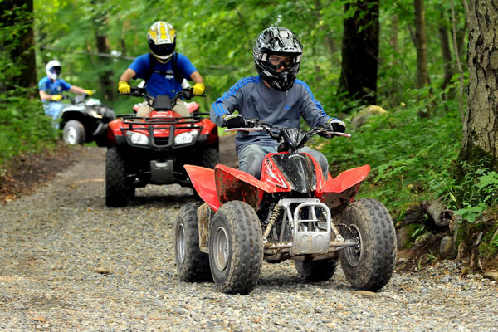
Why TREAD Lightly!
BSA National Motorized Sports Pilot Programs
Motorboating
Snowmobiles
Jet Skis
ATV’s
TREAD Lightly! can help us implement these programs in a safe and ethical manner

Slide 27
The Land Ethic
The Land Ethic is offered by Aldo Leopold in 1949 in A Sand County Almanac. He reflected on the interaction with man and the land. “The Land Ethic simply enlarges the boundaries of the new community which includes soils, waters, plants and animals, or collectively referred to as, the LAND.”
Notes:
The Land Ethic and Stewardship
“The land ethic simply enlarges the boundaries of the community to include soils, waters, plants, and animals, or collectively: the land.” - Aldo Leopold
“We abuse the land because we regard it as a commodity belonging to us. When we see the land as a community to which we belong, we may begin to use it with love and respect.” – Aldo Leopold
The concept of the Land Ethic was developed by Aldo Leopold in A Sand County Almanac. In this book, Aldo Leopold reflected upon his interaction with the land and how it had enriched him, but also how our society tends to trivialize or dismiss the role of the land. The following quotations provide a brief introduction to the Land Ethic concept as envisioned by Leopold:
"An ethic [that] presupposes the mental image of the land as a biotic mechanism. We can be ethical only in relation to something that we can see, feel, understand, love, or otherwise have faith in." … [Think of the land as an energy circuit, with energy flowing from the soils to the plants to animals and back.] This thumbnail sketch of the land as an energy circuit conveys three basic ideas:
That land is not merely soil;
That the native plants and animals kept the energy circuit open; others may or may not;
That man-made changes are of a different order than evolutionary changes, and have effects more comprehensive than intended or foreseen. These ideas, collectively, raise two issues: Can the land adjust itself to the new order? Can the desired alterations be accomplished with less impact?
Leopold sums up his thoughts with the following observation:
"A land ethic, then, reflects the existence of an ecological conscience, and this in turn reflects a conviction of individual responsibility for the health of the land. Health is the capacity of the land for self-renewal. Conservation is our effort to understand and preserve this capacity."
“Wilderness is a necessity ... They will see what I meant in time. There must be places for human beings to satisfy their souls. Food and drink is not all. There is the spiritual. In some it is only a germ, of course, but the germ will grow.”
John Muir
The Land Ethic teaches us that we should consider our actions in light of their impact on the living, breathing community that is the land, and that we should select the alternative available that does the least impact to that community. The Land Ethic grows strongest when we have experienced the Land, grown to love and respect it, and have labored to enhance or restore it or, as Leopold would have put it, when we have practiced “conservation” defined as restoring the capacity of the Land for self-renewal. We understand the Land Ethic and when we think of right in relation to the Land as follows:
A thing is right when it tends to preserve the integrity, stability, and beauty of the biotic community. It is wrong when it tends otherwise.
Are you ready to face the challenge of looking at the Land in this fashion? If so, then you understand the Land Ethic.
Continuum of Land Ethic Training
Land Ethic Leaders
Awareness Workshops
The Land Ethic and how it applies to the Outdoor Code
As mentioned earlier, the Land Ethic teaches us that we should consider our actions in light of their impact on the living, breathing community that is the land. Many people do not realize it, but Scouting was one of the first organizations to recognize that the conservation of our world's natural resources is vitally important. Ernest Thompson Seton, William T. Hornaday and Chief Scout Citizen and President of the United States Theodore Roosevelt felt very strongly about the need to protect our nation's natural resources. The BSA adopted the Outdoor Code in the middle of the 20th Century to help clarify this message and its principles still ring true today. The Outdoor Code speaks to being Clean in Our Outdoor Manners and stresses the importance of being Conservation Minded. These relate to the Land Ethic in that being Conservation Minded means adopting good practices towards our use of soil, water, minerals, grasslands, wildlife and energy. We will always encourage others to do so as well.
The importance of the BSA being a leader in Outdoor Ethics = Stewardship
"The earth does not belong to man, man belongs to the earth.
All things are connected like the blood that unites us all.
Man did not weave the web of life, he is merely a strand in it.
Whatever he does to the web, he does to himself." - Chief Seattle,1854
Early Scout leaders included
Theodore Roosevelt - “The nation behaves well if it treats the natural resources as assets which it must turn over to the next generation increased and not impaired in value.”
Ernest Thompson Seton – “I believe that natural history has lost much by the vague general treatment that is so common.”
Gifford Pinchot – “Conservation means the wise use of the earth and its resources for the lasting good of men.” “World-wide practice of Conservation and the fair and continued access by all nations to the resources they need are the two indispensable foundations of continuous plenty and of permanent peace.”
“If future generations are to remember us with gratitude rather than contempt, we must leave them more than the miracles of technology. We must leave them a glimpse of the world as it was in the beginning, not just after we got through with it.” - President Lyndon Johnson at signing of Wilderness Act, 1964
Scouting represents one of the largest youth organizations in the United States, with 2.7 million youth members and over 1 million adult volunteers. Scouting's goal is to train youth in responsible citizenship, character development, and self-reliance through participation in a wide range of outdoor based activities. As a result, the usage of our nation's outdoor areas by Scouting units is widespread. It is important that all members of the Scouting program understand and implement proper ways to enjoy our nation’s outdoor resources without leaving an impact. In other words, Scouts must be stewards of the land in practice and in theory. Learning and educating others in these proper methods is a key part of Scouting's outdoor strategy. Without proper understanding of how to use the land in a low impact fashion, Scout units as well as other outdoor users, could risk the loss of access to these beautiful places.

Slide 28
The Land Ethic
The Land Ethic grows strongest when we have experienced the LAND, grown to love and respect it, and have labored to enhance or restore it or, as Leopold would have put it, when we have practiced “conservation” defined as restoring the capacity of the Land for self-renewal.
“A thing is right when it tends to preserve the integrity, stability, and beauty of the biotic community. It is wrong when it tends otherwise.”

Slide 29
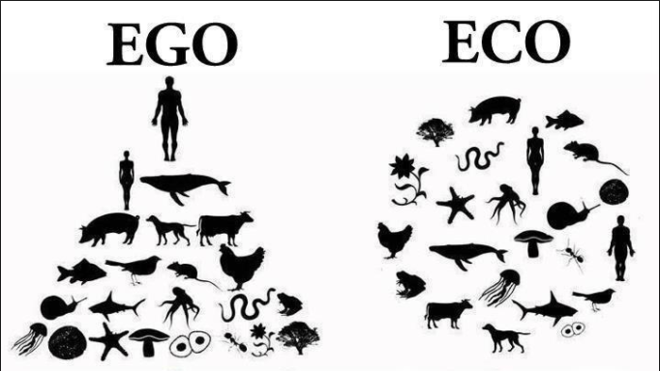
The Land Ethic
Notes:
In the EGO image the human is at the top of the food chain.
The ECO image has the human as but part of the eco system.

Slide 30

There’s Even a Patch
Outdoor Ethics Awareness Award
Recite and explain the meaning of the Outdoor Code.
Watch the National Park Service Leave No Trace video.
Complete the Leave No Trace online youth course
Earn the Tread Lightly! online course certificate.
Participate in an outdoor ethics course, workshop, or training activity facilitated by a person who has completed the BSA outdoor ethics orientation course or is a BSA outdoor ethics trainer or master.
Outdoor Ethics Action Award
Site for more information: http://www.scouting.org/scoutsource/OutdoorProgram/OutdoorEthics/Awards.aspx
Notes:
There are Awareness and Action Awards for Cubs, Boy Scouts, Venture (youth and adult)
See this site for detailed information on these awards:
http://www.scouting.org/scoutsource/OutdoorProgram/OutdoorEthics/Awards.aspx

Slide 31
BSA Outdoor Ethics Training Continuum
Awareness Workshop
In-Unit Training by Youth or Adults
Leave No Trace 101 *(outdoor ethics orientation course)
Leave No Trace Trainer Course
Leave No Trace Master Educator Course

Slide 32


BSA Outdoor Ethics Training Continuum
Tread Trainer Course
Master Tread Trainer Course

Slide 33
How Does This Apply To Our Use Of Our camps?
As we set up our ceremonial sites, what are our key concerns?
Location of our candles and torches?
Where we will find the wood we need for the fire lay?
Is the fire ring large enough?
ARE THESE THE RIGHT QUESTIONS?
Notes:
As we set up our ceremonial sites, what are the key concerns?
The first issue is how can we build the fire lay with minimal impact on the sub surface and the organisms beneath the surface.
To minimize the affects on the ground, we need to build a fire lay properly. One way to do this is to build up the fire ring with 6 inches of sand provide insulation for the land.
Another design is to reduce the fire lay to approximately 36 inches in diameter.

Slide 34

Our Camp Use
Today, let’s talk about campfire Impacts.
We always use existing fire rings
(if available).

Slide 35
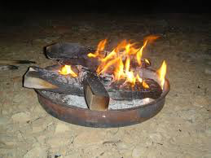
Pan Fire
Could This Work?

Slide 36
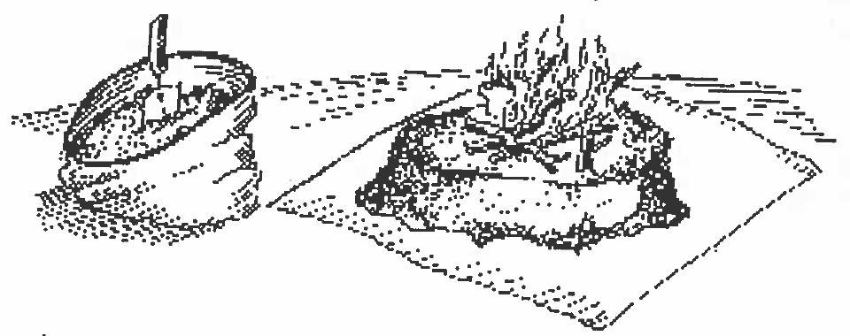
Mound Fire
Or This?

Slide 37
Mound Fire
Innovative method of building a Leave No Trace fire
Items needed
A garden trowel
Large stuff sack
A ground cloth/tarp
Lay the tarp out
Turn the stuff sack inside out
Fill with mineral soil
Spread the soil into a mound 4 to 6 inches high
Flatten the top and build your fire
Notes:
The thickness of the mound is critical to the insulating the surface underneath from the head of the fire.
It will also prevent tarp from burning.
The circumference of the mound should be more than the intended fire.

Slide 38
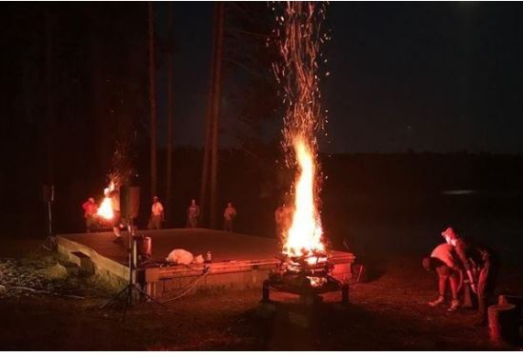
Ceremonial Pan Fire
How About This Ceremonial Pan Fire?

Slide 39
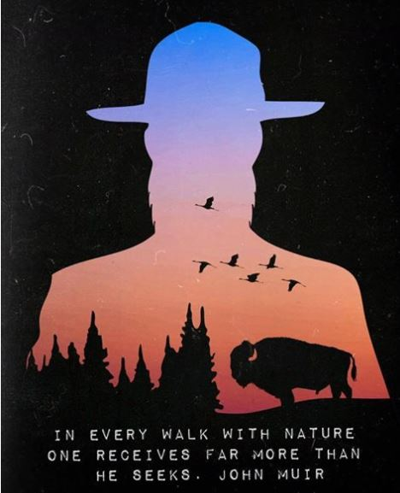
Does this make sense?

Slide 40

Our Role
The OA should be setting the example in Outdoor Ethics and Environmental Stewardship
OA Members should be Outdoor Ethics Guides.
The OA should bring the Outdoor Ethics message and training to our units, our summer camps and practiced wherever we camp.

Slide 41
What Can We Do?
Learn More about Outdoor Ethics!
Train OA Members in Leave No Trace and Tread Lightly
Promote Outdoor Ethics Awareness
Roundtables, camporees, etc.
Provide Outdoor Ethics Training to Units
Encourage Conservation & Outdoor Ethics Awards
Support the Outdoor Ethics Programs at Summer Camp
What Else?

Slide 42
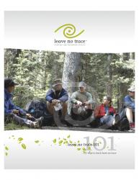
References and Resources
Publications:
101 Ways to Teach Leave No Trace (www.lnt.org)
Leave No Trace “PEAK Packs” (www.lnt.org)
Leave No Trace in the Outdoors by Jeff Marion (www.lnt.org)
Quotes from various Boys’ Life magazine articles (http://boyslife.org/)
TREAD Lightly video series (www.treadlightly.org)
Sand County Almanac by Aldo Leopold (www.lnt.org)
Soft Paths (www.lnt.org)
Leave No Trace pamphlet Series (www.lnt.org)
TREAD Lightly! pamphlet Series (www.treadlightly.org)
National Parks LNT DVD (www.nps.gov)
OE Guide Handbook (http://www.scouting.org/Home/OutdoorEthicsGuide.aspx)
Web sites:
LNT.org - The Leave No Trace Center for Outdoor Ethics
treadlightly.org - Tread Lightly!
www.aldoleopold.org - The Aldo Leopold Foundation
http://www.outdoorethics-bsa.org/ - BSA Outdoor Ethics Program
https://www.scouting.org/outdoor-programs/outdoor-ethics -National site for BSA Outdoor Ethics
http://tlkids.org – TREAD for kids
lnt.org/teach/peak – Leave No Trace for kids
https://www.scouting.org/outdoor-programs/outdoor-ethics/awards/- BSA Outdoor Ethics Awards
Notes:
Being an Outdoor Ethicist – Leave No Trace advocate means you are on a path to continue the journey to LEARN more than the principles, and more ways to protect the outdoors and especially how best to be stewards of the wilderness…and embrace the growing belief in Land Ethics.

Slide 43
Questions?
With thanks to Bob Sirhal and Bill Nay

Slide 44
Thank You
For more Information, contact:
Marshall Berger
Tschitani Lodge/ Connecticut Rivers Council
Northeast Region Outdoor Ethics Coordinator
Srteleman@gmail.com
7/31/18

