Slide 1




BSA Outdoor Ethics for Cub Scouts
The Outdoor Code
The Land Ethic

Slide 2

Outdoor Code
As an American, I will do my best to:
Be Clean in my outdoor Manner,
Be Careful with Fire,
Be considerate of the outdoors, and
Be Conservation Minded

Slide 3

Leave No Trace
Know Before you Go
Choose the Right Path
Trash your Trash
Leave What you Find
Be Careful With Fire
Respect Wildlife
Be Considerate of Other Visitors
Front Country
Back Country
PEAK
  Cub Scouts
Activity Specific
Notes:
Cub Scout Principles take out “Be Careful with Fire” because Cub Scouts don’t light fires

Slide 4
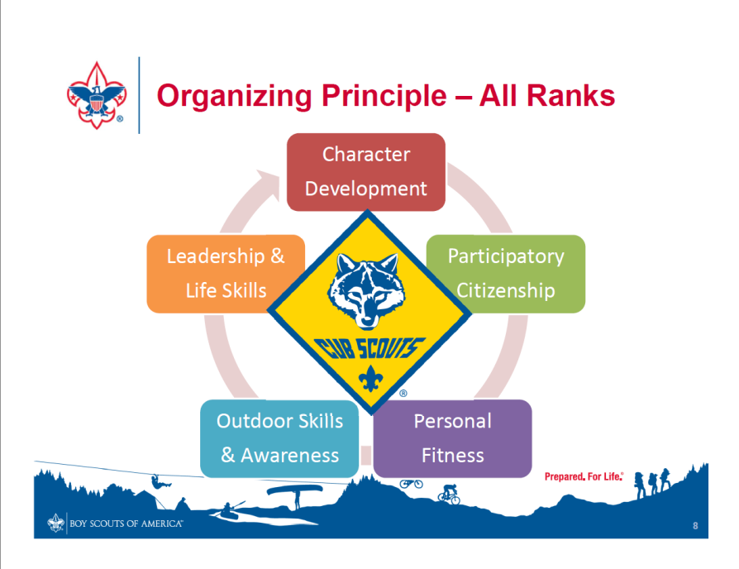
Incorporation into Cub Scout Program
Use Adventures to discuss Ethics
Teachable Moments
Service Projects
Awards
Games
  Web Of life
  Ok-No Way
  Surface Hopscotch
  Trash Timeline
  Have a Sip
  Generations
  Hiker, Biker, Horse
Notes:
Most of the Outdoor Ethics Program will be concentrated in the Outdoor Skills and Awareness section of Scouting
But ethical behavior spills into all areas of Scouting

Slide 5
Outdoor Ethics For Cub Scouts
Rank Advancement Format:
Recite Outdoor Code and
LNT principles for Kids
Learn a principle
Practice on an outing
Share what you did
It’s in the Book?

Slide 6
Where are the Principles?
Tigers: Trash your Trash
Wolves: Be Careful with fire.
Respect Wildlife
Bears: Leave What you find
Be kind to visitors (-)
Webelos / AOL:
Talk about principles.
Show how demonstrated

Slide 7







When to Teach them?
Focus on Activities
HIKE
CAMP
COOK

Slide 8
Hike Cook Camp
Know before you Go* x x x
Trash your Trash x x x
Leave What you Find x x
Choose the Right Path * Hike or tent x x
Respect Wildlife x x x
^{Be careful with Fire} / x x
Be Kind to Others X x X

Slide 9
Incorporation into Lion
Lion Advancement 2018 -
Lion Scouts have fun exploring and doing adventures that move them ahead towards their Lion rank. The Lion rank is earned by completing five adventures. The Lion's adult partner participates the whole time, but the recognition items are only for the scouts.
Lion Rank Requirements:
Complete each of the following Lion required adventures with your den or family:
Lion's Honor
Fun on the Run
Animal Kingdom
Mountain Lion
King of the Jungle
After earning the Lion rank, additional optional Lion elective adventures can be done for further exploration and fun: I'll Do It Myself, Pick My Path, Gizmos and Gadgets, On Your Mark, Build It Up, Knock It Down, Rumble in the Jungle, Ready, Set, Grow
Akela is the name given to the Cub Scout's leader. This is the Lion's adult partner, and that person is responsible for helping the Lion complete each adventure and marking the Lion's Adventure Book. The first page in the Lion Adventure Book can be used by the Lion to track progress all in one place by adding stickers given by the Lion Guide.
Once a Lion has completed enough adventures to earn rank, there's still more to do. There are many more adventures to explore until it's time to move on to a Tiger den. Some scouts strive to earn the remaining seven adventure stickers.

Slide 10
Lion Rank Requirements
Lion Requirement – Mountain Lion.
Do These:
Gather the outdoor items you need to have with you when you go on an outdoor adventure, and understand how they are used. Also understand and commit to practicing the buddy system.
Learn what SAW (Stay, Answer, Whistle) means. Demonstrate what you can do to stay safe if you become separated from the group when you are outdoors.
Demonstrate an understanding of respect for animals and nature when participating in a learning hike.

Slide 11
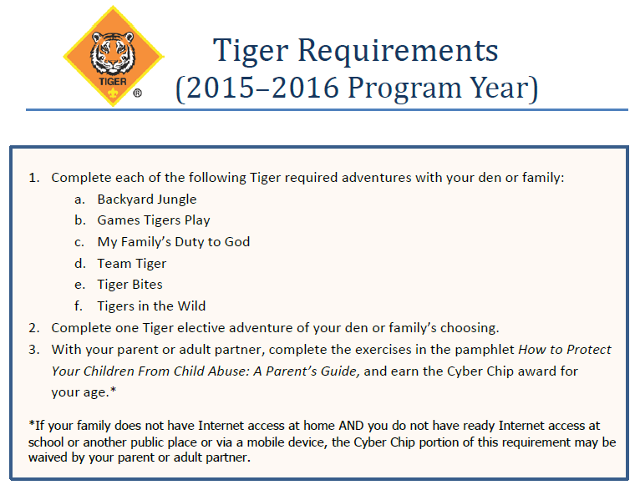
Incorporation into Tiger Program
2018 / 2019
Tigers in the Wild
Tiger Jungle
Games Tigers Play; My Tiger Jungle
Team Tiger Tiger Bites
Tiger Circles: Duty to God
Tigers in the Wild

Slide 12
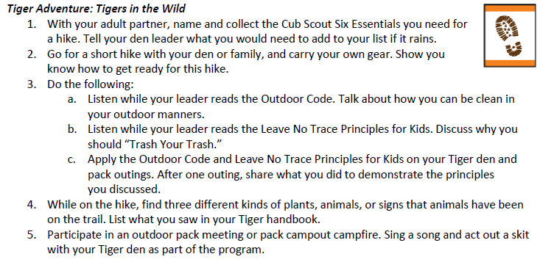
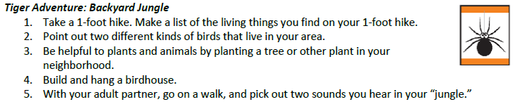
Tiger Rank Requirements
Bakyard Jungle
  The Land Ethic
Tigers in the Wild
  All
Notes:
Plan ahead and prepare – OK/No Way, Routes and Rivers, LNT Workbook
Travel and camp on durable surfaces – Durable Surface Hopscotch, Durable Surfaces Have Feelings Too, Find a Surface
Dispose of waste properly – Trash Timeline, Have a Sip

Slide 13
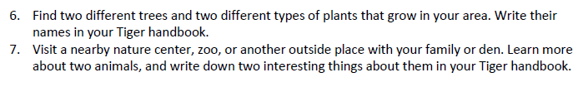
Tiger Rank Requirements

Slide 14
Tiger Rank Requirements
Complete Requirement 1 plus at least two others.
1 With your parent, guardian, or other caring adult, go for a walk outside, and pick out two or more sights or sounds of "nature" around you. Discuss with your partner or den.
2 Take a 1-foot hike. Make a list of the living things you find on your 1-foot hike. Discuss these plants or animals with your parent, guardian, other caring adult, or with your den.
3 Point out two different kinds of birds that live in your area. With your parent, guardian, or other caring adult, or with your den, find out more about one of these birds.
4 Be helpful to nature by planting a plant, shrub, or tree. Learn more about the needs and growth of the item you have planted.
5 Build and hang a birdhouse.

Slide 15
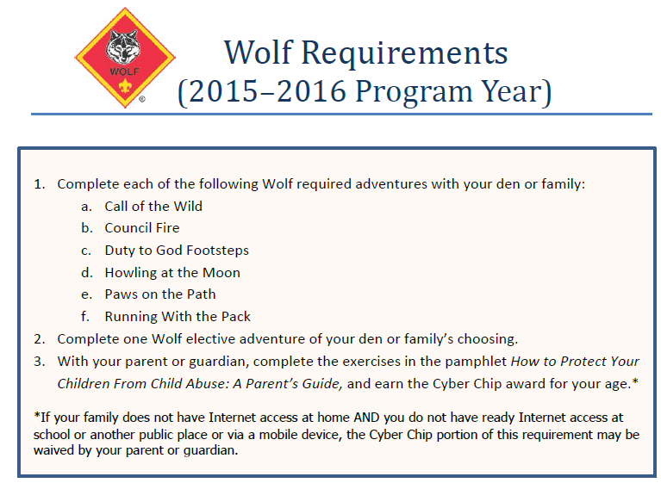
Incorporation into Wolf Program
2018 / 2019
Call of the Wild
Paws on the Path
Electives – Spirit of Water; Grow Something; and Finding Your Way

Slide 16
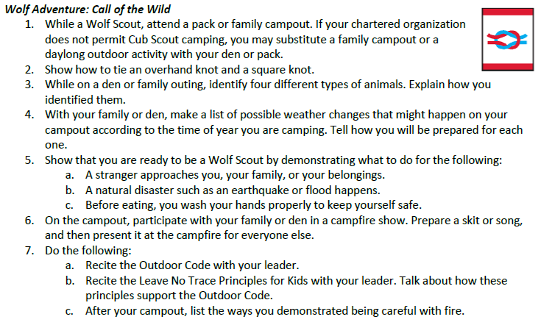
Wolf Rank Requirements
Notes:
LNT – OK/No Way/ Camp Oh No/ Will you make it? /
OC – Hand motions

Slide 17
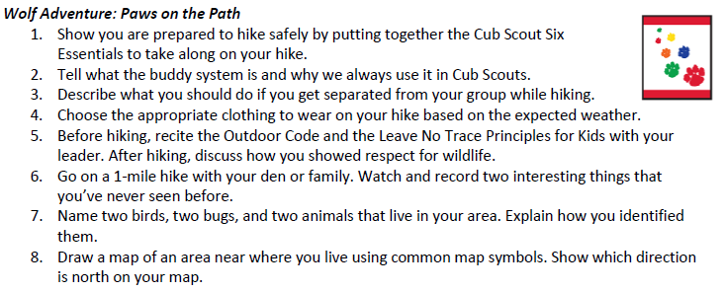
Wolf Rank Requirements
Notes:
LNT – OK/No Way, hiker/biker/horse, Rule of Thumb, Durable Surface Hopscotch, LNT workbook, stuffed campsite, web of life
OC – hand motions

Slide 18
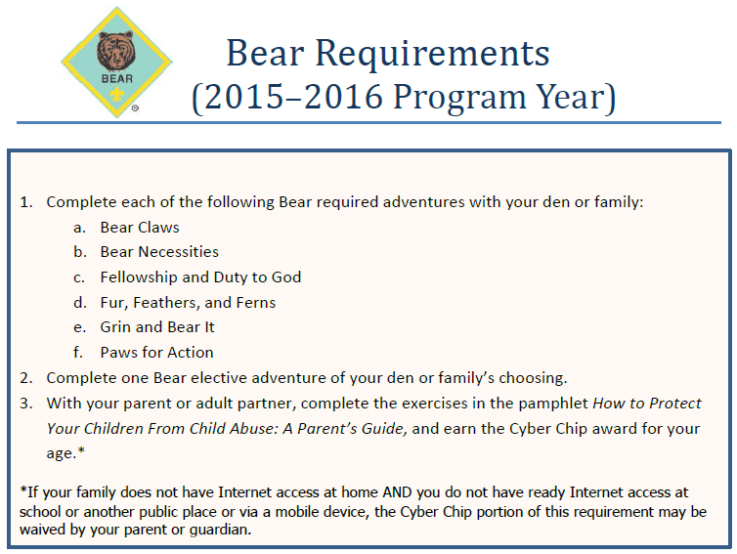
Incorporation into Bear Program
2018 / 2019
Bear Necessities
Fur Fin & Feather
Electives – Bear Goes Fishing and Bear Picnic Basket

Slide 19
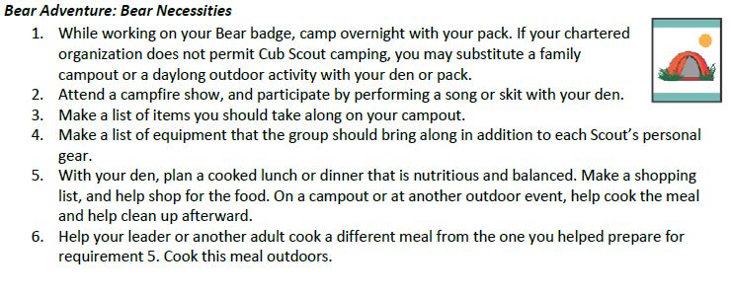
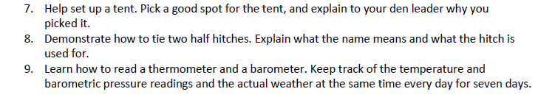
Bear Rank Requirements
Notes:
LNT – Camp Oh No, Durable Surfaces have feelings too, impact stick, Impact Monster, workbook

Slide 20
Bear Required Adventure: Fur, Feathers, and Ferns
 | Complete Requirement 1 plus three others. While hiking or walking for one mile, identify six signs that any mammals, birds, insects, reptiles, or plants are living near the place where you choose to hike or walk. Visit one of the following: zoo, wildlife refuge, nature center, aviary, game preserve, local conservation area, wildlife rescue group, or fish hatchery. Describe what you learned during your visit. Name one animal that has become extinct in the last 100 years and one animal that is currently endangered. Explain what caused their declines. Observe wildlife from a distance. Describe what you saw. Use a magnifying glass to examine plants more closely. Describe what you saw through the magnifying glass that you could not see without it. Learn about composting and how vegetable waste can be turned into fertilizer for plants. Plant a vegetable or herb garden.

Slide 21

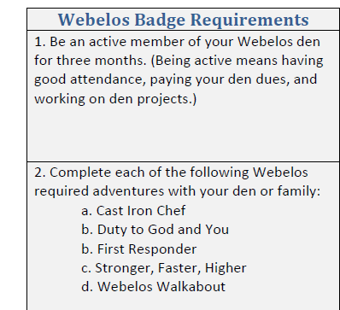
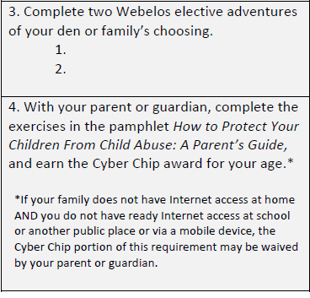
Incorporation into Webelos Program
For Rank
Webelos Walkabout
Cast Iron Chef
Electives -
2018 / 2019

Slide 22
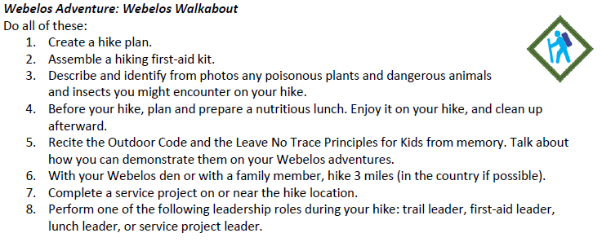
Webelos Rank Requirements
Notes:
LNT – STOP, OK/No Way, Find a surface, Surface Hopscotch, Hiker/Biker/Horse,
OC – hand motions

Slide 23
Cast Iron Chef - Webelos requirement
 | 1. | Plan a menu for a balanced meal for your den or family. Determine the budget for the meal. If possible, shop for the items on your menu. Stay within your budget.
 | 2. | Prepare a balanced meal for your den or family. If possible, use one of these methods for preparation of part of the meal: camp stove, Dutch oven, box oven, solar oven, open campfire, or charcoal grill. Demonstrate an understanding of food safety practices while preparing the meal.
 | 3. | Use tinder, kindling, and fuel wood to demonstrate how to build a fire in an appropriate outdoor location. If circumstances permit and there is no local restriction on fires, show how to safely light the fire, under the supervision of an adult. After allowing the fire to burn safely, safely extinguish the flames with minimal impact to the fire site.

Slide 24

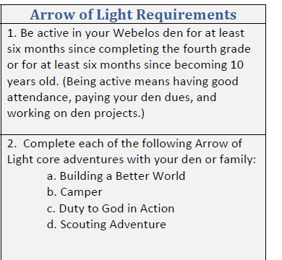
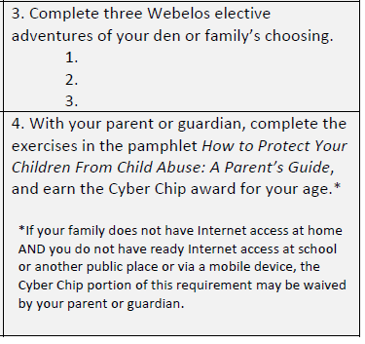
Incorporation into Webelos Program
Arrow of Light
Camper
Scouting Adventure
Electives – Castaway, Earth Rocks, Into the Wild, and into the Woods.
2018 / 2019

Slide 25
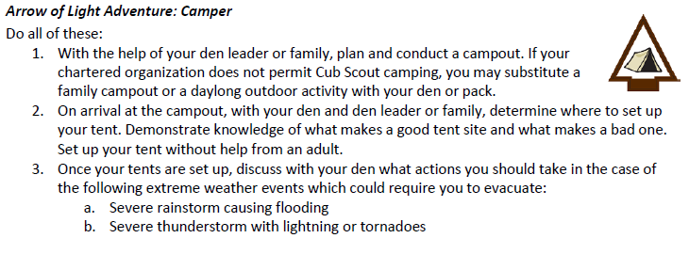
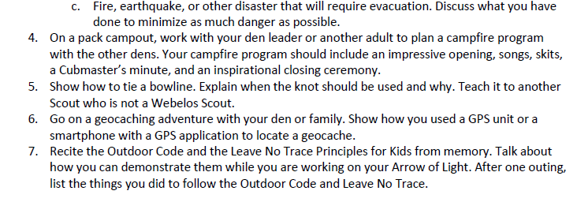
Arrow of Light Requirements
Notes:
LNT – Camp Oh No, Impact Monster, trash timeline, who will survive,
OC – Hand motions

Slide 26
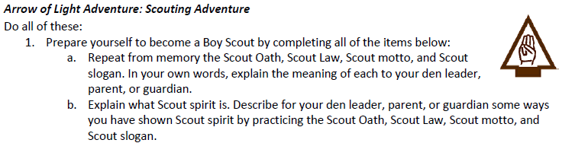
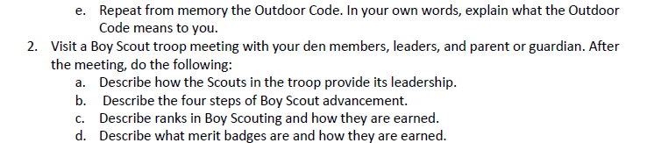
Arrow of Light Requirements
Notes:
OC – Trash Timeline, Web of Life, workbook

Slide 27
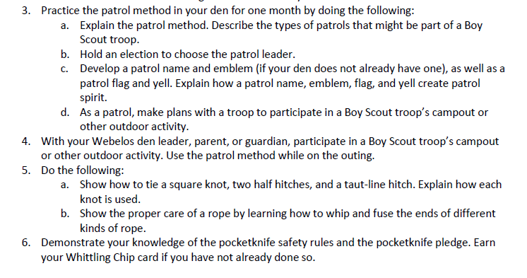
Arrow of Light Requirements
Notes:
LNT – STOP, camp Oh No
OC – conservation minded relating to woods tools and trees

Slide 28

ENGAGE!!!!
Hike it!
Pull out hike stuff. Say how matches with principles
Okay, No Way
Relay race, run to item. Den ids if fits principle. Run it to the okay or no way box without being caught
Fire in the Hole
Fire Telephone game – ask why, when, where, how, how big...
Whisper answer to neighbor
Remember to debrief following ALL activity

Slide 29
Outdoor Ethics for Cub Scouts
(and family)
The Outdoor Code + Leave No Trace
Focus on Activities in Adventures
HIKE
CAMP
COOK
Use Games to engage hearts, minds and bodies!

Slide 30
Resources examples
Hike it:
  7 Principle cards and map, whistle, boot, poncho, flowers, rope, flashlight, matches, garbage bag, trowel,band--aide, water, food, frog, radio
Way No Way
  7 Principle cards, 2 boxes: and map, whistle, boot, poncho, flowers, rope, flashlight, matches, garbage bag, trowel,band--aide, water, food, frog, radio
Fire in the Hole
  Card with questions: why, when, where, how, how big

Slide 31
Outdoor Ethics for Cub Scouts
Questions?
Thanks for coming!
Contact: Shawn Spencer
cubpack255@Hotmail.com

