Slide 1
Women: Doing Outside What We Do Inside! BSA National Outdoor Ethics Conference Theodore Naish Scout Reservation October 2018
Presenters:
Randa Kelton Kerin Farrell
Leave No Trace-Master Educators

Slide 2
Course Description
We choose out clothes, use the bathroom, manage our temperature and intake just fine at home. How do we manage it when we are outside? Come gain some background knowledge, learn about products on the market, along with tricks and skills needed to make your outdoor life easier!

Slide 3
7 Principles of Leave No Trace
Plan Ahead and Prepare
Travel and Camp on Durable Surfaces
Dispose of Waste Properly
Leave What You Find
Minimize Campfire Impacts
Respect Wildlife
Be Considerate of Other Visitors

Slide 4
Most issues for women in the outdoors come down to two words:
BODY
FLUIDS

Slide 5
Cause: Sweat
SWEAT is the body's mechanism for safely dumping excess heat you generate during exercise.
It doesn't start to smell until bacteria already living on your body (skin’s normal flora, filling up all of the cracks and crevices on your epidermis) go to work on it.
And consider this:
If you didn't have sweat glands, you'd have to pant like a dog to keep your internal body temperature within a safe range during a hot hike.

Slide 6
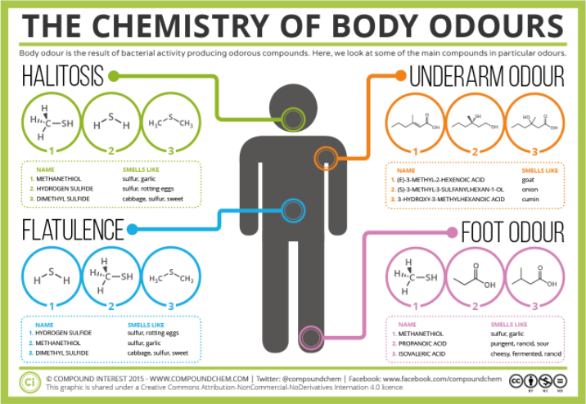

Slide 7

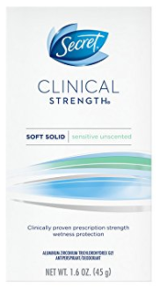

Effect:
Smell:
Antiperspirant?
Skip it?
It’s a smellable…
Options
Sticking & Friction = Chafing
Chafing Sticks
Various Powders
Clothing Options

Slide 8


Fabrics

Slide 9
Cotton
Cotton is 99% cellulose polymers, from a variety of cotton plants.
Polymers are molecules made from joining many smaller molecules.
The fiber structure of cotton pulls liquid in, giving it absorbing capacity.
This means cotton fabrics/clothes retain sweat/excessive moisture that doesn't evaporate from the skin and you’re in wet clothes.

Slide 10
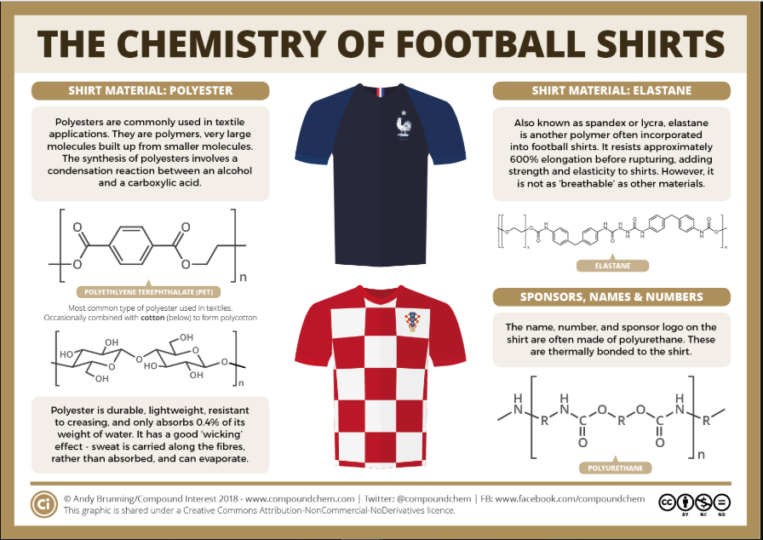

Slide 11
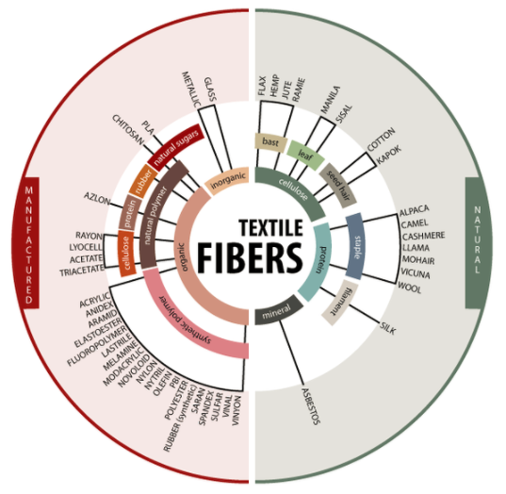
Biodegradable Textiles and Fabrics
http://gpktt.weebly.com/classification-of-textile-fibers.html

Slide 12
What about Wicking?
Natural fabrics like cotton and even wool have been better for excessive sweaters than synthetic fabrics because they breathe better
Light wool, like merino, helps transfer heat away from the body to provide a cooling effect.
Since the body cools when air hits moist skin, cotton is a good if you need to get your body temperature down in a hurry.
But where cotton and other natural fabrics fall short is that they all retain the excessive moisture that doesn't evaporate from the skin
So you stay wet

Slide 13
What about Wicking?
Candles draw wax up the wick to the flame.
Wicking fabrics pull moisture from the body to the exterior of the shirt where it can evaporate more easily.
Instead of the water being absorbed by the fiber it sits in droplets on the fiber’s surface and moves around the fabric by running along the weave. Eventually, the water droplets reach the outside of the fabric where, if exposed to the air, they evaporate.
Wicking fabrics are made from synthetic, polyester blends which do not retain moisture like natural fabrics do.

Slide 14
Biodegradable Textiles and Fabrics
Types of biodegradable fabrics: Natural textiles that can easily break down; includes cotton, silk, wool, cashmere, and hemp.
Cotton: One of the most biodegradable fabrics you can have, especially if it is 100% cotton. In a compost, cotton may biodegrade within as little as a week but usually takes about 5 months.
Wool: Wool clothing will decompose in about one year but can take as long as five depending on the blend.
Types of non-biodegradable clothes: Manufactured synthetic textiles including polyester, spandex, nylon, and rayon. Though these will eventually break down, it may take between 20 and 200 years to fully biodegrade these textiles.

Slide 15
Clothing:
Shirts
Wear loose fitted moisture wicking shirts with great ventilation.
Can be worn under or over other hiking clothing
SPF rated at UV 40+,
No cotton fibers (only nylon & polyester) so will dry quickly
Fits well to protect you from pesky insects and creepy crawlies
Draws sweat away from your body and enhance evaporation
Wash & wear
Has extra buttons, if that's the closure method
Features reinforced seams

Slide 16



Clothing:
Pants
Quick Dry.
Loose enough for movement and thermals in cold weather.
SPF rated at UV 40+,
No cotton fibers
Fits well to protect you from pesky insects and creepy crawlies
Pockets!
Wash & wear
Removable legs
Reinforced seams

Slide 17
Clothing:
Bras, Panties, Girdles/Spanx & Thermals
No cotton!
Wash & wear
Odor resistance and Moisture wicking performance technology, keeps you fresh and feeling dry throughout your day
Tag-less labeling and no seam design eliminates chafing while minimizing no show panty lines
Stay in place 4 way stretch ultra-comfortable nylon elastane fabric allows for freedom of movement and conforms to the body for great support

Slide 18
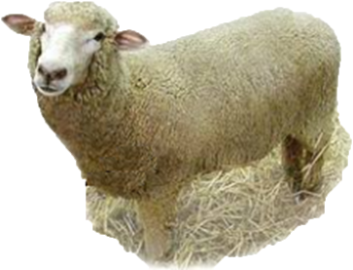
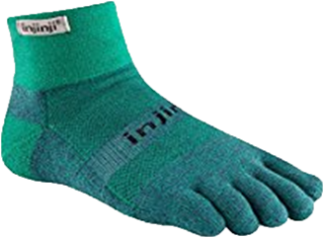
Clothing:
Socks
No cotton!
Sweaty feet and improperly fitted shoes & socks cause hot spots and blisters
Odor resistance and Moisture wicking performance technology, keeps you fresh and feeling dry throughout your day
Injinji Toe Socks
55 Polyester, 40 Nylon, 5 Lycra
Proper toe alignment,
Prevent Blisters and hotspots

Slide 19
Cause: Urine
Every time you urinate (pee), you are saying good-bye to the end products of biochemical reactions your cells used to:
produce energy for your hike,
rebuild from injury or stress, and to
replenish themselves.
Urine comes from a sterile environment (your kidneys and bladder), and should not have an offensive odor.

Slide 20
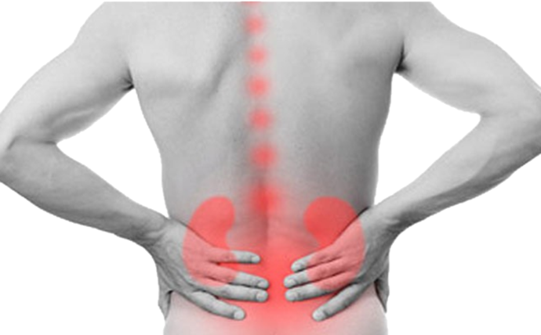
Urine Odor
It shouldn’t smell, but if it does, it might be a urinary tract infection.
Keep on eye on these problems:
Burning sensations during urination,
Fever and/or chills,
Dull ache in your back,
Dark, cloudy, stinky urine ...
Definitely symptoms you want to bring to a health care provider as soon as possible after your hike.
Notes:
UTI’s occur in women significantly more than men - in fact, 40% of women will get a UTI in their lifetimes while only about 12% of men will get the same condition.
A woman’s urethra is shorter than her male counterpart’s. This means that bacteria do not have to travel as far from the urethral opening outside of the body to get to the bladder or other parts of the urinary tract. Our urology experts explain that a woman’s urethra opening is located close to the anus, so it is easier for her to bring bacteria from the anus into the urethra. This is often done when wiping after urinating or passing a bowel movement, but it’s also easy to do during sexual activity. While it is possible for a man to inadvertently transfer the bacteria as well, it is less likely since a male’s urethra is further away.
Women also are more prone to catching a UTI if they use a contraceptive diaphragm. Diaphragms contain spermicide, which could eliminate good bacteria living in the vagina that help fight infections. Additionally, a diaphragm could make it more difficult for the bladder to empty completely, and our experts say that urine that lingers in the bladder could cause an infection.
Some studies have found that women going through menopause or post-menopause are also more likely to develop a urinary tract infection. This may be attributable to lower levels of estrogen. For this reason, a physician may prescribe estrogen cream in order to prevent chronic urinary tract infections.
https://www.affiliatedurologists.com/blog/why-women-get-uti-s-more-than-men

Slide 21
Urine Odor
Or it could signal dehydration.
Darker and more smelly urine is immediate feedback about how hydrated you are (or aren't!).
Pale yellow urine without a smell and in large amounts: you have plenty of water in your bloodstream.
The darker the color, the more it smells and the less there is, is an indicator that you urgently need to drink more pure, cool water.

Slide 22
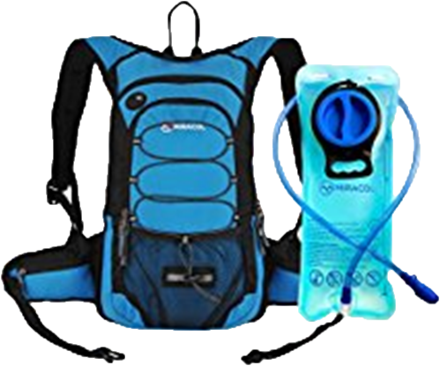

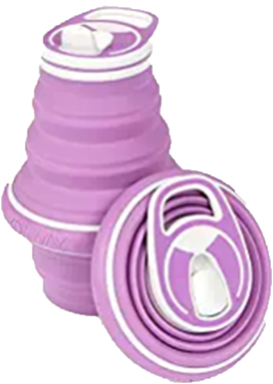
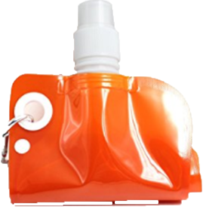
So drink, hydrate, refill, repeat!
Carry Collapsible Water Bottles in addition to your regular water bottle or hydration system.
Refill often.
Drink.

Slide 23

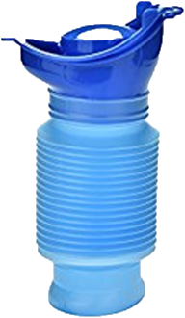
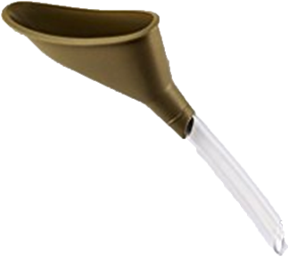
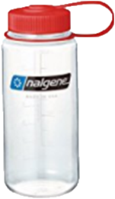

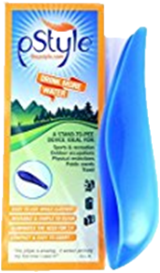
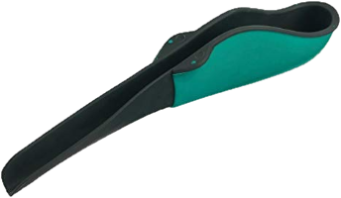
Which of course leads to evacuation
Female urinary devices
Pee like a guy
Less to disrobe
No Squatting
Requires Practice – lots and lots of practice

Slide 24
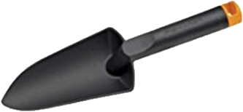
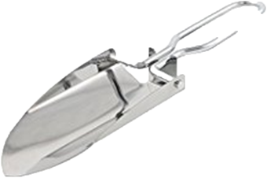
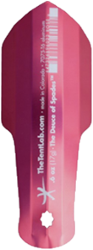
Catholes
Find a location at least 200’ from water sources, your tent, your kitchen & the trail.
Dig a hole 6-8” deep and at least 4” wide.
Go for it.
Add some dirt. Grab a stick & stir.
Fill the hole, mark it with the stick, ucky side in the dirt.
Return the area to its original condition, as best you can.

Slide 25
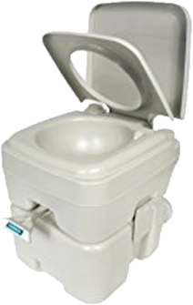
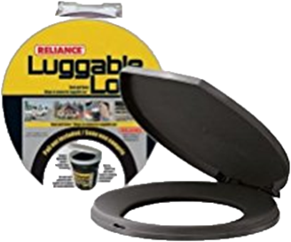

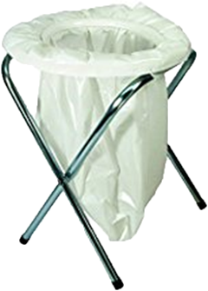
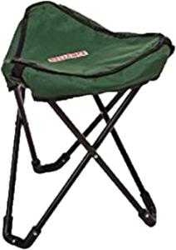
Need to sit?
Luggable Loo 5-gallon bucket
Pool Noodle is a lot cheaper
Portable Toilets
Portable Folding Toilets
Biffy Bag
Try-to-Go Camping Chair/Portable Toilet
Dual Functionality
Weight capacity of 300 lbs

Slide 26
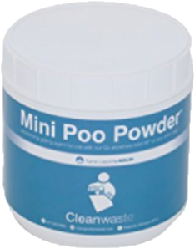
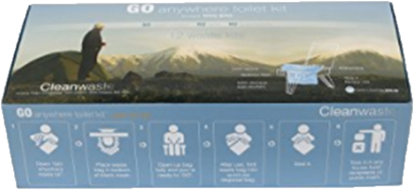
What to do with solid waste? - Retail
Poo Powder
Use a scoop in any plastic bag to make your own waste bags.
Prevents backsplash and turns liquid waste to solid in seconds
Odor neutralizer and decay catalyst help with smell and breaking down solid waste
Go Anywhere
Pre-loaded with Poo Powder, TP & hand sanitizer

Slide 27
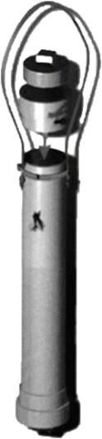

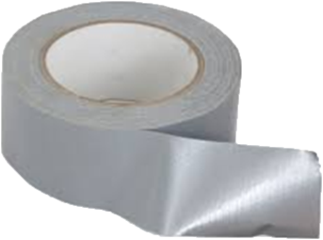
And when you have to carry it out…
Poop Tube
Duct Taped Zip Top Bags
The limit is your creativity

Slide 28


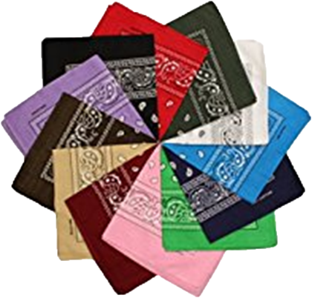
Wiping
Toilet Paper
Baby Wipes
“Flushable” Wipes
Bandanas

Slide 29
Cause: Blood
The body's river of life, delivers oxygen to trillions of cells.
It carries away waste products, too:
Carries carbon dioxide to the lungs as you exhale,
Carries toxic nitrogen compounds to the kidney for urinary excretion,
Carries other ingested toxins to your liver for processing,
Carries infectious organisms to the lymph nodes...

Slide 30
A Menstrual Primer
Every month or so, a woman’s uterus lining gets thicker to prepare for a fertilized egg.
Her body chemicals, hormones, cause her ovaries to release one egg about once a month.
If the egg is not fertilized, the egg and the lining of her uterus pass through the cervix and out the vagina as her “period”.
This is part of the menstrual cycle, which is what makes it possible for a woman to have a baby.

Slide 31
Menstrual Blood
It’s not odorless, but you shouldn't smell ammonia or other strong odors
Sanitary Options:
Pads
Sizes
Disposable or re-usable
Tampons
Cotton or Polyester
Applicator or not?
Size?
Internal Cups

Slide 32
Related & Random Facts:
The time it takes for a tampon or pad to degrade in a landfill is centuries longer than the lifespan of the woman who used it, particularly when wrapped in a plastic wrapper or bag. In addition, the process of manufacturing these products – turning wood pulp into soft, cotton-like fibers – is both resource- and chemical-intensive.
The average woman uses roughly 11,000 tampons in her lifetime.
Disposable tampons aren't sustainable, but do women want to talk about it?
The Guardian
April 27, 2015

Slide 33
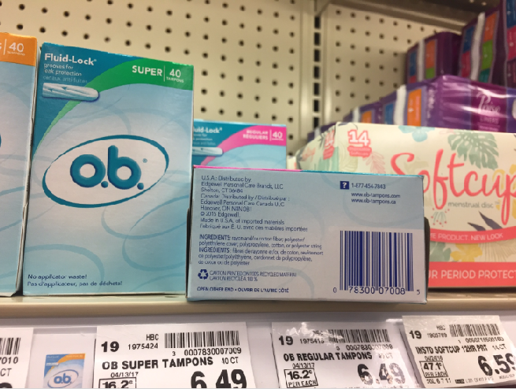

Slide 34


Slide 35
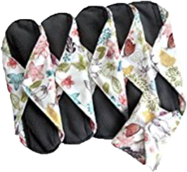

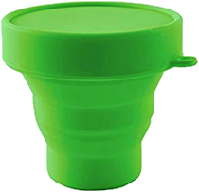
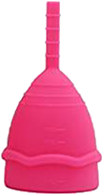
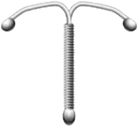
More “natural” options
Cotton Tampons
Bamboo Pads
Silicon Menstrual Cups
Some IUDs

Slide 36
Hygiene of Single-Use Sanitary Products
AKA Disposable products
Always wash hands before & after use.
Initial use has plastic trash that needs to be contained and secured.
Used products also need to be contained and secured.
Remember to give her the time & space to handle this.
Pack it in, pack it out.

Slide 37

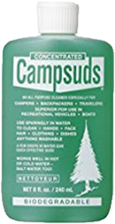
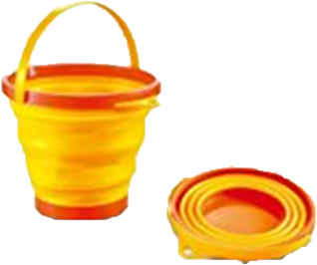
Hygiene of Reusable Sanitary Products
Always wash hands before & after use.
Reusable products need to be washed out after use, daily.
Travel with a collapsible bucket & cleanser/soap.
Remember to give her the time & space to handle this.
Educate that this is not a joke, nor something
to be embarrassed of.

Slide 38
Do menstrual odors attract bears?
The Journal of Wildlife Management published some research results in 1991(a bit dated, but worthy of reading).
To bottom line it for you, NO - bears seem to prefer your food to your used "feminine hygiene" products. So on a hiking trip, hang your smellables properly, to avoid bear visitors.
You can use a stuff sack, or a bear bag, just don't ever bring the bag into your tent once it's gotten odors embedded in it.
Or skip the hanging routine, and use a bear canister - to safely stow your smellables, not the bear!

Slide 39
Gear Facts:
We get colder faster than men do.
Layer up.
Merino Wool
CoolMax
Wicking fabrics first, then layer with your other materials
Avoid Cotton!

Slide 40
Nocturnal Issues:
We get colder at night.
Use a Sleeping Pad – Get off the Ground!
Wear clean, dry, layered sleeping clothes
Use Sleeping Bag Liners!
Silk
Fleece
Radiant Double Bubble Pad
Hats & Socks
Head
Hands
Feet
Air Activated Heater Pads
Sticky toe pads on your bum and feet
Eat before bed
Burning calories while you sleep generates energy!

Slide 41
Gear vs. Anatomy
Male vs. Female
Gear was originally designed for men.
Some companies merely made it pink.
Watch for gear that works for your body!
You are physically different from men in ways you likely don’t think about:
Watch this!

Slide 42
Physical Differences Between Men & Women
The average man is taller and heavier than the average woman.
Men have more body hair than women do, especially on the chest and extremities.
Men are over 30% stronger than women, especially in the upper body.
On average, girls begin the physical differences about two years before boys.

Slide 43
Physical Differences Between Men & Women
Men have larger hearts and lungs than women and their higher levels of testosterone cause them to produce greater amounts of red blood cells.
Women have larger livers, stomachs, thyroid glands, kidneys, lower blood pressure and a faster heartbeat than men.
Differences in intake and delivery of oxygen translate into some aspects of performance: when a man is jogging at about 50% of his capacity, a woman will need to work at over 70% of her capacity to keep up with him.

Slide 44
Physical Differences Between Men & Women
Women’s center of balance is lower than a man’s. Women’s skeletal structures have wider hips, broader facial bones, smaller chins, a longer trunk, and shorter legs than men.
Men’s skin has more collagen and sebum, which makes it thicker and oilier than women’s skin.
Women generally have a greater body fat percentage than men. Men get fat on the belly, women on the derriere and thighs.

Slide 45
Physical Differences Between Men & Women
Men have better distance vision and depth perception, and usually better vision in lighted environments. Women have better night vision, see better at the red end of the light spectrum, and a have better visual memory.
Men are 10x more likely to be color blind.

Slide 46
Physical Differences Between Men & Women
Women are thought to have more resistance to disease due to the fact that their adrenal glands produce more cortin than men’s do.
The only three diseases that women die from more often than men are breast cancer, female reproductive disorders, and benign tumors. Otherwise, every other disease, including of course cancer and heart disease, kills men at a higher frequency.
Due to a lack of testosterone, women are 10 times more likely to injure their anterior cruciate ligament (ACL) than men.

Slide 47
Physical Differences Between Men & Women
Men and women have different levels of certain hormones; for example, men have a higher concentration of androgens such as testosterone, while women have a higher concentration of estrogens.
Female hormonal patterns are more complex and varied. The glands work differently in the two sexes.
For example, a woman's thyroid is larger and more active; it enlarges during menstruation and pregnancy, which makes her more prone to goiter, provides resistance to cold, and is associated with the smooth skin, relatively hairless body, and the thin layer of subcutaneous fat that are important elements in the concept of personal beauty.

Slide 48
Physical Differences Between Men & Women
Women are more sensitive to sound than men.
Due to a woman’s estrogen, she has an increased chance of developing osteoarthritis.
Women can withstand high temperatures better than men because their metabolism slows down less.

Slide 49
General Cleaning
Go light – carry a do it all product.
Liquid Pure-Castile Soap is great because it doubles as a face wash, shampoo, and dish, sock and underwear washing soap. That means just one GoToob or small plastic bottle to a multitude of cleaning chores.
On a regular road trip, believe it or not Palmolive dish soap does it all too.

Slide 50



Plan Ahead and Prepare
Repack what you’ll carry.
Carry the smallest amount necessary.
Carry Multi-purpose products.
Use Packing Cubes.
Microfiber Towels.
Collapsible Dishes & Sporks.
Compressible/Inflatable Pillows.
Collapsible Lanterns/Flashlights.

Slide 51
Dispose of Waste Properly
Basically: carry it in, carry it out!
Plan to bring in as little as possible, so there’s less to bring out.
Wrap it tight.
Pack out toilet paper and hygiene products.
Keep smellables sequestered.

Slide 52
Leave What You Find
Unless it’s someone else’s trash. Then, be brave, clean up after them too.
But don’t add to it!

Slide 53
Minimize Campfire Impacts
Basically here, don’t burn that stuff!

Slide 54
Respect Wildlife
They will dig it up!
Outside of catholes, don’t bury it.
And for catholes, go deep. Stir well.
They will dig it up.

Slide 55
Be Considerate of Other Visitors
Don’t do in their line of sight that what you would not want to see yourself!
Don’t leave it for them to find.

Slide 56
Questions?
If not…
Thank you!
Randa Kelton Kerin Farrell
randa.galbreath@gmail.com PhoenixLNT@att.net
954-668-6321

