Slide 1


Notes:
Tom

Slide 2
Welcome to the
BSA Outdoor Ethics Community!

Slide 3
BSA Mission Statement
The mission of the Boy Scouts of America
is to prepare young people to make ethical and
moral choices over their lifetimes by instilling
in them the values of the Scout Oath and Law.
BSA Programs use the Outdoors as a Method.

Slide 4

Four
Elements
of BSA Outdoor Ethics

Slide 5
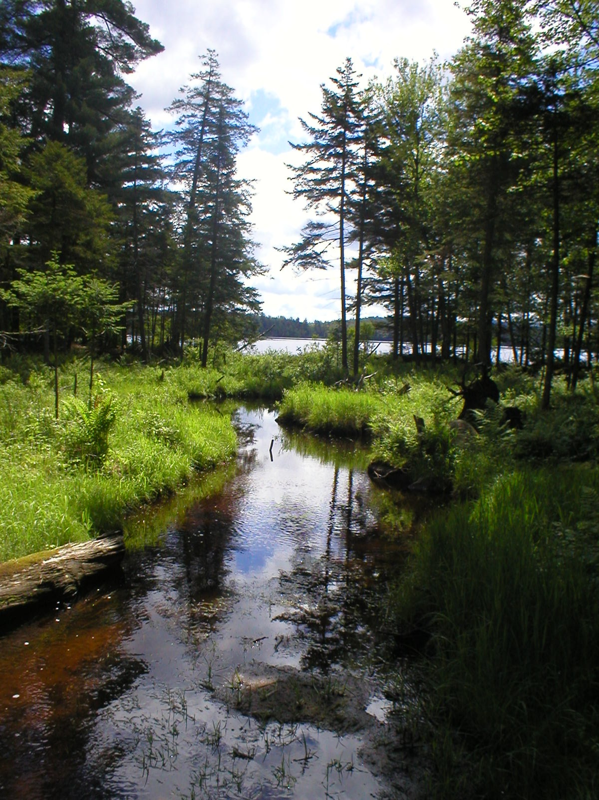
The Land Ethic
From the Aldo Leopold Foundation:
“a call for moral responsibility to the natural world. At its core, the idea of a land ethic is simply caring: about people, about land, and about strengthening the relationships between them.”
“A land ethic expands the definition of ‘community’ to include not only humans, but all of the other parts of the Earth, as well: soils, waters, plants, and animals, or what Leopold called ‘the land.’”

Slide 6

The Outdoor Code
The Outdoor Code has guided Scouts for decades toward responsible behavior in the outdoors, respecting both the natural world and other people.

Slide 7
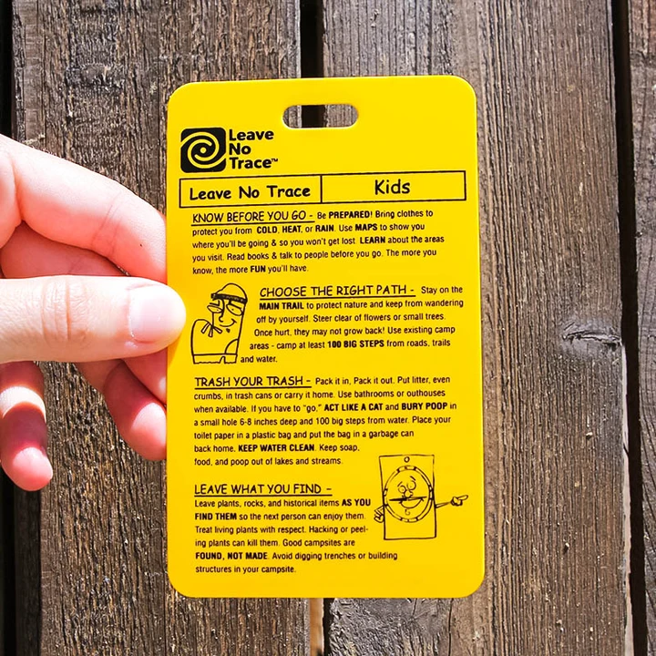
Leave No Trace
The seven principles of Leave No Trace provide specific, holistic, science-based recommendations for most outdoor activities.
The BSA first introduced Leave No Trace into our programs in the 1990’s.
A formal partnership with the Leave No Trace Center for Outdoor Ethics was established in 2005.

Slide 8
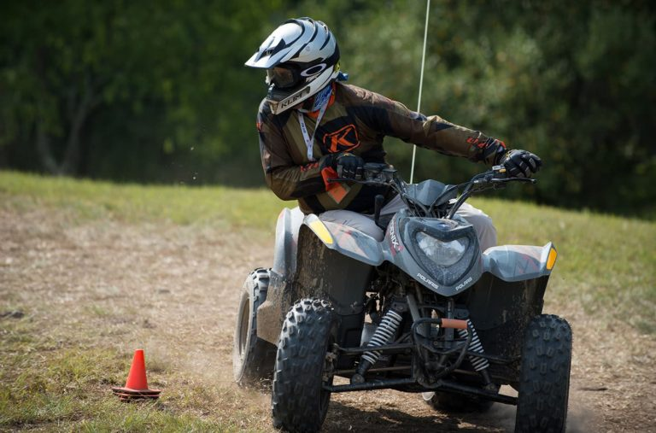
Tread Lightly!
“Tread Lightly!’s goal is to balance the needs of the people who enjoy outdoor recreation with our need to maintain healthy ecosystems”
Five principles
Applicable for Scout use of ATV’s and personal watercraft
BSA Memorandum of Understanding with Tread Lightly! signed in 2010

Slide 9
Internet resources
BSA Outdoor Ethics web site (www.outdoorethics-bsa.org)
  Training resources
  Contact list
  Course calendar and events information
BSA National web site (www.scouting.org)
  Outdoor Programs section
Facebook group(s) – BSA Outdoor Ethics, Leave No Trace
Partner sites

Slide 10
Contacts
Outdoor Ethics Contacts
  Council Outdoor Ethics Advocate
  Leave No Trace Master Educators
  Area Outdoor Ethics Advocate,
  Region Outdoor Ethics Coordinator, National Committee
  Find contact info on www.Outdoorethics-bsa.org web site
Council / District Training Chair
Council Program or Camping Director, Camp staff leadership

Slide 11
Outdoor Ethics Training
Outdoor Ethics Orientation – open to all BSA members
Leave No Trace 101 – 3-4 hours; open to all BSA members
Leave No Trace Trainer – open to adults & youth ages 14+
Leave No Trace Master Educator – open to registered adults age 18+
Tread Trainer & Tread Master – offered primarily by Tread Lightly!
Various BSA courses: BALOO, IOLS, Powder Horn, Wood Badge, etc.
Merit Badges, Scout Handbook & Fieldbook

Slide 12
We welcome your involvement and appreciate your support!

Slide 13
Notes:
Tom

