Slide 1


Notes:
Tom

Slide 2
Welcome
and
Thanks!

Slide 3
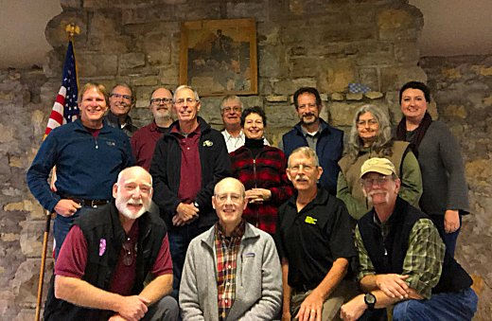
Outdoor Ethics Sub-committee

Slide 4
Continued Progress
More Council Outdoor Ethics Advocates reporting more activity
More Leave No Trace Master Educators
More Leave No Trace Trainers
IOLS, Wood Badge, and Powder Horn course content updates
Outdoor Ethics Guide Position of Responsibility
Contact Database updates
Additional and updated content on Outdoorethics-bsa.org and
scouting.org
Scouting during the pandemic

Slide 5
Voice of the Scout – summer 2019
85% of youth-facing volunteers report being very or somewhat
familiar with the Leave No Trace principles
Of those familiar with Leave No Trace, 91% of volunteers incorporate
use of Leave No Trace in planning outdoor activities
79% of ScoutsBSA members agree that participation in Scouting has
increased their practicing of the Leave No trace principles
Less than 1% of youth-facing volunteers indicate that they have
never heard of Leave No Trace

