Slide 1
Notes:
Tom

Slide 2
Looking Forward
Scott Anderson
Chair, National Outdoor Ethics Sub-Committee
Notes:
Tom

Slide 3
Outdoor Ethics Sub-Committee
Outdoor Programs Committee
Mark Rose, Chair

Slide 4
Outdoor Ethics Sub-Committee
Professional Support
Frank Reigelman
Director, Programs and Properties
National Adventures Group
Andrea Watson
Brian Gray
Tom Pendleton
Ollie Burks
Myla Epley

Slide 5
Outdoor Ethics Sub-Committee
Serve the mission of the
Boy Scouts of America

Slide 6
Outdoor Ethics Sub-Committee
Vision Statement
The membership of the Boy Scouts of America, through education and behavior, is recognized as a leader in the ethically responsible use of our outdoor recreational spaces.

Slide 7
Outdoor Ethics Sub-Committee
Mission Statement
The mission of the Boy Scouts of America's Outdoor Ethics Committee is to encourage, advise, and support the inclusion of outdoor ethics in all program areas of Scouting and to support our Council's Outdoor Ethic programs.

Slide 8
Outdoor Ethics Committee
Leadership
Eric Hiser 2006 - 2014
Dave O’Leary 2014 - 2020
Scott Anderson 2020 -

Slide 9
Outdoor Ethics Committee
Leadership
Eric Hiser 2006 - 2013
Dave O’Leary 2013 - 2020
Scott Anderson 2020 -
Average SEVEN YEARS (oh my)

Slide 10
Outdoor Ethics Committee
Leadership
      Thank You

Slide 11
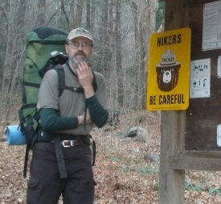
Resolution – David O’Leary
Resolution
WHEREAS, the National Adventures Committee wishes to express its appreciation and gratitude to David O’Leary for leaving an indelible impact as the Outdoor Ethics Subcommittee Chairman for the Boy Scouts of America,
WHEREAS, during David’s six years of leadership, Outdoor Ethics continued to be integrated at all levels of the BSA, through age-appropriate programs enhancements, engaging exhibits at National and International Jamborees and national conferences.
WHEREAS, David’s commitment to Scouting reaches well beyond Outdoor Ethics, serving on National Camping School faculty, NCAP Assessment teams, and numerous volunteer roles at the unit, district and council level,
BE IT THEREFORE RESOLVED, the National Adventures Committee, the Outdoor Program Support Committee volunteers, Outdoor Programs & Properties staff and the Boy Scouts of America, express our profound thanks and gratitude.
Notes:
Mark

Slide 12

Thank you Dave O’Leary

Slide 13
Outdoor Ethics Committee
Continuing Members
Paula Boothe - Vice Chair, ROEC-WR
Mark Hammer - Vice Chair
Charlie Thorpe - Vice Chair
Toby Green - ROEC-CR
Marshall Berger - ROEC-NER
Shawn Spencer
Dave O’Leary
Eric Hiser
Jeff Marion

Slide 14
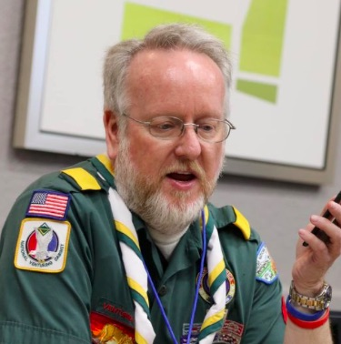
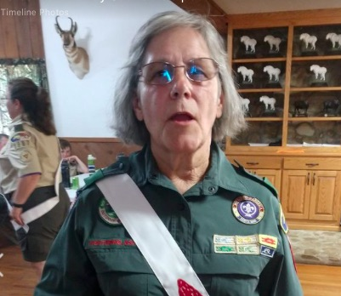
New Committee Members
Barbara Saunders
Cub Scout Initiatives
David Wilson
Social Media

Slide 15
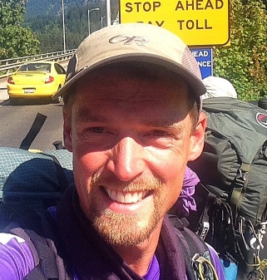
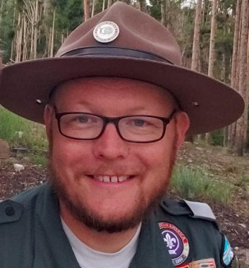
New Committee Members
Joshua Lamothe
Educational Assets
Matt Durrant
Virtual Training

Slide 16
Committee Recruiting Questions
How does one get asked to serve?
Serve your Council.
  Be a Council Outdoor Ethics Advocate
  Lead Leave No Trace Trainer Courses
Serve the BSA Nationally
  Master Educator Course Instructor
  Staff our National Events Exhibits

Slide 17
Committee Recruiting Questions
What are we doing to add diversity?
Mostly Older White Men
      Committee Currently
  All Caucasian
  12 Male
  3 Female
  Average age estimate 61

Slide 18
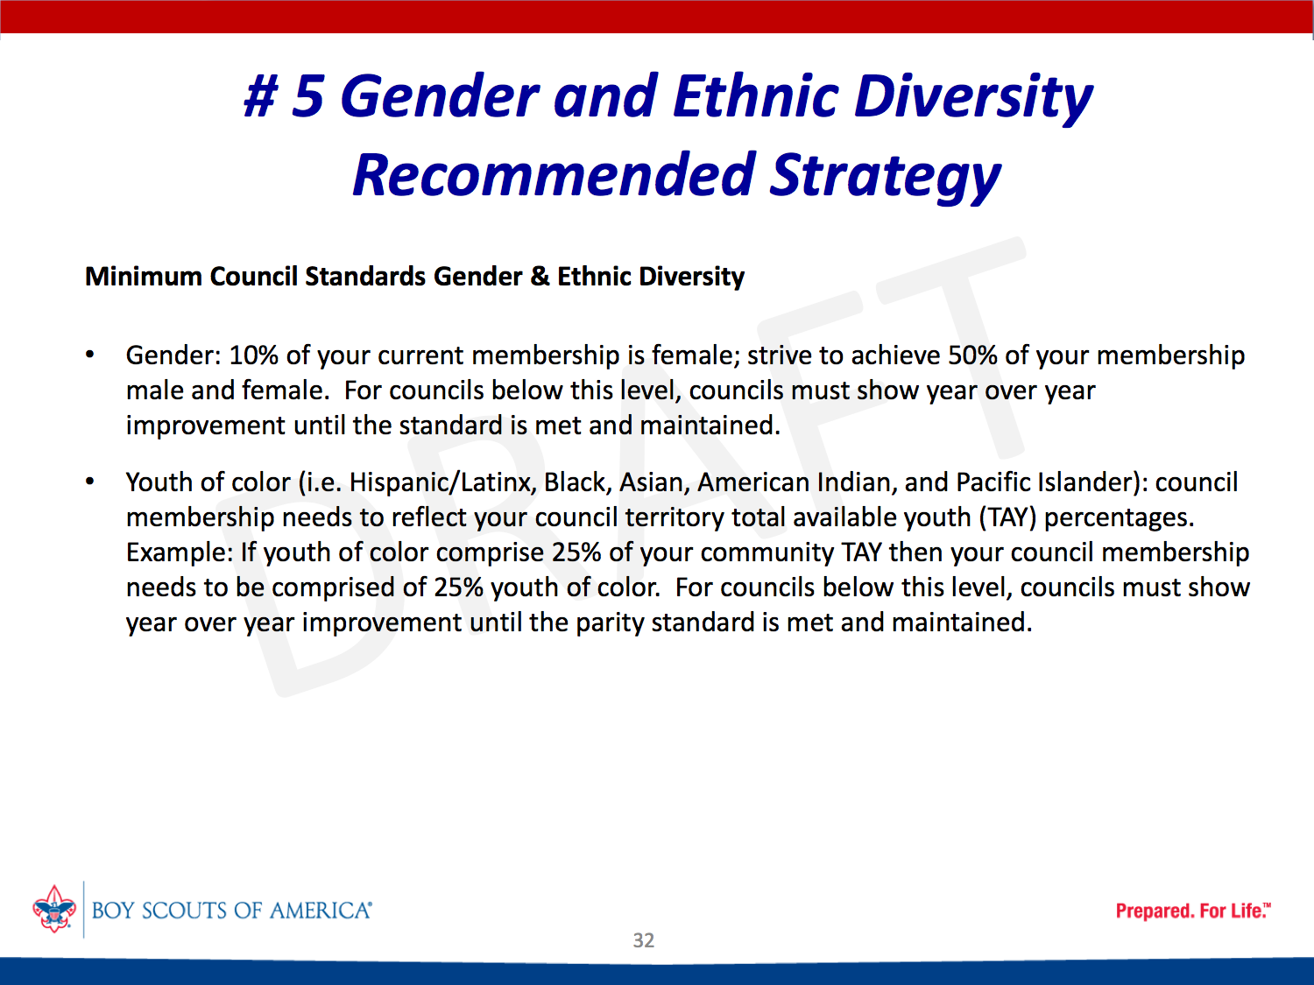

Slide 19
Committee Recruiting Questions
What are we doing to add diversity?
      Encourage Council Diversity
        COEA Selection
      Encourage Diversity in ME Instructors
      Weigh Diversity Needs when Recruiting

Slide 20
Committee Re-Organization
Objectives
  Efficient use of volunteer resources
  Improve Service to our Councils
  Improve Communications
  Facilitate Revisions to our Resources
  Quality Control of our Curriculum

Slide 21
Committee Organization
3 Service Groups
  Operations
  Communications & Information Resources
  Curriculum & Educational Assets

Slide 22
Committee Organization
Operations Group
Vice Chair, Paula Boothe
Regional Outdoor Ethics Coordinators
Western Region Paula Boothe
Northeast Region Marshall Berger
Central Region Toby Green
                Southern Region Vacant

Slide 23
Committee Organization
Operations Group
We will re-structure this group to follow the Churchill plan elements that get adopted by the BSA.
Dividing up the 16 service territories to better serve our councils.

Slide 24
Committee Organization
Operations Group
Priority - Serving our Areas and Councils
Council Reporting
Program Delivery
Master Educator Courses
Advocate Training
Roundtables

Slide 25
Committee Organization
Operations Group
WHATS NEW
Monthly Virtual Outdoor Ethics Roundtables
2020 Yearly Report

Slide 26
Committee Organization
Communications and Information Resources Group
Vice Chair, Mark Hammer
David Wilson
David O’Leary

Slide 27
Committee Organization
Communications and Information Resources Group
Priority - Volunteer Communications & Resources
Website Management
Social Media
Volunteer Communications
Data Archiving

Slide 28
Committee Organization
Communications and Information Resources Group
WHATS NEW
Visit our website:
OutdoorEthics-BSA.org

Slide 29
Committee Organization
Communications and Information Resources Group
WHATS NEW
Join our Facebook group:
BSA Outdoor Ethics

Slide 30
Committee Organization
Communications and Information Resources Group
WHATS NEW
Look for our upcoming blog:
BSA Outdoor Ethics News

Slide 31
Committee Organization
Curriculum & Educational Assets Group
Vice Chair, Charlie Thorpe
Josh Lamothe
David O’Leary

Slide 32
Committee Organization
Curriculum & Educational Assets Group
Priority - Curriculum Development
Update Schedule for Educational Assets
Lead Instructor Development

Slide 33
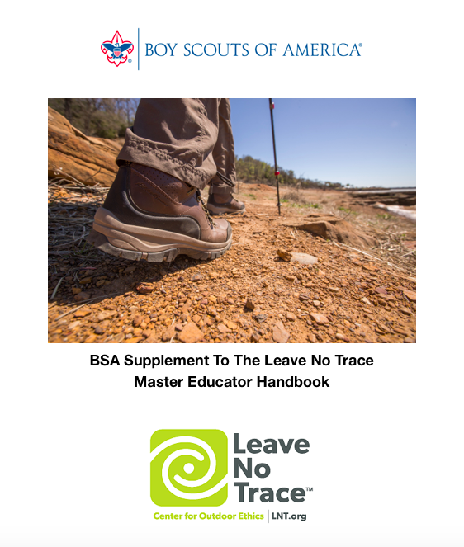
Committee Organization
Curriculum & Educational Assets Group
WHATS NEW
New Release:
BSA Supplement
to the
Leave No Trace
Master Educator Handbook

Slide 34
Committee Organization
Special Projects

Slide 35
Committee Organization
Special Projects
    Cub Scout Initiatives
Virtual Education
    National Exhibits

Slide 36
Committee Organization
Cub Scout Initiatives Workgroup
    Workgroup Chair: Barbara Saunders
Focus is on developing a plan to provide greater support for our Cub Scout volunteers.
  Council & District Level
  Pack and Den Level

Slide 37
Committee Organization
Virtual Training
    Matthew Durrant
Focus is on developing the tools for teaching Outdoor Ethics in a variety of virtual formats.
    Train the Trainer
    Virtual Outdoor Ethics Roundtables

Slide 38
Committee Organization
National Exhibits
    Still Scott Anderson
Focus is on organizing and staffing our major event outreaches.
Jamborees (National & World)
NOACs, VenturingFests
Outdoor Program Conferences

Slide 39
World Organization of
the Scout Movement
Notes:
The World Organization of the Scout Movement (WOSM) has its own World Scout Environmental Program and has embraced the UN's Sustainable Development Goals creating "Scouts for SDGs" supporting the goals of protecting life on land and in water. International SCENES (Scout Centre of Excellence for Nature and Environment) camps are starting to include Leave No Trace in their camp programs.
Internationally we are seeing outdoor ethics being taught to Scouts and Scouters in Asia and Europe and there is a long term hope that WOSM and its many Scout Associations around the world will adopt the Seven Principle of Leave No Trace.
How cool would that be?

Slide 40
What You Can Do
Vision Statement
The membership of the Boy Scouts of America, through education and behavior, is recognized as a leader in the ethically responsible use of our outdoor recreational spaces.

Slide 41
What You Can Do
Learn
        Recreational Impacts
        Outdoor Skills & Ethics
Leave No Trace Awareness Course, Outdoor Ethics Orientation Course, Leave No Trace 101 Course, Tread Lightly Awareness Course

Slide 42
What You Can Do
Practice
    Outdoor Code
    Seven Principles of Leave No Trace
    Tread Lightly!
However, wherever, and whenever you recreate in the outdoors.

Slide 43
What You Can Do
Practice
Eliminate the Avoidable Impacts
Minimize the Unavoidable Impacts

Slide 44
What You Can Do
Teach
    Youth and Volunteers members
    Teach our Volunteers to Teach
BSA Leave No Trace Trainer Courses & Master Educator Courses
Tread Trainer & Master Tread Trainer Course
Project Learning Tree Facilitator Course

Slide 45
What You Can Do
Teach
    Youth and Volunteers members
    Teach our Volunteers to Teach
BSA Leave No Trace Trainer Courses & Master Educator Courses
Tread Trainer & Master Tread Trainer Course
Project Learning Tree Facilitator Course

Slide 46
What You Can Do
Volunteer
Serve your Council
  Council Outdoor Ethics Advocate
  Council Committees
    Training, Conservation, Program, etc.
  District Committees
Council Outdoor Ethics Advocate Training

Slide 47
Where Can I Find Help
Websites
https://www.outdoorethics-bsa.org
https://www.scouting.org/outdoor-programs/outdoor-ethics/

Slide 48
What You Can Do
EMail
Outdoor.Ethics@scouting.org
Visit:
http://outdoorethics-bsa.org/contacts/

Slide 49
Upcoming Events
Notes:
Tom

Slide 50
2021 National Outdoor Program Conference
Summit Bechtel Reserve
October 13-17, 2021
Includes:
Full slate of outdoor ethics sessions with some of our top presenters.
Pre-Conference Training Programs
October 10-12, 2021

Slide 51
Virtual Roundtables
    Dec. 2
  Pt 1 Website Exploration
  Pt 2 Reporting Tools for Council Outdoor Advocates
Jan 2021
  Short Term Camp Overnight Trainings
Feb 2021
  Women Outdoors
Notes:
Dec 2 Website Exploration pt 1 pt 2 Reporting tools for council Outdoor Advocates 7pm cent
Jan 2021 Short Term Camp as it applies to Overnight trainings
Feb 2021 Women Outdoors

Slide 52
Leave No Trace
Master Educator Courses
BSA Leave No Trace ME - AR
March 12-17
BSA Leave No Trace ME - FL
April 29 - May 4
BSA Leave No Trace ME - ID
August 2-7
BSA Leave No Trace ME - Ontario
August 9-14
BSA Leave No Trace ME - MN
August 15-20
BSA Leave No Trace ME - IL
September 10-12, 23-26
BSA Leave No Trace ME - NM
September 25-30
Notes:
BSA Leave No Trace ME - FL
April 29 - May 4
BSA Leave No Trace ME - ID
August 2-7
BSA Leave No Trace ME - Ontario
August 9-14
BSA Leave No Trace ME - MN
August 15-20
BSA Leave No Trace ME - NM
September 25-30

Slide 53
Website
OutdoorEthics-BSA.org
Notes:
BSA Leave No Trace ME - FL
April 29 - May 4
BSA Leave No Trace ME - ID
August 2-7
BSA Leave No Trace ME - Ontario
August 9-14
BSA Leave No Trace ME - MN
August 15-20
BSA Leave No Trace ME - NM
September 25-30

Slide 54
Notes:
Tom

Slide 55
Thank You
Notes:
Tom

Slide 56
2020 National Outdoor Ethics Conference Planning Team
Chandra Clark - Southern Region
Meredith Blackwood - Conference Chair
Kenna McIntire - Program Director
Occoneechee Council

Slide 57
2020 National Outdoor Ethics Virtual Conference Planning Team
Marshall Berger
Paula Booth
Chandra Clark
Matthew Durrant
Toby Green
Mark Hammer
Dave O’Leary
Frank Reigelman

Slide 58
Thank You for Attending
Notes:
Tom

