Slide 2
Largescale
Council Conservation Projects

Slide 3
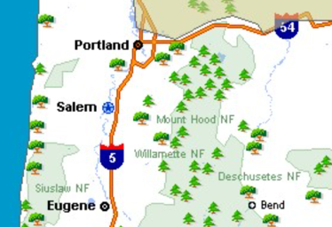
For Reference:
Norm Dannemiller service@cpc-oa.org
Associate Lodge Advisor – Wauna La-Mon´tay Lodge
Cascade Pacific Council, Portland OR
Mount Hood National Forest [MHNF]
Willamette National Forest [WNF]

Slide 4
Safety Moment
Severe weather hazards, such as tornadoes, lightning, hail, flash flooding, and downbursts, can be dangerous. Each requires a basic understanding of what to do so that you can protect yourself and your Scouts. The scale of weather conditions can seem daunting—ranging from high heat with no humidity to torrential downpours with possible flooding. However, some key basic principles can help everyone prepare. Here are a few for you to consider:
Know the weather forecast before you set out on your trip.
Prepare for the types of weather hazards that are associated with your destination, such as tornadoes, lightning, snow, torrential rains, and high winds. The BSA’s online Weather Hazards training (available through My.Scouting.org) is a great resource in this area and should be renewed every two years.
Double-check weather conditions immediately upon arrival to verify forecasts.
The weather can be integral in becoming lost or injured. If visibility becomes limited, respond quickly to gather the Scouts in your care.
Inquire about the location of any designated emergency shelters in the area.

Slide 5
Largescale Conservation Projects
For this workshop:
Explore Conservation Projects in a larger setting
Single Day Event
Multiple Day Event
Recognize the potential of Exceptional Volunteers
Value of the Volunteer’s Time
Event Staffing
Understanding Opportunities in Developing Partnerships
Essential for working on Public Lands
Resources and Knowledgebase

Slide 6

Some Background: The Model
2008 – Large Scale Conservation Project
Mark Twain National Forest – Missouri
Manti-La Sal National Forest – Utah
George Washington & Jefferson National Forests – Virginia
Shasta-Trinity National Forest – California
Bridger-Teton National Forest – Wyoming
Larger Goal – Set an Example → Be a Model
Working with a large partner – USFS
Recapturing a moment – Largest BSA Service Effort since WWII

Slide 7
ArrowCorps Concept and Wauna La-Mon´tay Lodge
ArrowCorps 2011
MHNF – Barlow, Clackamas Ranger Districts
51 persons – Week Long – 2 Crews;
District office project (Public Facing), Rogue Campsites Restoration
ArrowCorps 2014
MHNF – Barlow, Zig-Zag, Hood River, Clackamas Ranger Districts
87 persons – Week Long – 4 Crews
Buck & Pole Fencing, Single Track Mtn Bike Trail Repair, Campsite Remediation
ArrowCorps 2016
MHNF – Zig-Zag Ranger District, WNF – Detroit Ranger District
96 persons – Week Long – 5 Crews, 2 National Forests
Trail Brushing to USFS Clearances, ADA trail restoration w/ USFS Crew

Slide 8
ArrowCorps Concept and Wauna La-Mon´tay Lodge
ArrowCorps 2019
MHNF – Barlow Ranger District, WNF – Detroit Ranger District,
BLM – McGowan OEC
112 persons – Week Long – 8 Crews, 2 Nat’l Forests, 1 BLM property
Invasive species remediation, Trail Brushing to USFS Clearances, Bridge & Shelter Construction
Notable Logistics -196 mi between furthest crews
ArrowCorps 2021
WNF – Detroit Ranger District
87 persons – Week Long – 6 Crews (Cohorts & COVID Protocols)
Trail Brushing to USFS Clearances, Conservation Project – Rain Bars on Marion Mtn.
ArrowCorps 2023
WNF – Detroit Ranger District
96 persons – Week Long – 6 Crews
Trail Brushing to USFS Clearances, Winter Shelter Service Road Brushing,
Wilderness Conservation Project – Turnpike & Drainage

Slide 9
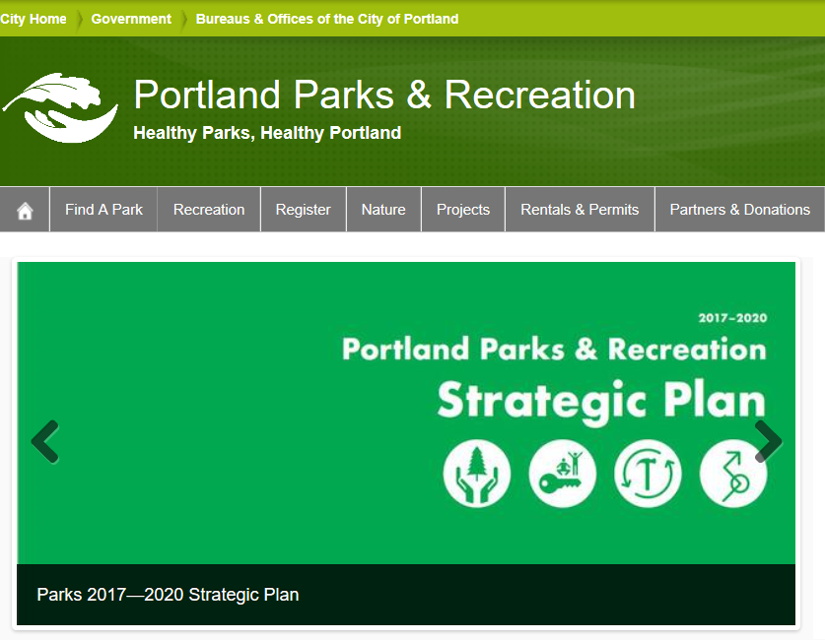
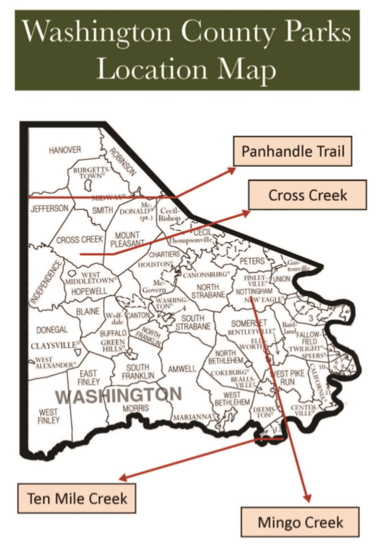
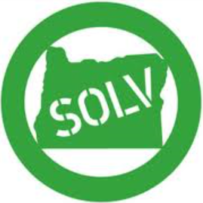
Conservation Project Size
Small Scale Projects
City or County Partners
City Park & Recreation Departments
County Park & Open Spaces
Volunteer Organizations
Half Day to Full Day Event
No Basecamp needed
3-6 Month Event Horizon
Minimal Budget $

Slide 10
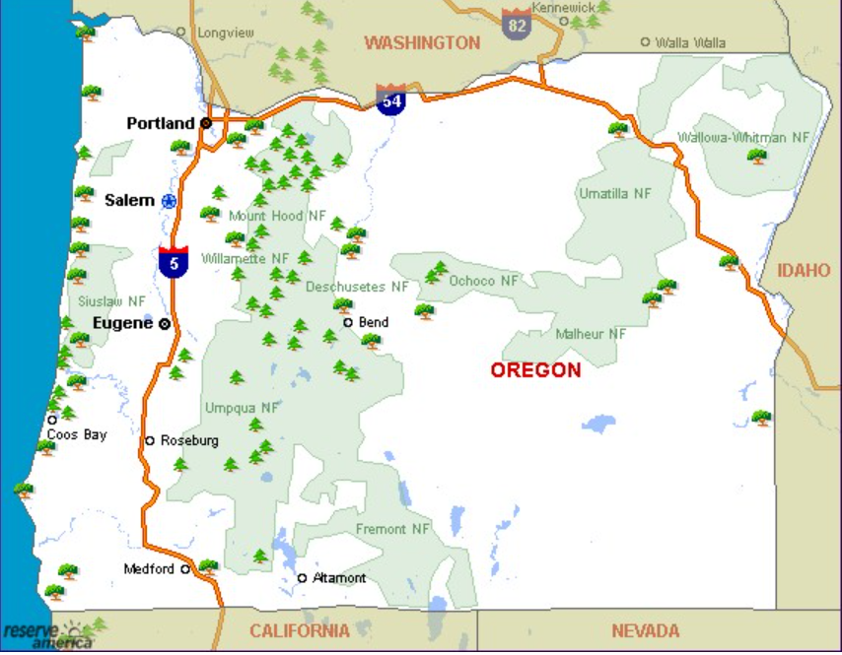

Conservation Projects
Medium Scale Projects
Regional or State entity
State Park System
State Highway Department
Large County or Regional Park System
Weekend or Long Weekend Event
Common Basecamp
Likely a Single Work Location
Logistics similar to an Induction Weekend
6-9 Month Event Horizon
Modest Budget $$

Slide 11
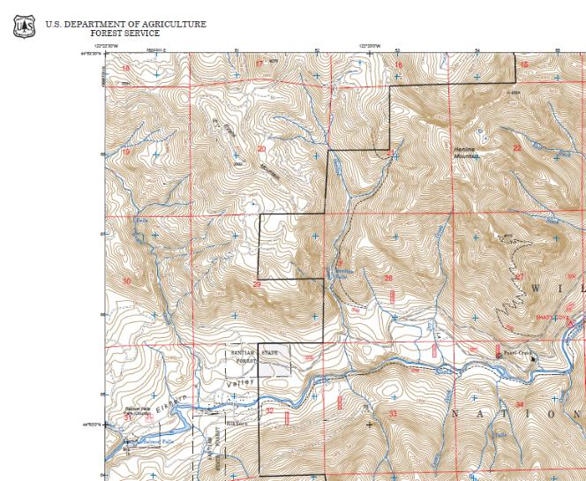

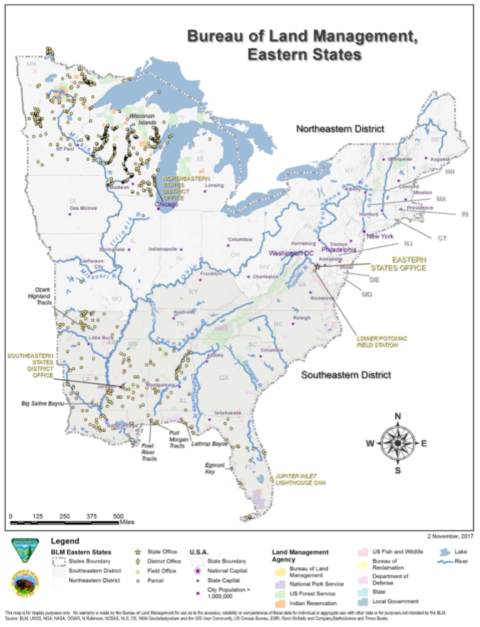
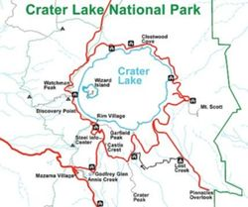


Conservation Projects
Large Scale Projects
Major Partner (USFS, BLM, NPS, etc)
Week Long (4-5 working days)
Basecamp(s)
Remote Work Site Location(s)
Significant Logistics
Staff Support
Food Service
Transportation
Field Camp(s) Support
Participant Safety
12 – 18 month event horizon
Big Budget $$$+

Slide 12
Size matters…
Key considerations for each one:
Small Scale Project
3 – 6 Month Event Horizon
Youth POC + Advisor
Budget
Medium Scale Project
Moderate Planning & Logistics
Event Chairperson, Associate Advisor, small staff
6 – 9 Month Event Horizon
Responsibilities
Fee & Budget

Slide 13
Size matters…
Key considerations for each one:
Large Scale Project
High Planning, High Logistics
12 – 18 Month Event Horizon
Partner Involvement
Event Chair, Event Advisor, Lodge Advisor, Staff Professional + others involved
Full Event Staff w/ Identified Roles & Responsibilities
Staff / Participant Fee and Budget
Risk Management (Weather, Fire, RA’s JHA’s and TCP’s)
Plan-Delegate-Train-Trust
Futureproofing: One Time or Repeating/Re-occurring Event (?)

Slide 14


Partnering Organizations
Typical for Small to Medium Scale:
Local and Regional Entities
State, County and City Parks
Local Conservation Groups
Identify and Start Conversations Early
Finding the right contact a bit easier
Typically will maintain a list of volunteer projects
Opportunity to work alongside the community

Slide 15


Partnering Organizations
Typical for Large to Medium Scale:
State and National Entities
Identify and Start Conversations Early
Finding the right contact takes time
Volunteer Waiver or Volunteer Agreement
Be Organized
Accurate estimate of persons, ages, abilities
Detailed time plan (working days / hours)
Intra-Agency Differentiation
National Forests differ, and so do Ranger Districts
Semper Gumby

Slide 16
A Few Words about Organization:
ICS – Incident Command System
Predictable, Defined Organizational Scheme
Structured to facilitate activities in major functional areas:
Command
Operations
Planning
Logistics Intelligence & Investigations
Finance and Administration
Developed for Large Scale Incidents – Disasters: Manmade, Natural and Otherwise
Incidents where Event Scale & Scope = Personnel Exchanges necessary or multi-agency interaction

Slide 17
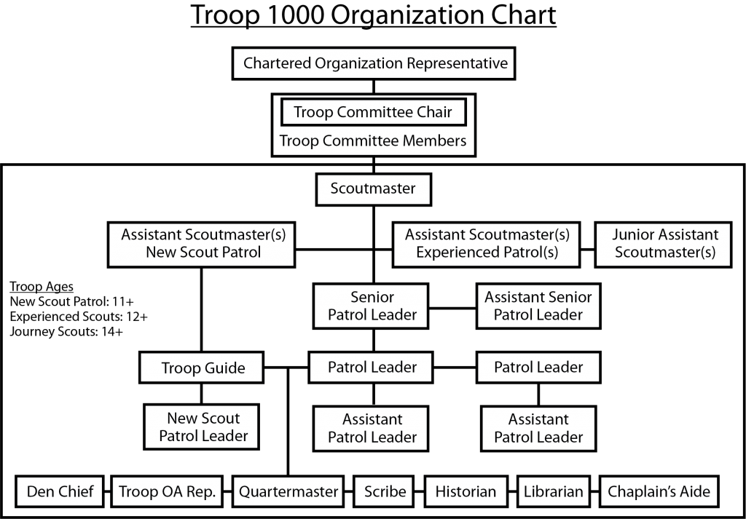
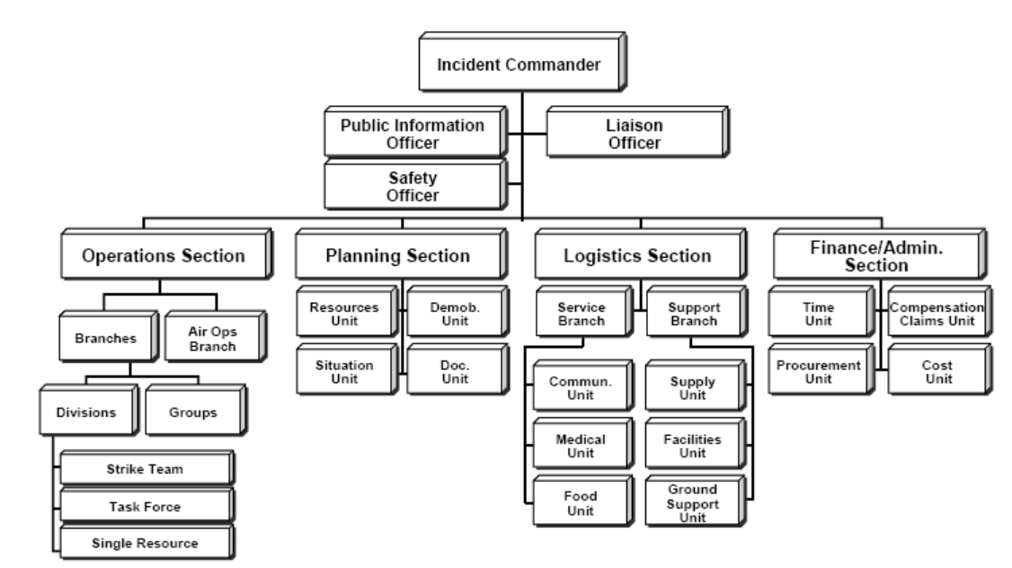
ICS – Incident Command System

Slide 18

ICS – Incident Command System
Universal Platform –
Across Fed Gov’t Agencies
Across Military Entities
Across State & Civil Entities
Why you might want to know about it:
Common language within Fed/State/Local authority you are partnering with
Defined Organizational Chart – as a resource not a model
Additional Logistics, Finance & Administrative Roles
If your event utilizes ICS, keep in mind:
It is a Scalable System
Utilize the Roles needed
Delegate – Train – Trust
(A lot of) Reporting – After Action (?)
Want more Information?
https://www.fema.gov

Slide 19
Partners – How do they Fit In?
The mission of the USDA Forest Service is to sustain the health, diversity, and productivity of the Nation's forests and grasslands to meet the needs of present and future generations.
The Bureau of Land Management's mission is to sustain the health, diversity, and productivity of public lands for the use and enjoyment of present and future generations
The National Park Service preserves unimpaired the natural and cultural resources and values of the National Park System for the enjoyment, education, and inspiration of this and future generations.
The mission of the Oregon Parks and Recreation Department is to provide and protect outstanding natural, scenic, cultural, historic and recreational sites for the enjoyment and education of present and future generations
SOLV believes that their mission, is to bring Oregonians together to improve our environment and build a legacy of stewardship

Slide 20


Partnering Organization Relationship
Working Directly with Agency
Volunteer Organization
Embedded Partner
2011, 2014, 2016
2019
2021, 2023

Slide 21
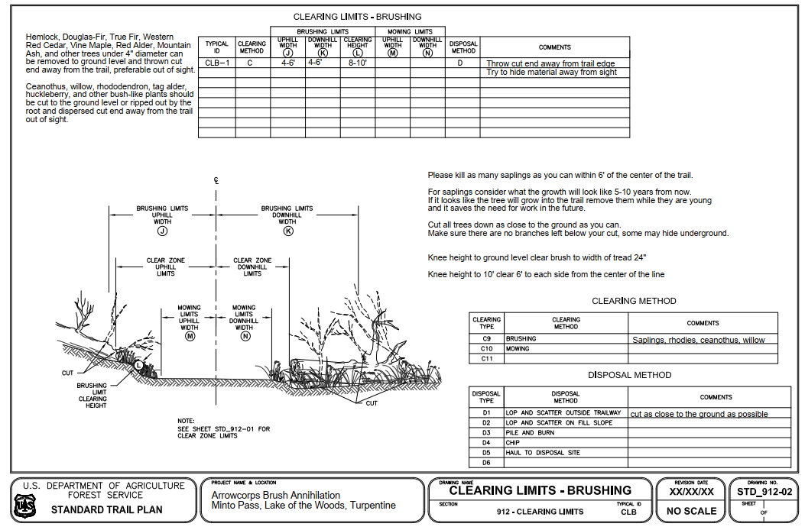
Conservation Projects – Managing Expectations
Scope of Work [SOW]:
Relationship with Partner
Staff Development
Participant Understanding

Slide 22
Conservation Projects – Staffing
If Event is Single Day
Minimum Staffing needed to ensure successful outcome
As a Guide – event conforms to NCAP Day camp STD
If Event is multiple day and ≤ 1 Night on Trail
Formal Staffing to ensure successful outcome
Conforms to NCAP Short-term or Long term camp STD
Must Have if event > 1 Night on Trail = Trek [NCAP PS-218]
Staff Certifications req’d (CPR/AED, FA, WFA)
Staff development training for Trek Program [NCAP SQ-410]
Conforms to Long-term camp STD
NCAP AO-802
Intent to Operate

Slide 23
Staff Development
Small to Medium Scale
Meetings over Several Months
Refreshments at Meetings
Project parameters, goals/objectives
Recognition or Swag
Large Scale
Mandatory Staff Development Attendance
– Included in event cost everyone pays
– Staff cost = Participant Cost
Staff Retreat Weekend or Multi-day training prior to event
Certified Skill Sets (NCAP, WFR, WFA, CPR/AED, FA, LNT)
Breakouts for Specific Trainings
Use your Partner Connections – SME’s for Training
Fully Developed Schedule / Program for Staff Training Event

Slide 24
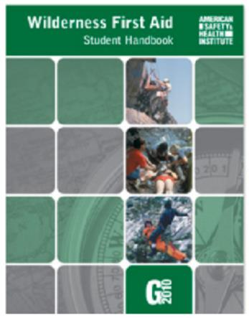
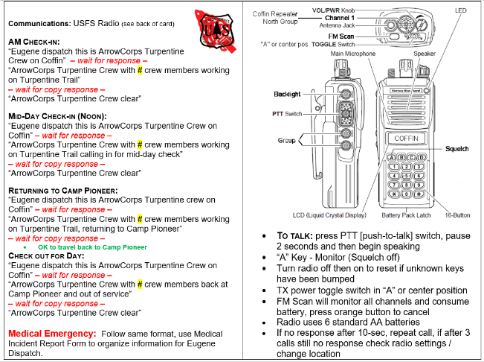
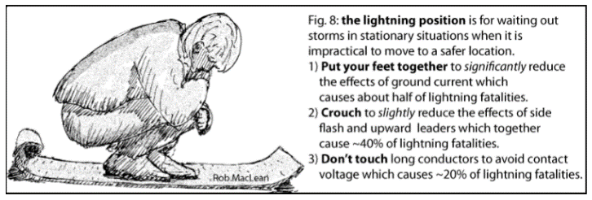
Staff Take-Aways
Experience
w/ Mandatory Staff Development
Certified Skill Sets
WFR, WFA, CPR/AED, FA, LNT
Partner Connections
Staff Specific Swag (?)

Slide 25
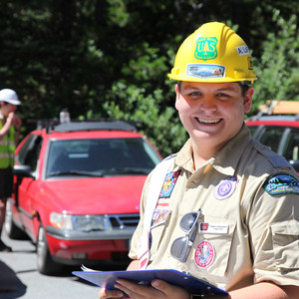
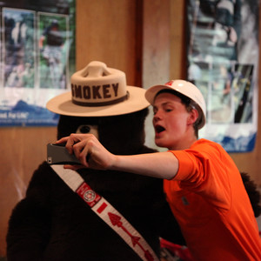
Participants / Exceptional Volunteers
Check-In Process
Event Management [NCAP AO-804, HS-503]
Waivers – VA’s – JHA’s – PPE
Radical Welcoming!
Event Program
Project Orientation & Safety
Developed Daily Schedule
Deployment
Event Conclusion
Closing / Conclusion of Activity
Event Swag – Tokens of Appreciation
Check-out

Slide 26
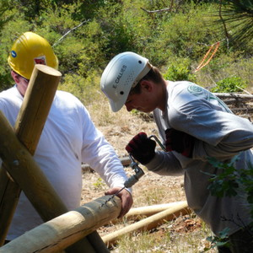
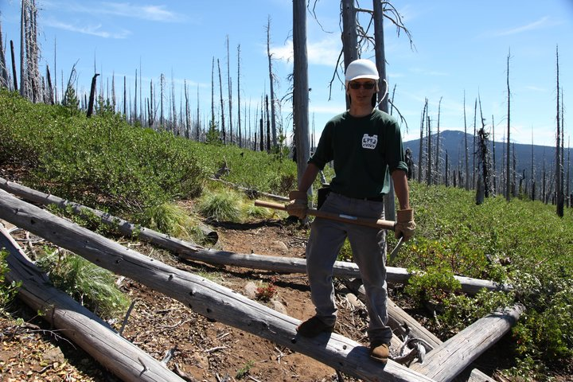
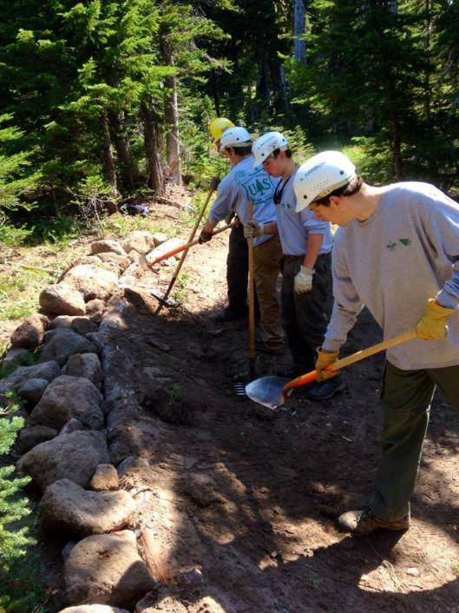
Participants / Exceptional Volunteers
Radical Welcoming
Value the Participants Time
Crew assemblage and Ice-Breakers
Crew Foreman Orientation
Site Specific Safety
Gear Checks (TREK)

Slide 27
Participant Take-Aways
Partnering Organization as a Career Path
USFS Ranger / Trail Crew Boss
Forester / Public Lands Manager
Team Leader of a non-profit conservation organization
Community Level
Community service advocate
Urban conservation/sustainability advocate
Founder of a non-profit conservation organization
Scouting Level
Small/large scale conservation project chairperson
Unit level LNT Trainer
National Conservation Award recipient

Slide 28
Conservation Projects – ReCap
Explore Conservation Projects in larger communities & settings
Single Day Event considerations
Multiple Day Event considerations
Leveraging Exceptional Volunteers in Conservation Activities
Value the Volunteer’s Time no matter the project size
Staff – Helping Others to be Successful
Understanding Opportunities in Developing Partnerships
Resources and Knowledgebase
Necessary to work on Public Lands

Slide 29
Conservation Projects
Thank you

