Slide 1

Outdoor Ethics, Conservation, and Order of the Arrow

Slide 2

Meet Your Trainer
Tschitani Lodge/ Connecticut Rivers Council
Canton, CT
Nordic Ski Patroller

Slide 3
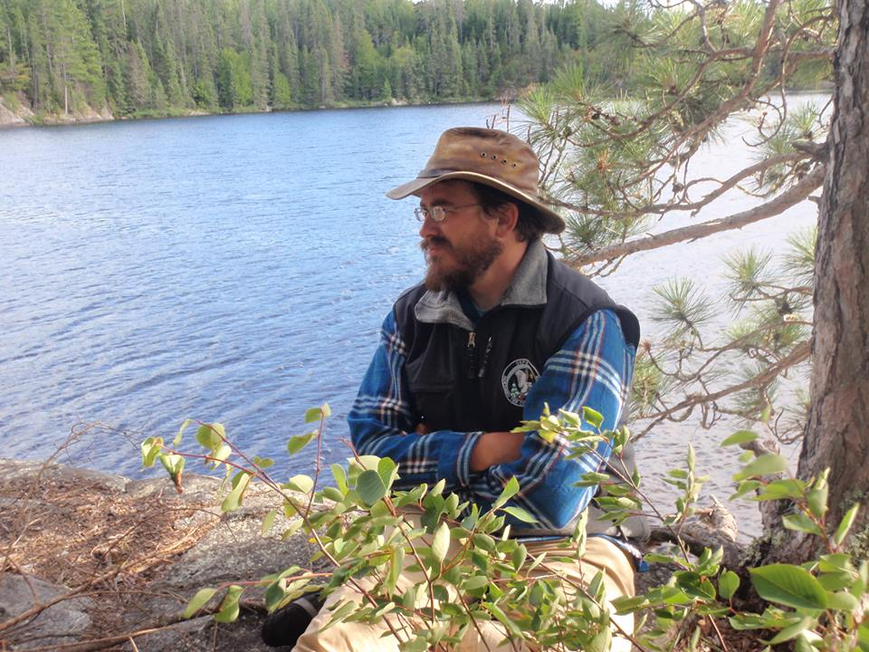
Meet Your Trainer
Cho-Gun-Mun-A-Nock Lodge/ Hawkeye Area Council
Cedar Rapids, IA
Have served on OA Conservation Staff at Northern Tier and Philmont
Ted Weiland

Slide 4

Learning Objectives
Knowledge of the BSA Outdoor Ethics program which includes the Outdoor Code, Leave No Trace, Tread Lightly! and the Land Ethic.
Knowledge of the BSA Conservation program including the DCSA.
Understand the importance of outdoor ethics in outdoor activities.

Slide 5
Goals
The goal of this BSA Outdoor Ethics presentation is to:
Reaffirm the concept of Outdoor Ethics
How these skills and activities apply for the Order of the Arrow.
As the servant leaders of Scouting, our Arrowmen can:
Teach youth and adults at all program levels
Understand how we can care for the land
Be better stewards of our camps and the properties we use for all activities

Slide 6
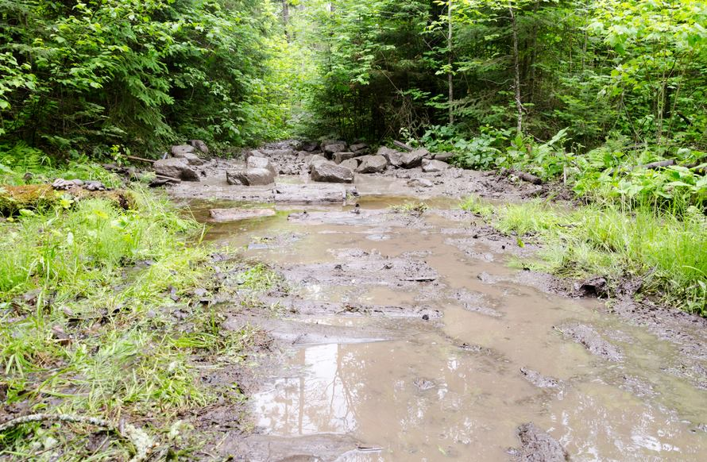
Big Footprint
IMPACTS
IMPACTS
IMPACTS

Slide 7
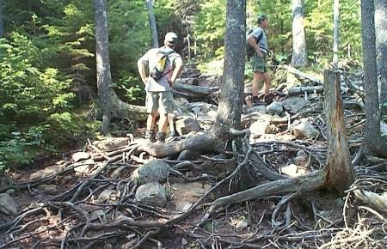
Vegetation Impacts
Vegetation loss
Spread of non-native species
Tree damage

Slide 8
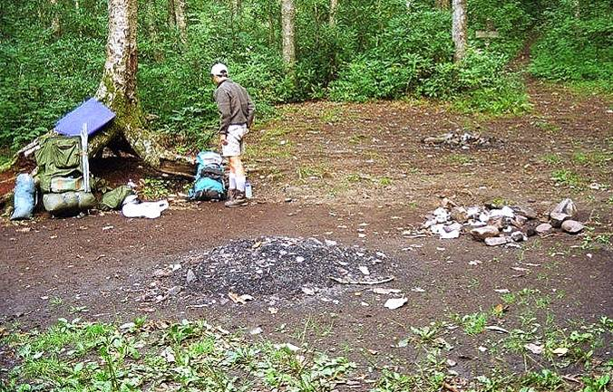
Soil Impacts
Soil compaction
Soil erosion
Loss of organic litter

Slide 9
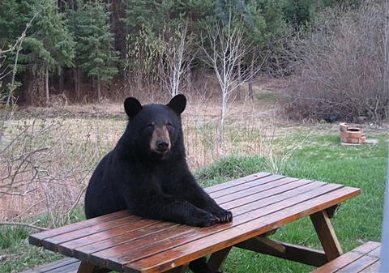
Wildlife Impacts
Disturbance of wildlife
Altered behavior
Reduced health & reproduction

Slide 10
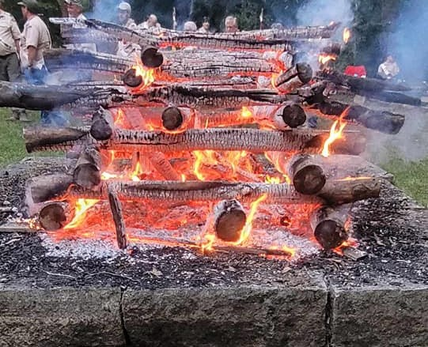
Campfire Impacts
Sterilize Soil
Fire Stains & Nubbins
Ecosystem Zapper
Universal Garbage Can

Slide 11
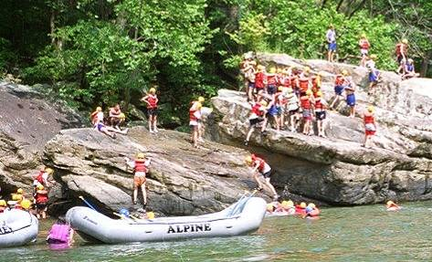
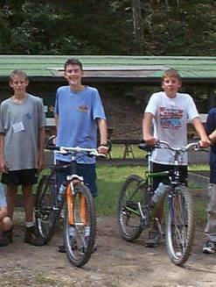
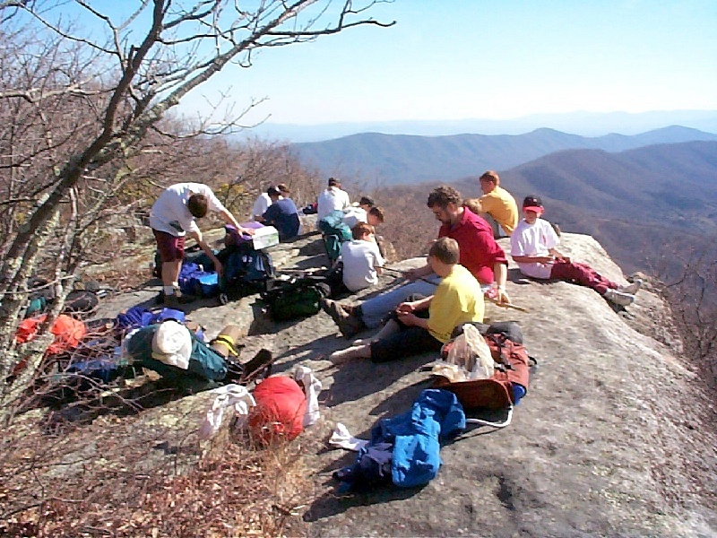
Social Impacts
Crowding
Conflicts
Noise

Slide 12
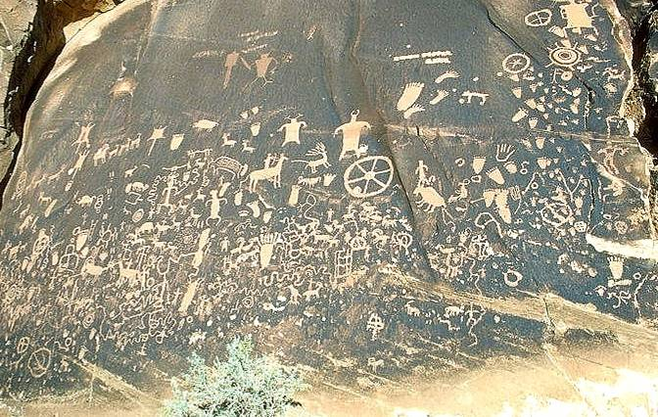
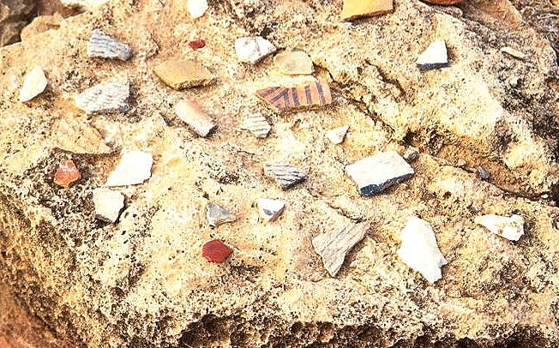
Cultural and Historic Impacts
Theft of artifacts
Damage to historic structures
Damage to cultural features

Slide 13
Public Perception
Common perceptions by Federal land management agencies about BSA units on federal land:
Scouts out of control
Too much noise
Group sizes too big
Camping skills badly out of date
Inappropriate play damages the backcountry
Don't keep appointments to do service work
Completely soak up popular campsites or shelters
Unskilled campers using areas that call for expert skills
Using inappropriate areas (hi-use, fragile) to train new campers

Slide 14
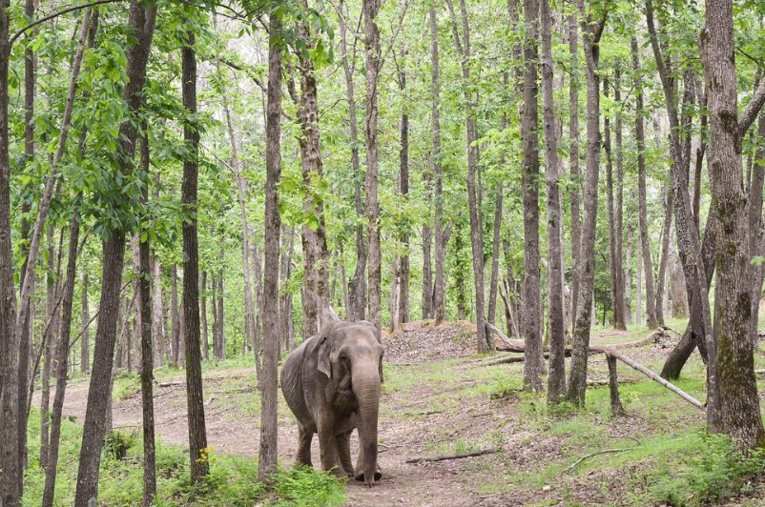
“Elephant in the Woods”
The BSA is the elephant in the woods.
Can Arrowmen help reduce these impacts?
PC: The Elephant Sanctuary of TN

Slide 15
Our Native American Connection
“Treat the earth well. It was not given to you by your parents –it was loaned to you by your children.”
Native American proverb

Slide 16
Wise Words from Meteu
“You who love the haunts of nature,
love the moonlight on the water,
love the sunshine on the meadow,
love the shadow of the forest,
love the wind among the branches ever murmuring, ever sighing,
love the rushing of great rivers…”

Slide 17
Scouting’s National Honor Society
As Scouting’s National Honor Society, our purpose is to:
Recognize those who best exemplify the Scout Oath and Law in their daily lives and through that recognition cause others to conduct themselves in a way that warrants similar recognition.
Promote camping, responsible outdoor adventure, and environmental stewardship as essential components of every Scout’s experience, in the unit, year-round, and in summer camp.
Develop leaders with the willingness, character, spirit and ability to advance the activities of their units, our Brotherhood, Scouting, and ultimately our nation.
Crystallize the Scout habit of helpfulness into a life purpose of leadership in cheerful service to others.

Slide 18
What is an Ethic?
What does ethics mean?
How can we become a more ethical person?

Slide 19
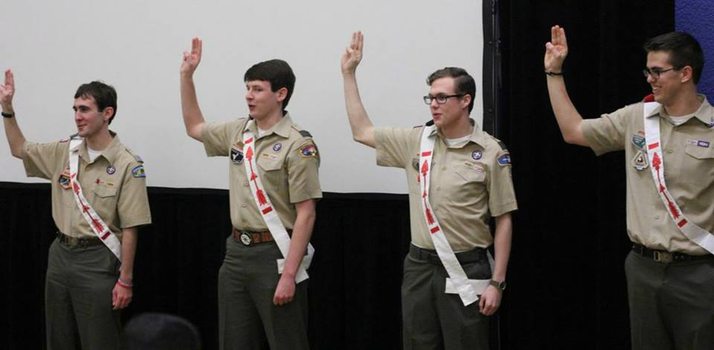
So What is an Ethic?
The Obligation
The Admonition

Slide 20
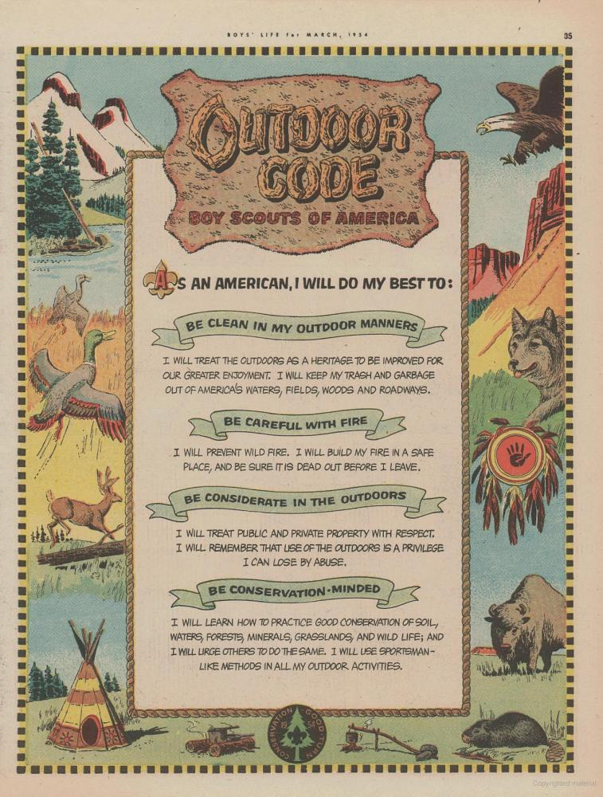
The Outdoor Code
An Ethic for scouts for 70 years!
As an American, I will do my best to:
Be clean in my outdoor manners
Be careful with fire
Be considerate in the outdoors
Be conservation minded

Slide 21
BSA Outdoor Ethics Program
This program exemplifies
“Self Reliance and Service”
Have been a hallmark of the Aims and Methods of Scouting and the Order of the Arrow.

Slide 22



Outdoor Ethics Components
 | Leave No Trace | Primary Set of Principles
 | TREAD Lightly! | Primary Set of Principles for Mechanized Activities
 | The Land Ethic | Spirit of Conservation and Environmental Stewardship

Slide 23

Plan Ahead and Prepare
Travel and Camp on Durable Surfaces
Dispose of Waste Properly
Leave What You Find
Minimize Campfire Impacts
Respect Wildlife
Be Considerate of Other Visitors

Slide 24
TREAD Lightly! focuses on people that use or are affected by motorized and mechanized vehicles
https://www.treadlightly.org/
Travel responsibly
Stay on designated roads, trails and areas.
Cross streams only at designated fords
Respect the rights of others
Yield the right of way to those passing you
Educate yourself
Use maps and regulations from public agencies
Avoid sensitive areas
Stay on designated routes, avoid meadows & wetlands
Do your part
Model appropriate behavior, dispose of trash responsibly
Minimize the use of fires
Repair degraded areas

Slide 25
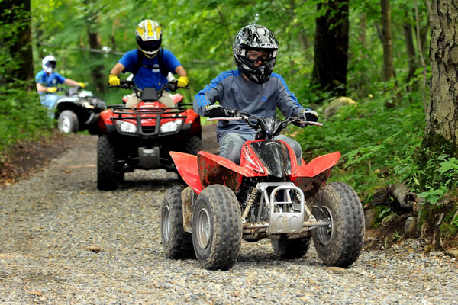
Why TREAD Lightly!
BSA Motorized Sports Programs
Motorboating
Snowmobiles
ATV’s
TREAD Lightly! can help us implement these programs in a safe and ethical manner

Slide 26
The Land Ethic
The Land Ethic is offered by Aldo Leopold in 1949 in A Sand County Almanac.
He reflected on the interaction with man and the land.
“The Land Ethic simply enlarges the boundaries of the new community which includes soils, waters, plants and animals, or collectively referred to as, the LAND.”

Slide 27
The Land Ethic
The Land Ethic grows strongest when we have:
Experienced the LAND
Grown to love and respect it
Have labored to enhance or restore it
As Leopold would have put it, when we have practiced “conservation” defined as restoring the capacity of the Land for self-renewal.
“A thing is right when it tends to preserve the integrity, stability, and beauty of the biotic community. It is wrong when it tends otherwise.”

Slide 28
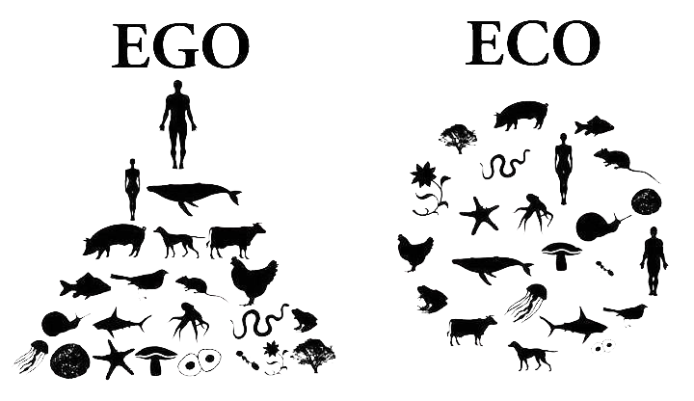
The Land Ethic

Slide 29


Outdoor Ethics Awards
Awareness Award
An introduction to some of the key concept of Outdoor Ethics
Action Award
Take your interest to the next level!
https://www.scouting.org/outdoor-programs/outdoor-ethics/awards/scouts-bsa/

Slide 30

Distinguished Conservation Service Award (DCSA)
Replaced the Hornaday Medal program in 2021
Youth Award
Distinguished Conservation Service Award
Adult Award
Distinguished Conservationist
Organization Award
DCSA Certificate

Slide 31
Distinguished Conservation Service Award (DCSA)
DCSA Youth
Available to Scouts BSA, Venturing, & Sea Scouts
Numerous requirements including 2 high level conservation projects that have been approved by your Council Conservation Committee
Distinguished Conservationist (Adult)
Available to any adult who has contributed at least 20 years of conservation based work at the regional, national, or international level.

Slide 32
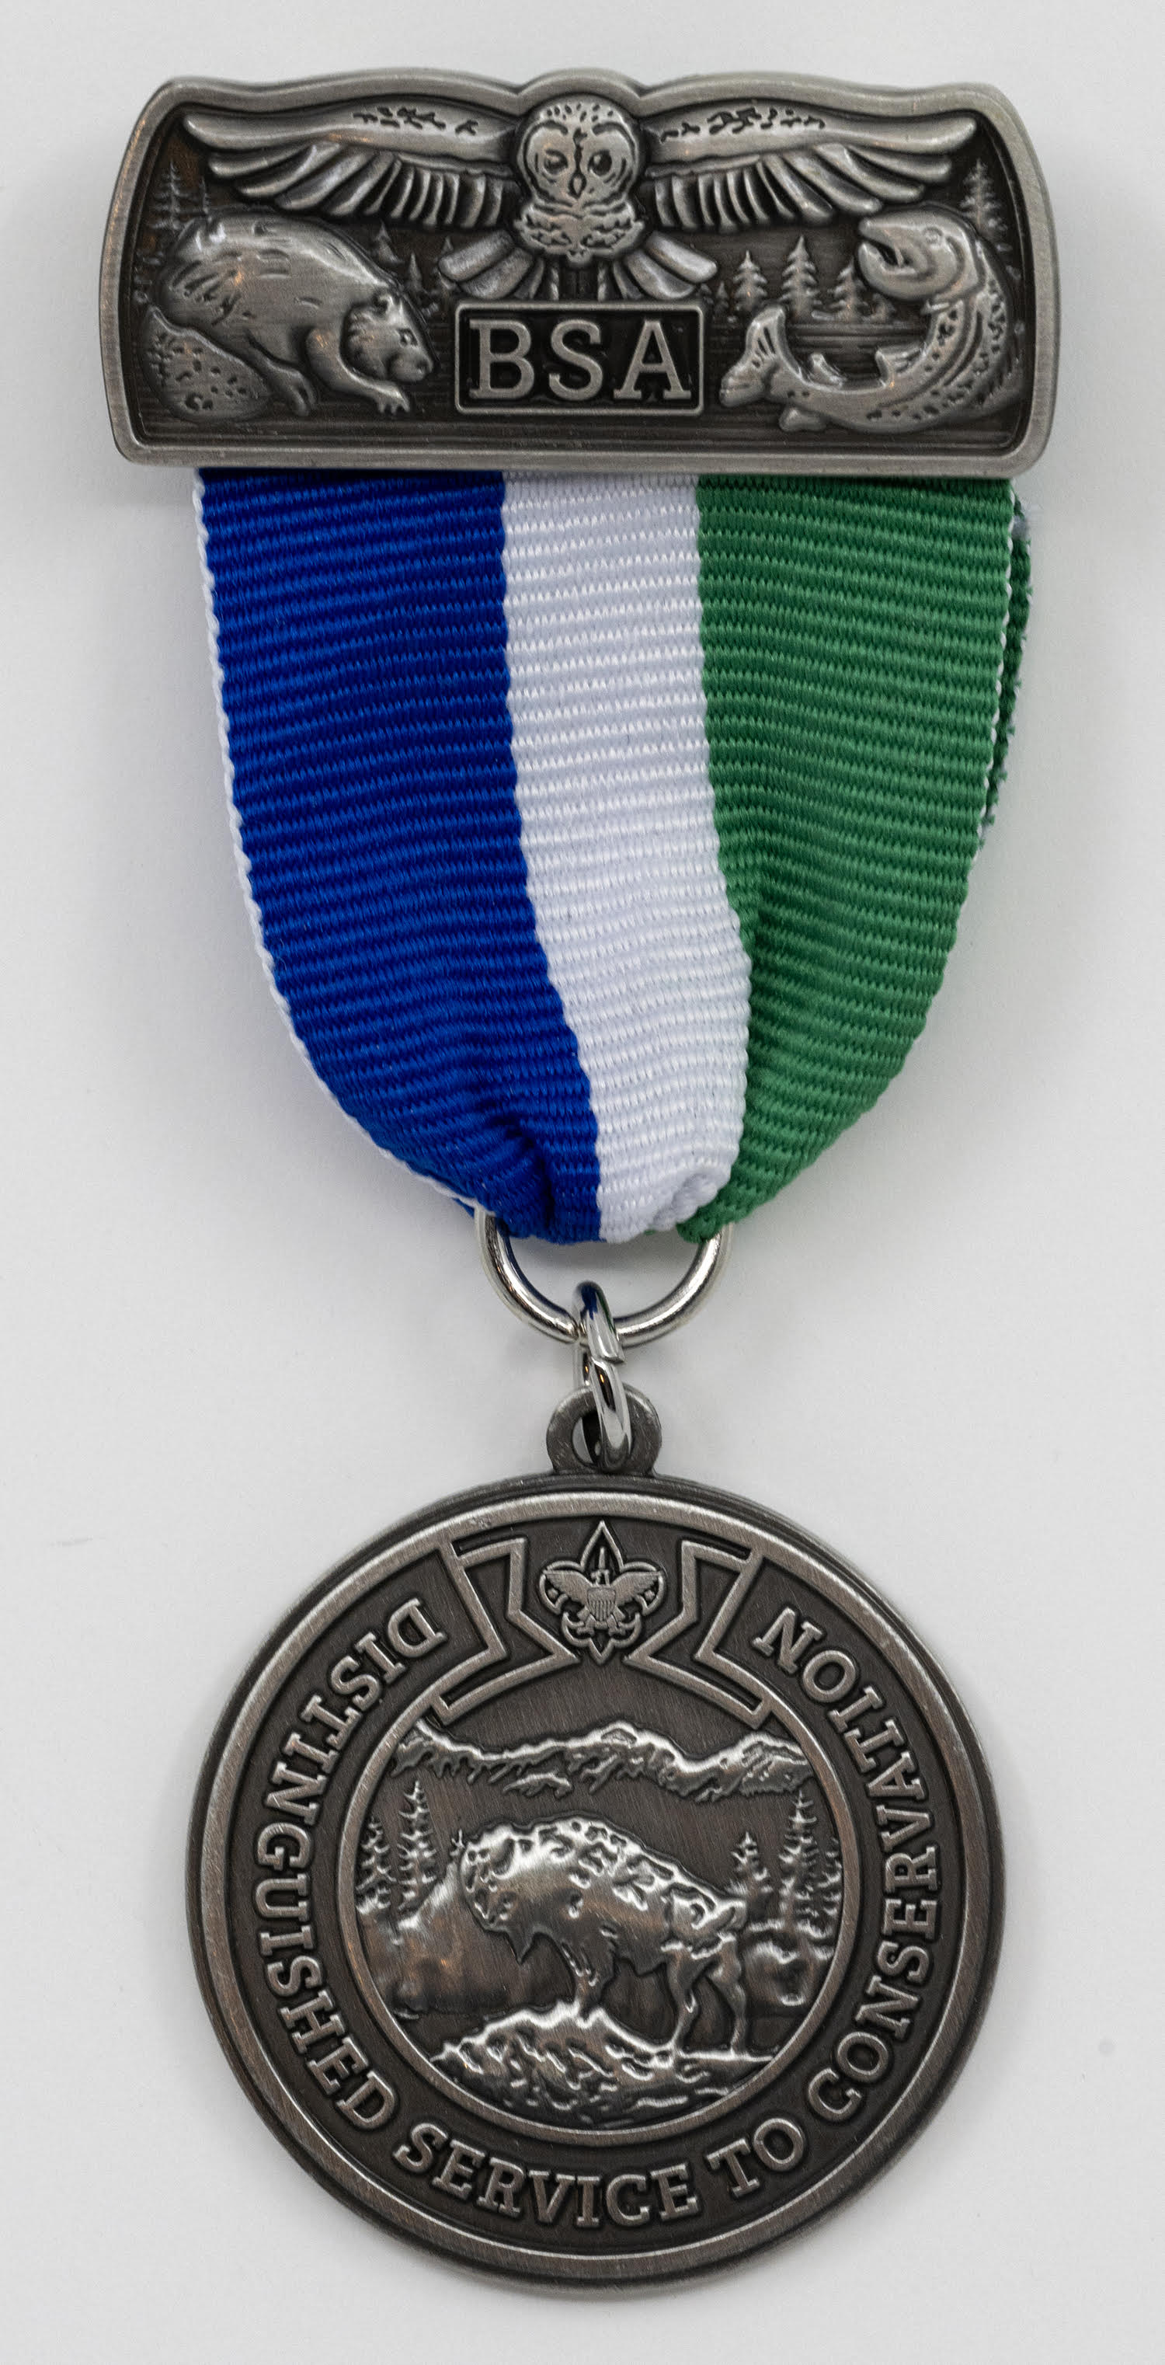


DCSA
Recognition for those who earn this award includes a knot and a medal.
Youth medal can be pinned to shirt.
Adult medal on a ribbon to be worn around the neck.

Slide 33
BSA Outdoor Ethics Training Continuum
Awareness Workshop
BSA Outdoor Ethics Orientation
Leave No Trace Basics
Leave No Trace Level 1 Course
Leave No Trace Level 2 Course

Slide 34
BSA Outdoor Ethics Training Continuum
Tread Trainer Course
Master Tread Trainer Course

Slide 35
How Does This Apply To Our Use Of Our camps?
As we set up our ceremonial sites, what are our key concerns?
Location of our candles and torches?
Where we will find the wood we need for the fire lay?
Is the fire ring large enough?
ARE THESE THE RIGHT QUESTIONS?

Slide 36
Our Camp Use
Today, let’s talk about Campfire Impacts.
We should always use existing fire rings (if available).

Slide 37
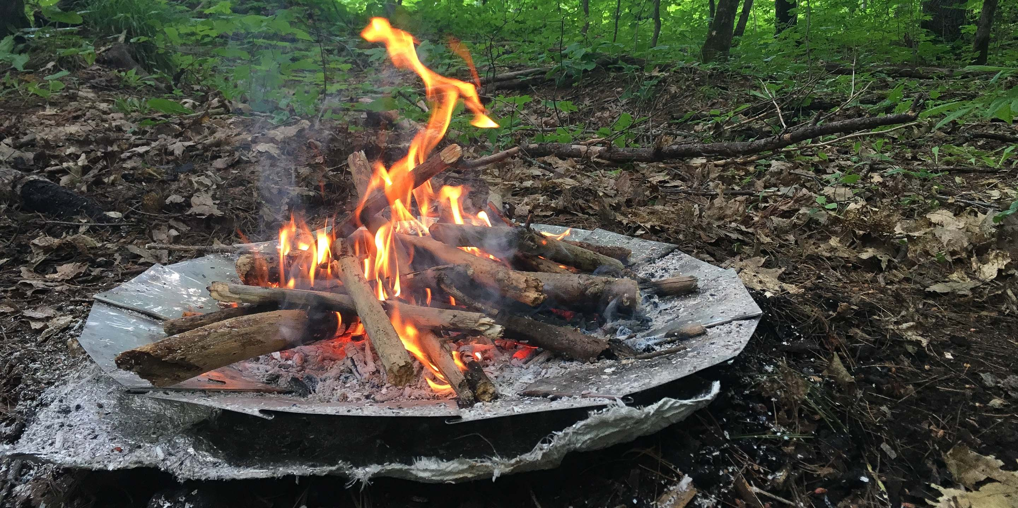
Pan Fire
Could this work?

Slide 38
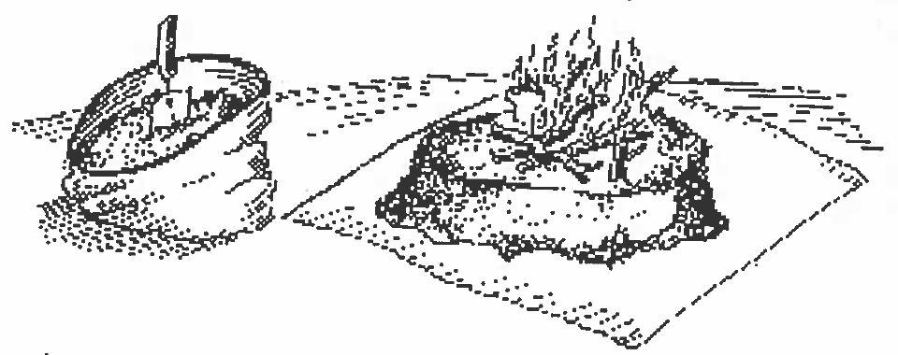
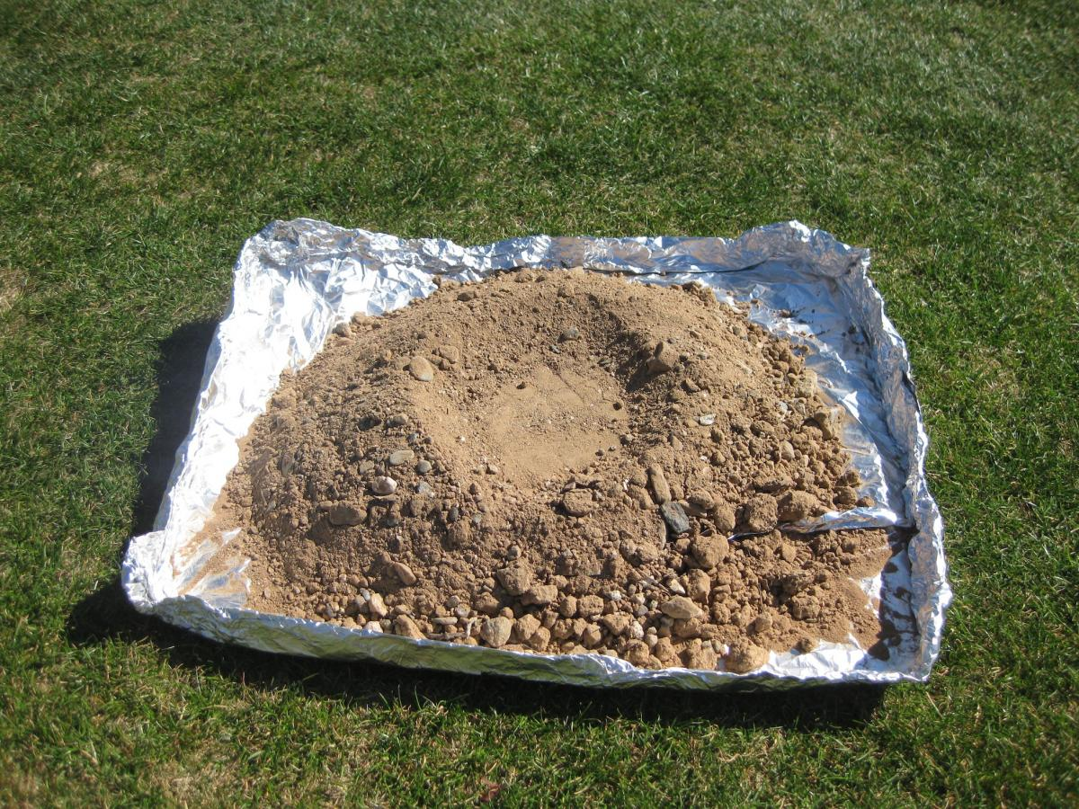
Mound Fire

Slide 39
Mound Fire
Innovative method of building a Leave No Trace fire
Items needed
A garden trowel
Large stuff sack
A ground cloth/tarp
Lay the tarp out
Turn the stuff sack inside out
Fill with mineral soil
Spread the soil into a mound 4 to 6 inches high
Flatten the top and build your fire

Slide 40
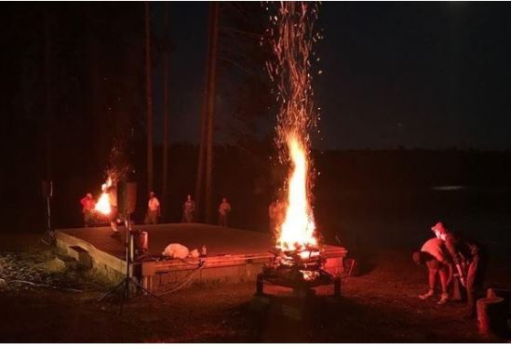
Ceremonial Pan Fire
The use of fire as a visual aid doesn’t mean you need to leave a trace.
We can do both!

Slide 41


Slide 42

Our Role
The OA should be setting the example in Outdoor Ethics and Environmental Stewardship
OA Members should be Outdoor Ethics Guides.
The OA should bring the Outdoor Ethics message and training to our units, our summer camps and practiced wherever we camp.

Slide 43
Our Role
Scouting principles promote responsible use of natural and human resources such as:
forests
water
land
outdoor ethics
good stewardship of BSA lands for today and tomorrow
We have an obligation to plan for the future when it comes to our properties.

Slide 44
Our Role
Integrating Conservation Projects
Improve camp trails
Enhance program offerings at camp
Distinguished Conservation Service Award projects can happen on BSA properties

Slide 45
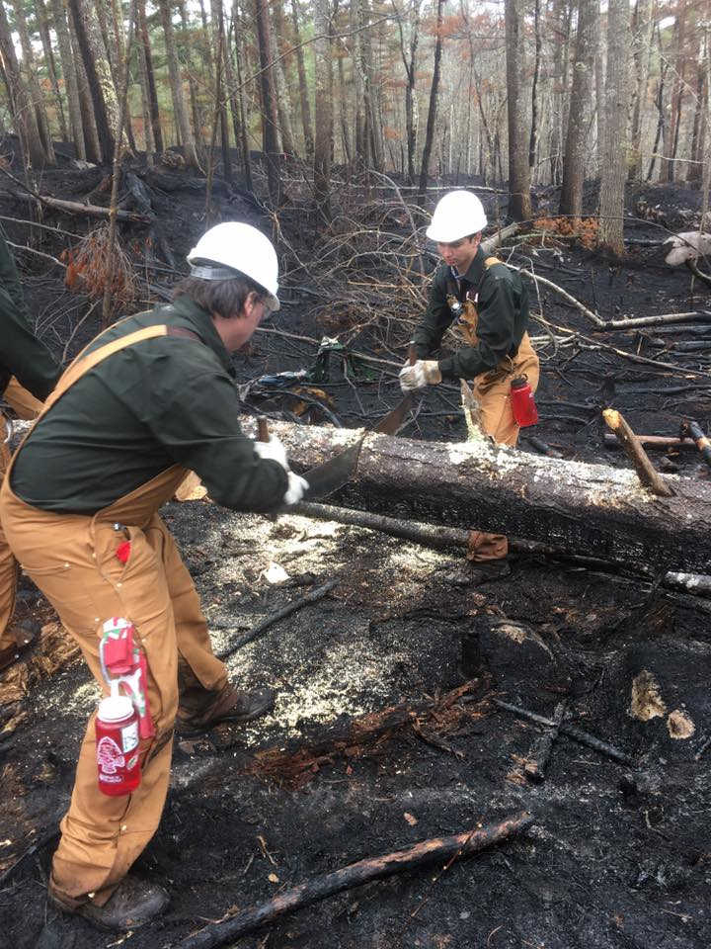
Our Role
Training Youth and Adults
A good forest management plan includes not only taking care of the forest but also training those who are going to help maintain it.

Slide 46
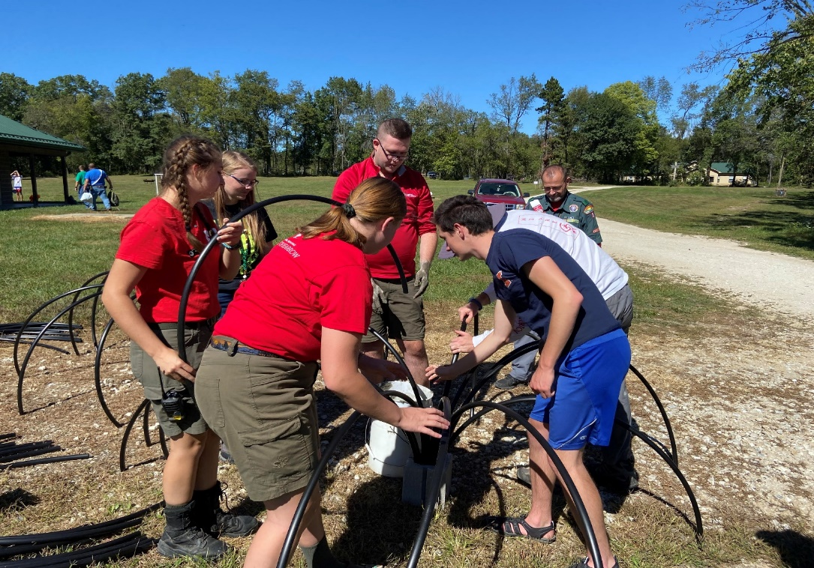
Our Role
Improving the experience of young people by giving back to camp through service

Slide 47
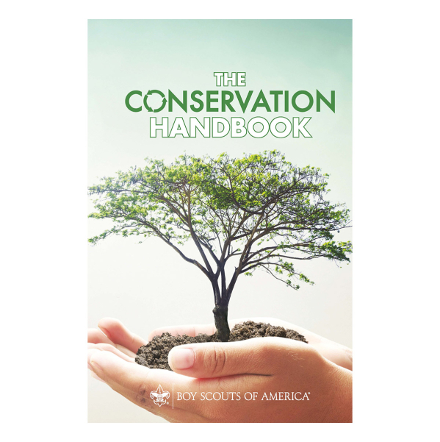
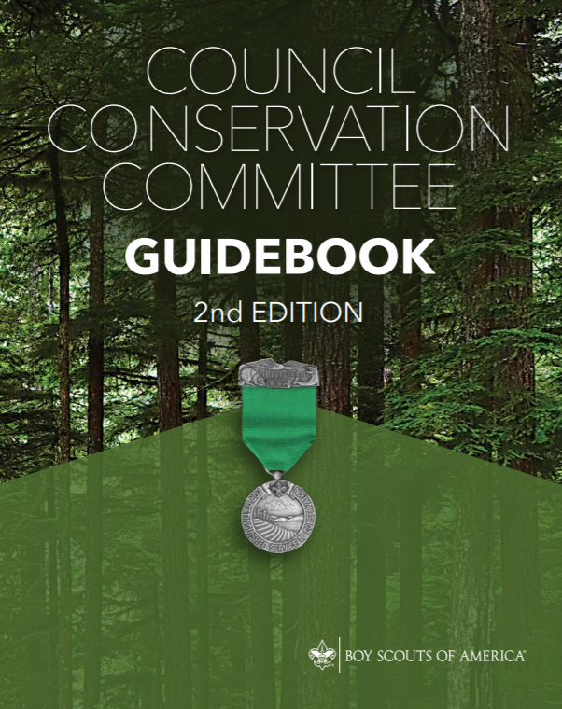
Resources For Success

Slide 48
What Can We Do?
Learn More about Outdoor Ethics!
Train OA Members in Leave No Trace and Tread Lightly
Promote Outdoor Ethics Awareness
Roundtables, camporees, etc.

Slide 49

New Initiative!
Scouting for Clean Waterways!
In celebration of the 70th Anniversary of the Conservation Good Turn for America.
One of Scouting America’s SDGs!

Slide 50

What Can We Do?
Provide Outdoor Ethics Training to Units
Encourage Conservation Projects
Support the Outdoor Ethics and Conservation Programs at Summer Camp and OA High Adventure
What Else?

Slide 51
References and Resources
Publications:
101 Ways to Teach Leave No Trace (www.lnt.org)
Leave No Trace “PEAK Packs” (www.lnt.org)
Leave No Trace in the Outdoors by Jeff Marion (www.lnt.org)
Quotes from various Boys’ Life magazine articles (http://boyslife.org/)
TREAD Lightly video series (www.treadlightly.org)
Sand County Almanac by Aldo Leopold (www.lnt.org)
Soft Paths (www.lnt.org)
Leave No Trace pamphlet Series (www.lnt.org)
TREAD Lightly! pamphlet Series (www.treadlightly.org)
National Parks LNT DVD (www.nps.gov)
OE Guide Handbook (http://www.scouting.org/Home/OutdoorEthicsGuide.aspx)
BSA Distinguished Conservation Service Award Toolbox for Council Conservation Committees (Scouting.org)
Council Conservation Committee Guidebook (2nd Ed)
The Conservation Handbook
Web sites:
LNT.org - The Leave No Trace Center for Outdoor Ethics
treadlightly.org - Tread Lightly!
www.aldoleopold.org - The Aldo Leopold Foundation
http://www.outdoorethics-bsa.org/ - BSA Outdoor Ethics Program
https://www.scouting.org/outdoor-programs/outdoor-ethics -National site for BSA Outdoor Ethics
https://www.scouting.org

Slide 52


Questions?

Slide 53
Thank You!
For more Information, contact:
Marshall Berger
Tschitani Lodge/ Connecticut Rivers Council
Outdoor Ethics East Manager
For more Information, contact:
Ted Weiland
Cho-Gun-Mun-A-Nock Lodge/Hawkeye Area Council
Outdoor Ethics Midway/South Manager

Slide 54

Takeaway Challenge
Develop new ways to integrate Outdoor Ethics & Conservation into Order of the Arrow programs back home!

