Slide 2
Outdoor Ethics and Summer Camp
Michelle Bierstedt
Sioux Council

Slide 3
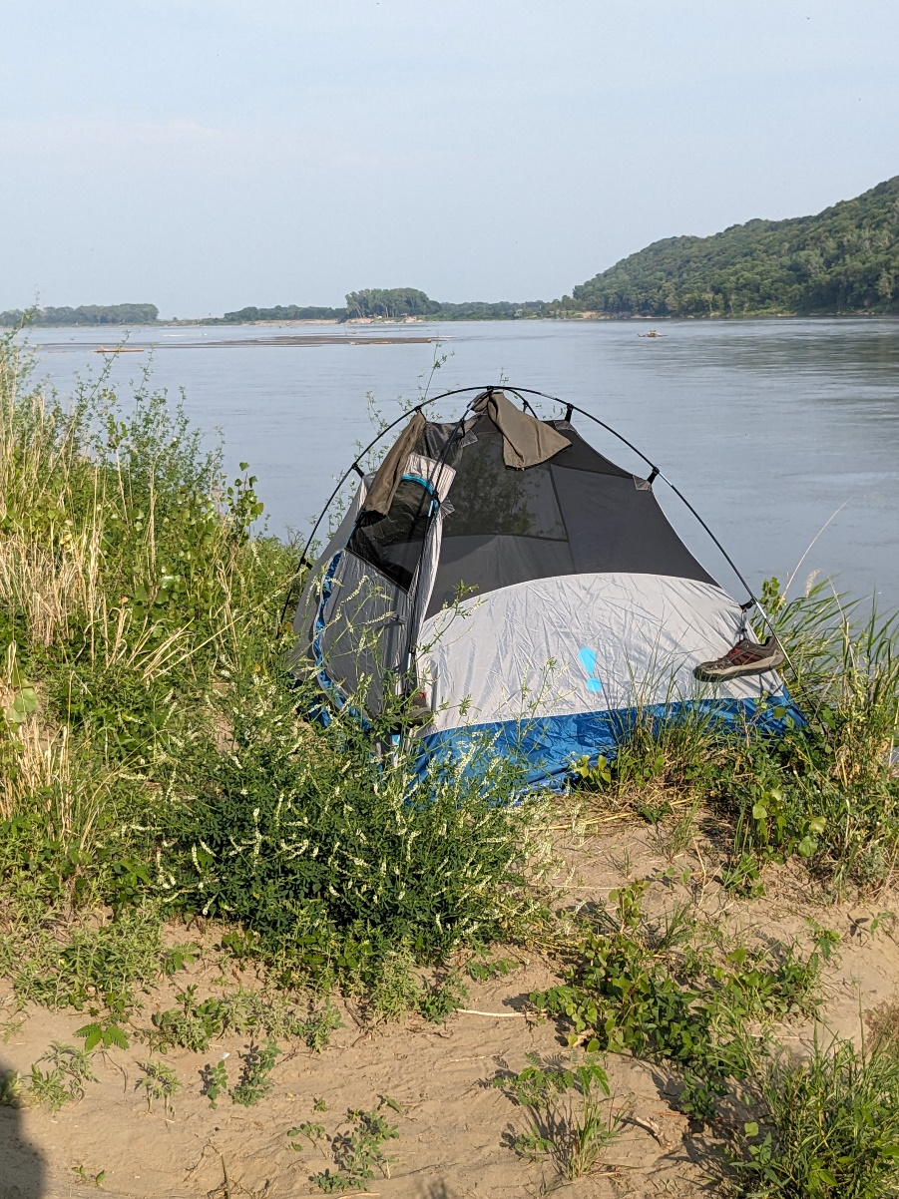
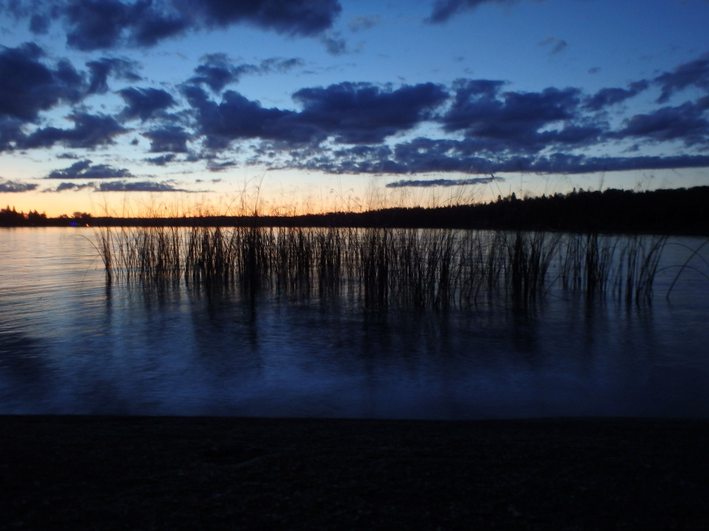
Saturday 11-11:45

Slide 4
Safety Moment: Campout Safety
Camping can be enjoyable in almost any area—from the backcountry to summer camp, as well as national high-adventure bases, to name a few. When you decide on a camping trip, you need to consider who, what, where, when, how, and why.
Documentation Needed—medical records, guidebooks, and permission slips.
Training—Youth Protection training, CPR/first aid, and Hazardous Weather, or specific training, such as Trek Safely or Wilderness First Aid,
Planning—Become familiar with your campsite location and do some research about the weather, licensing/permit requirements, and project or activity guidelines Equipment—vehicles involved or tools necessary for your camping experience. Also consider trailer requirements and first-aid or emergency kits.
Emergency Planning—. Keep a cellphone handy as well as a list of local authorities (fire department, police, hospitals, etc.) in case an emergency occurs. If you are in the backcountry, canyons, or a remote location, coverage may be one to two hours away. A GPS tracking/messaging device is helpful in these locations.
Program-age-appropriate activities, safety equipment, proper supervision, and a discussion on potential hazards.
https://www.scouting.org/health-and-safety/safety-moments/campout-safety-checklist/

Slide 5

Cub Scout to High Adventure
Outdoor Ethics skills learned at camp impact choices beyond camp

Slide 6
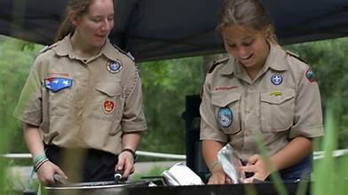
It all begins with the STAFF
Staff Development begins before campers arrive
Leave No Trace Basics
Merit Badge Program
High Adventure Program
Outpost Activities Program

Slide 7

Public Service Announcements
Dining Hall Announcements (daily)
In Campsite
Program Areas
Campfire Skits/Songs
Posters and Banners

Slide 8


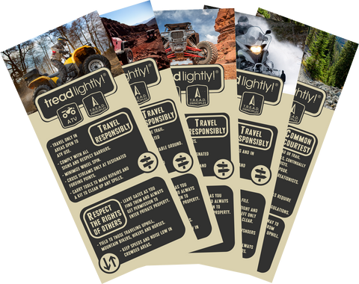
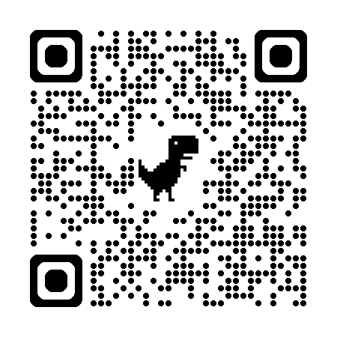
Education
National Symbols Cache, US Forest Service
https://symbols.fs2c.usda.gov/
Leave No Trace Peak Pack Activities
https://treadlightly.myshopify.com/collections/learn

Slide 9
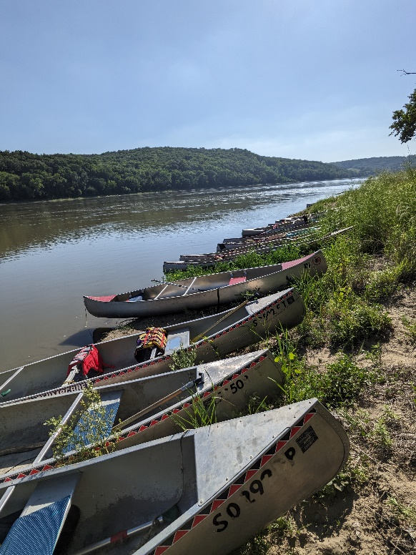
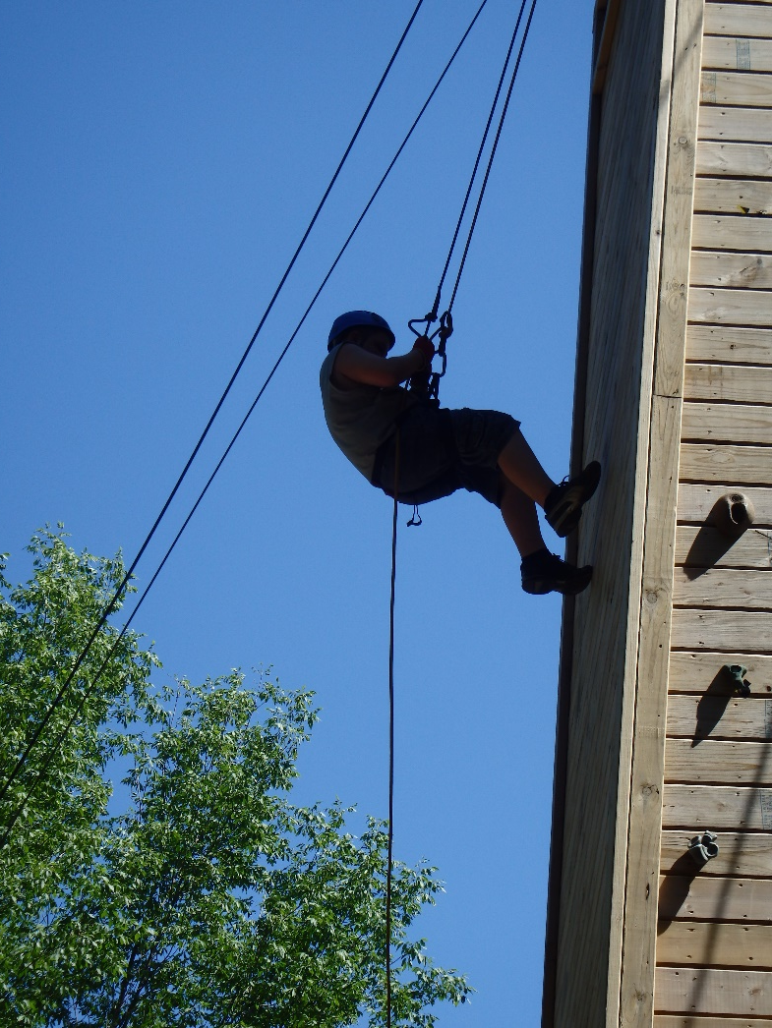
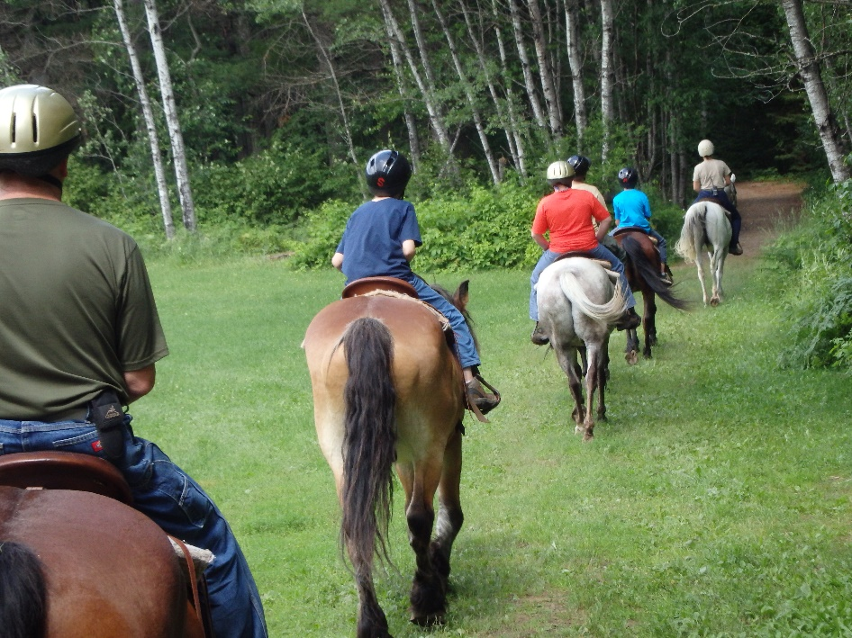
Camp Programs
Long Term Scout Camp
High Adventure Bases
Webelos Camp
Cub Scout Family Camp
Cub Scout Day Camp

Slide 10
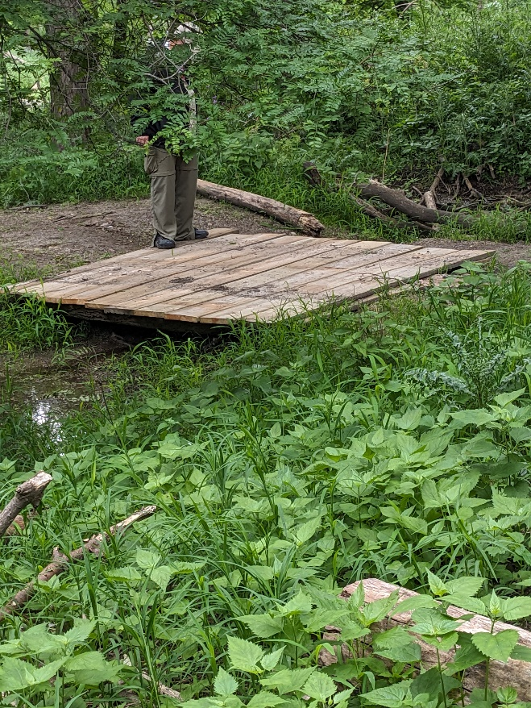
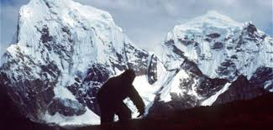
Training and Program on Camp Properties
Offer Basic or Awareness course to adult leaders or as a unit activity throughout the week at Summer Camp
Weekend or Week Long Trainings
Weekend program activity
Camporee with an Outdoor Ethics theme (ZOMBIE APOCALYPSE)
Cub programs with an Outdoor Ethics theme (bigfoot works great)
Conservation Corps – trail crews
Conservation related service –all scouts
Bigfoot Basecamp!

Slide 11
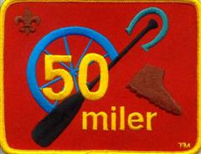
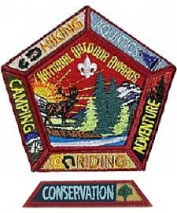


Special Awards
AND, Make Your Own
In Cooperation with the National Park Service

