Slide 2
Creating Good Publicity for Scouting
Through Outdoor Ethics and Conservation

Slide 3
Goals and Objectives
During this session we will explore and discuss:
Where, when, how have we succeeded in the past
What sorts of Conservation/ Outdoor Ethics projects can we use
Partnerships, Beneficiaries, Tie-ins
Where to Publicize
How-To’s Using the media
BSA Guidelines
Useful websites

Slide 4

What has worked in the past
“…when you break camp there are two things you should leave behind you:
Nothing 2. Your thanks…”
Conservation was one of the first Merit Badges
Scout Troops and Councils began an early association with the newly established
National Park Service when it formed

Slide 5
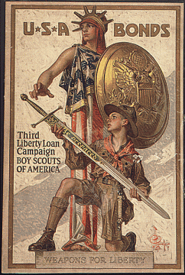
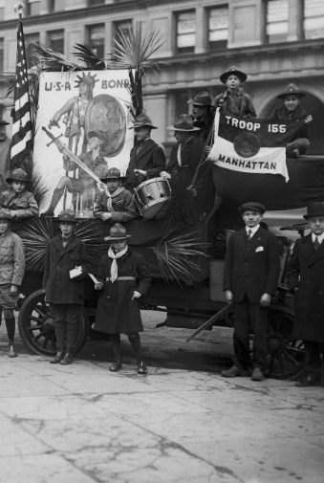
What has worked in the past
During World War 1 Scouts:
— Sold 2,350,977 Liberty Loan bonds, totaling $147,876,902
— Sold war savings stamps, to a value of $53,043,698
— Distributed more than 300 million pieces of
government literature
— Aided in food and fuel conservation projects
— Planted Boy Scout war gardens

Slide 6
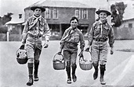
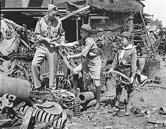
What has worked in the past
During the Second World War Scouts were known for:
— Included 69 specific requests from the government
— Collected 30 million pounds of rubber during a two-week drive
— 20,000 Scouts earned the Gen. Douglas MacArthur Medal for Victory Gardens
— Distributed pledge cards for war bonds and savings stamps
— Distributed stamp posters
— Collected aluminum, wastepaper, and salvage
— Conducted defense housing surveys
— Distributed air-raid posters
— Served as messengers and dispatch bearers
— Assisted emergency medical units
— Served as fire watchers

Slide 7
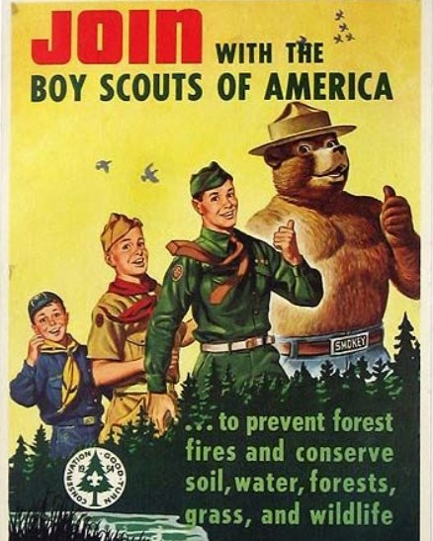


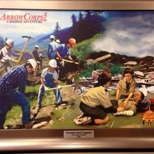
What has worked in the past
In 1954 the Boy Scouts of America established the
Conservation Good Turn Award
In 1971 Project SOAR brought Scouting to America’s attention
In 2008 the BSA conducted ArrowCorps5
º In cooperation with the U.S. Forest Service
º 3,600 Scouts and adult volunteers participated
º $5.6 million worth of improvements made to national parks
BSA High Adventure Bases continue to offer opportunities to publicize
our Conservation efforts to the public

Slide 8
What do we have to provide
Something to publicize!
Conservation Projects
Eagle Projects, DCSA Projects and presentations
Adopt-A-Park
(Trail, Roadway, Stream, etc.)
Stream Monitoring
Award Presentations

Slide 9
Partnerships
We are not the only organization out there,
others may have established relations with the media
Land management agencies
(Federal, State, County Municipal, Private)
Trail organizations
Watershed Associations
Friends of…
Outdoor Organizations
Outdoor Businesses
Piggy-backing on established conservation-oriented events may help with publicity

Slide 10
Who benefits
Planet Earth! The Future!
Scouting America!
The Scouts!
Land Managers
(NPS, USFS, BLM, USFW, etc.
State, County, Local)
Wildlife, Environmental, Nature Centers
Private lands
The Nature Conservancy, etc.
National and Regional NGO’s
Baykeeper/ Riverkeeper
Clean Ocean Action
Invasive Species Week

Slide 11
Tie-Ins
National Trails Day
National Public Lands Day
Earth Day
MLK Day of Service
Invasive Species Week
National Parks Week
Anniversaries/ Birthdays
Major environmental legislation/ notable conservationists
Develop an Environmental Calendar
to coordinate your events

Slide 12
Where Do We Publicize – Media Outlets
Local newspapers (online editions also)
Local public TV/ radio (online also)
Websites
Outdoor Ethics and Conservation
Social media
OE/C Facebook
others
Township newsletters (County newsletters)
and websites
Church bulletins, school/ PTA newsletters
Unit, council newsletters/ websites
Signage
at project site

Slide 13
How to Publicize
What do the Media want?
“positive stories about real people doing good things”
Know what is newsworthy and what is not
It must be new

Slide 14
Who to contact
For most newspaper or local media outlets
Many media start with an Editor-in-chief –
Who might send you to a Managing editor –
Who might send you to a News editor –
Who then sends you to a Features editor or maybe a Photo editor
Webmasters
Newsletters
Personal contacts

Slide 15
Story Angles Media Seek
Efforts that benefit the community and its residents
Creative ideas generated by the youth members
Educational initiatives
Efforts with a human-interest component
Initiatives created by local trends
Strong visuals for photo opportunities
unusual point of view
Scouts in action

Slide 16
The Five W’s and the H
The more you do for them, the more likely they will help you
Who: your “unit “ and any partners / beneficiaries
What: components of initiative and its importance
When: timing of event
Where: all or parts of the community or specific locale
Why: purpose, rational
How: specifics

Slide 17
The Approach
Find out who you want
editor → reporter
Check out reporter’s previous work
Ask for preferred method of contact
phone, email, text
Prepare your press release
the five W’s and the H
Provide talent release
(National, Council, other)

Slide 18
The Follow-up
Be sure to follow-up with your contact
Express your Thanks
Ask when the article will appear
Share your contact information for any follow-up questions
You will want to establish a relationship with your contact
The more you can do for them, the more likely they can help you

Slide 19
Discussion
Tell me what I don’t know

Slide 20
Useful Websites
https://filestore.scouting.org/310-275UnitPRBrochure_v10.pdf
https://filestore.scouting.org/samplecouncilprguidebook.pdf
https://scoutingwire.org/social-media-guidelines/
https://filestore.scouting.org/filestore/marketing/pdf/talent/pdf
https://filestore.scouting.org/filestore/pdf/19-673.pdf
https://www.mayflowerbsa.org/wp-content/uploads/Mayflower-Council-Unit-PR-101.pdf
https://bsacac.org/resources/promoting-scouting/
https://blog.scoutingmagazine.org/2021/07/07/good-news-heres-how-to-get-your-scouts-featured-in-local-media

Slide 21
Prepared by
Tom Temple
September 2024

