Slide 2
Effective Teaching Strategies
Randa Kelton

Slide 3
How do people learn?
Retained Learning
  10% of what they read
  20% of what they hear
  30% of what they see
  50% of what the hear and see simultaneously
  70% of what they say and do simultaneously
Learning preferences

Slide 4
EDGE
Explain, Demonstrate, Guide, Enable
  Hands on skills and knowledge
Critical thinking? Decision making? Judgement?
  Provide opposites, extremes
  Compare and contrast
  Model thought processes

Slide 5
Tactics That Work Well
Establish trust and credibility
Establish positive learning environment
Guide through the information - clear, concise, structured, organized
Differentiate teaching methods
Repetition

Slide 6
Lessons from Interpretation
Self-referencing
Use questions to focus attention on a teachable moment
Foreshadowing
Comparisons and contrived situations
Visual aids

Slide 7
Lessons from the Classroom
Learning objectives guide curriculum design
Tiny Steps and Cycles of…
  Explicit Instruction
  Guided Practice, Repetition
  Mastery
Solid Foundation
Structure, Scaffolding
Evidence, reasoning, back it up

Slide 8
Student Centered
Universal Design
  Things that are good for neurodivergent learners are good for ALL learners.
Provide foundational knowledge and build on it
Give all participants the opportunity to feel confident and smart, to access prior knowledge, and to make connections.

Slide 9
Be Positive
Young people are…
Learners are…

Slide 10
Don’t Be This Guy…
The children now love luxury; they have bad manners, contempt for authority; they show disrespect for elders and love chatter in place of exercise. Children are now tyrants, not the servants of their households.
~Socrates (469–399 B.C. )

Slide 11
Microcycles - Quiet on the Set
Activity → Debrief
Activity→Debrief→Activity→Debrief→Activity→Debrief

Slide 12
Gradual Skill Building
Gradually increase complexity, difficulty
First Cycle
  Introduce activity mechanics and foundational concepts
Second Cycle
  Introduce complexity to mechanics and/or concepts

Slide 13
The Ethics Game
Careful card pairs
Introduce the anthropocentric vs biocentric analysis

Slide 14
Durable Surfaces Choice Game
Inception - learning objectives and teacher needs
Reflect → adjust → reflect → adjust → …
Snow in the late spring
Dry grass in the late fall

Slide 15
Durable Surfaces Choice Game
Provide foundational knowledge vs content question
  Durable Surface - resistant and/or resilient
  Impact
Engage audience in applying the knowledge
  Elicit examples of…
    resistant surfaces, resilient surfaces, impacts

Slide 16
Durable Surfaces Choice Game
Snow in the late spring
Deep winter snow
Early spring grass
Late fall grass
Granite
Lichen covered granite
Mud
Dry dirt
Trail
Tent pad

Slide 17
Durable Surfaces
Intro with the durable surfaces baggies
Develop with card game
End with hopscotch
Penetrometer, 1-Foot Hike

Slide 18
Trash Timeline
Foundational knowledge → add layers
STEM, evidence, cause/effect, compare/contrast
Structure for success on a final task

Slide 19


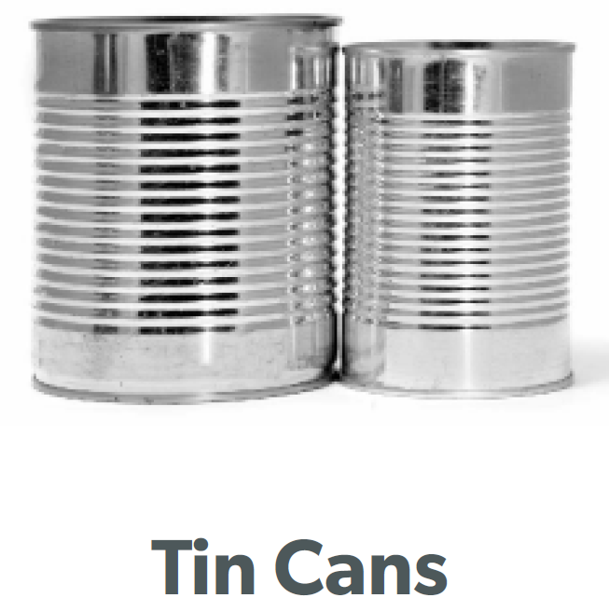
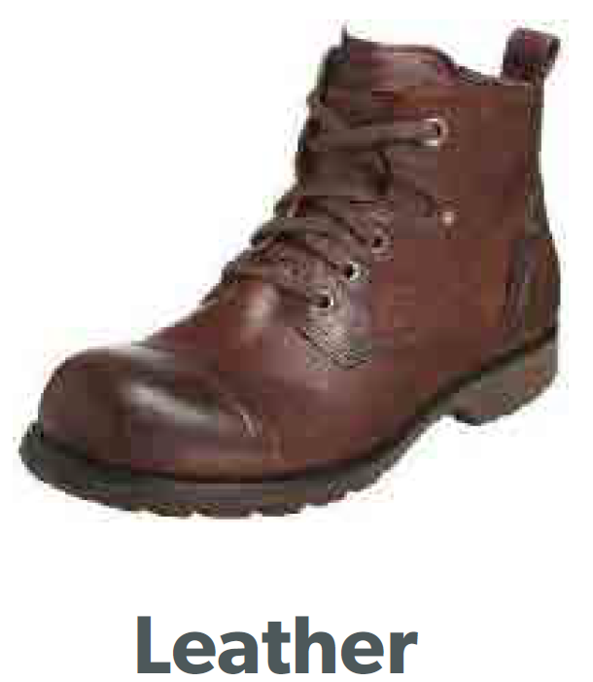
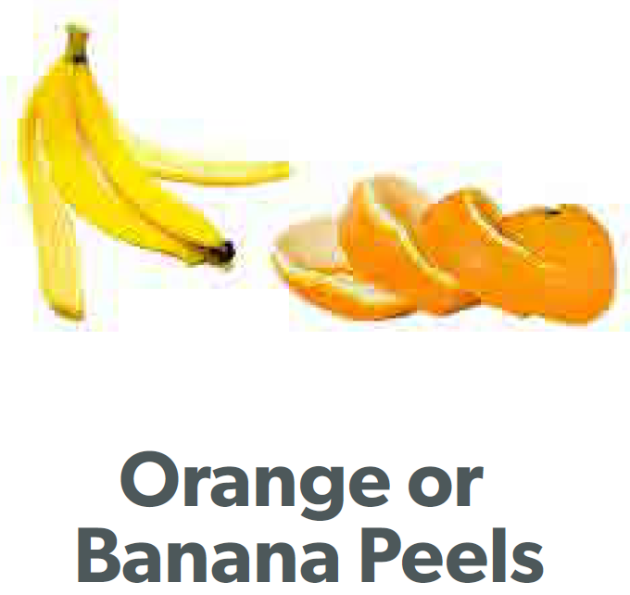


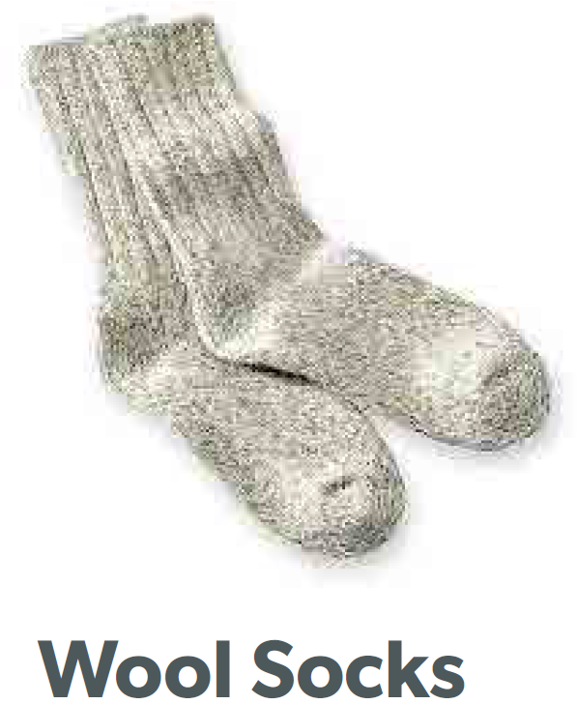
Degrade, Biodegradable, Biological, Synthetic, Mineral, Petroleum, Environmental Factors

Slide 20
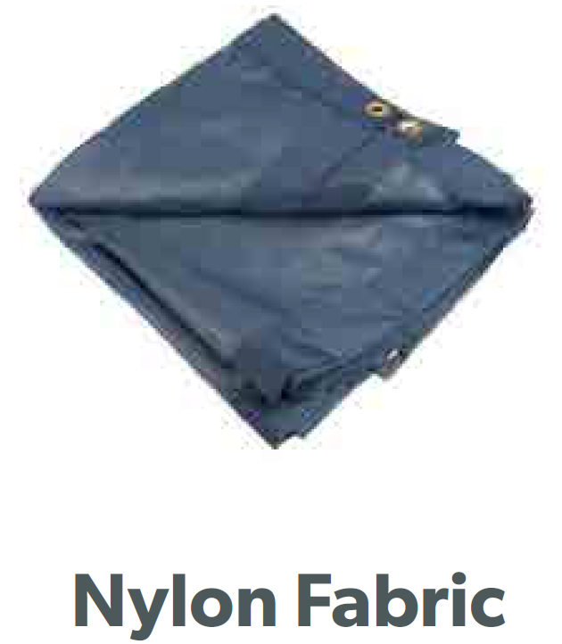



Slide 21
Review
Learning objectives guide curriculum design
Tiny Steps and Cycles of…
  Explicit Instruction
  Guided Practice, Repetition
  Mastery
Solid Foundation
Structure, Scaffolding
Evidence, reasoning, back it up

Slide 22
Thank you!!!

