Slide 2
Michelle Bierstedt
Sioux Council
Making Outdoor Ethics
Exciting and Engaging for Youth

Slide 3
Safety Moment
Attention deficit hyperactivity disorder, or ADHD, is a brain disorder found more commonly in children, but adults can have it as well. It involves difficulty with keeping attention, controlling one’s urges, and in maintaining the ability to act appropriately in response to different situations.
ADHD may include problems involving inattention, hyperactivity, impulsiveness, or any combination of these. Symptoms include:
An inability to give close attention to details.
Making careless mistakes.
Difficulty paying attention during tasks.
Not seeming to listen when spoken to directly.
Difficulty organizing tasks or activities.
Struggling to follow through on complex instructions.
Being easily distracted.
Fidgeting.
Difficulty awaiting one’s turn.
Interrupting or intruding on others.
How to Help
Seat the Scout near a good role model.
Allow extra time to complete work.
Give clear, concise instructions.
Ignore minor inappropriate behavior.
Supervise closely.
Remind Scout to check over their work.
Praise appropriate behavior.
https://www.scouting.org/health-and-safety/safety-moments/attention-deficit-hyperactivity-disorder-adhd/

Slide 4
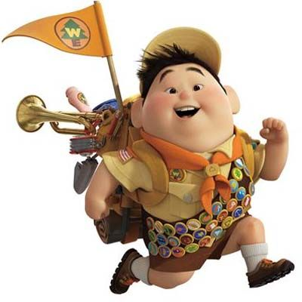
Friday 10-10:45; Saturday 10-10:45
From the beginning…
Fun - Hands On - Relevant

Slide 5
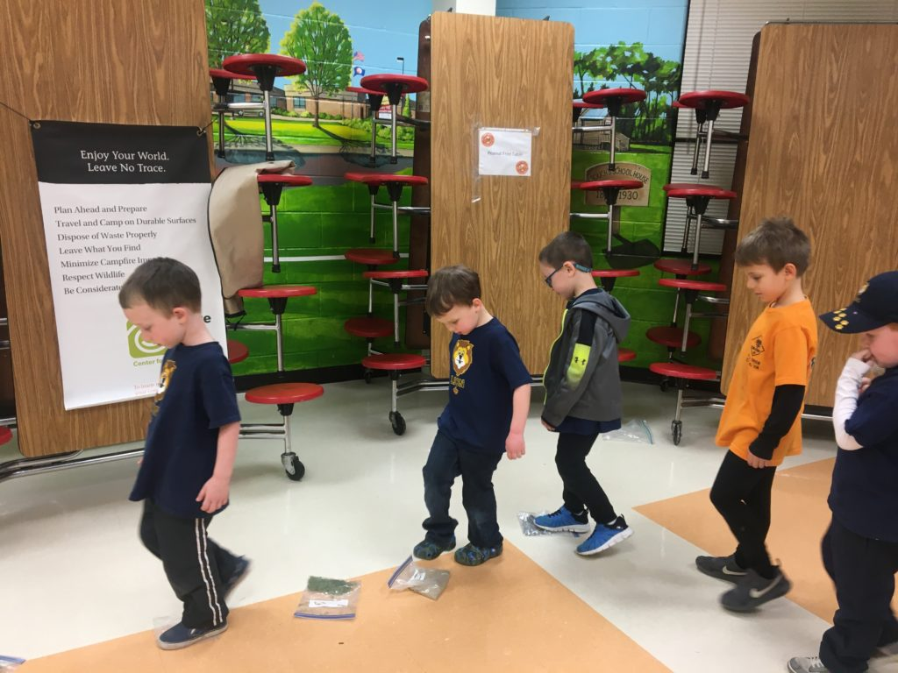
Who
*Cub Scouts
*Webelos
*Young Scouts
*Older Scouts
*Adult Leaders
*Parents
*Community
Durable Surfaces game: Put different surfaces in a Ziploc bag. Then have scouts walk on the bags and decide which surface was most durable ---least durable

Slide 6
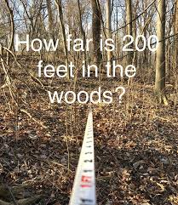
Where
Needed: 200 foot rope, 1 volunteer
Have the group (-1 volunteer) walk out what they think 200 feet is. Then have the volunteer walk out with the 200 foot rope. Optional: The person(s) closest to 200 feet and the volunteer each receive a hang tag or carabiner or other prize.
Wrap up –have everyone start at 0 and pace off how many steps 200 feet is.
Unit Meetings
Cub Camps
Long Term Camps
Weekend Campout
OA Meetings
District Roundtables
Camporee
Community Events

Slide 7
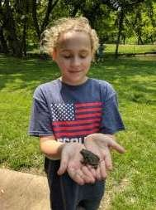
How – In Person
Team Games
Art Project
Competitions
Exploration
Experiment
Skits
Legos
Big Foot Playbook
101 Ways to Teach Leave No Trace
Leave No Trace Peak Pack
Leave No Trace and Lego activities
Project Learning Tree
Project Wild and Project Wet
TREAD Lightly!
Any activity can be modified for your group

Slide 8

-Virtual or Technology
Kahoot.com
Blooket.com
Menti.com
Jeopardy labs
Videos
Virtual Tours
Public Service Announcements

Slide 9
Collaborative Activities
LEGO
Build a campsite that includes a camp stove, tent, and a place to keep food safe from wildlife!
Camp stoves are the perfect way to cook food when camping—they are efficient, easy to clean, and minimize campfire impacts. It’s important to store food in a safe place so that wildlife are not attracted to your campsite. Your tent is NOT a good place to store food or other smellables!

Slide 10
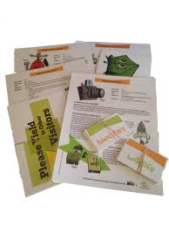

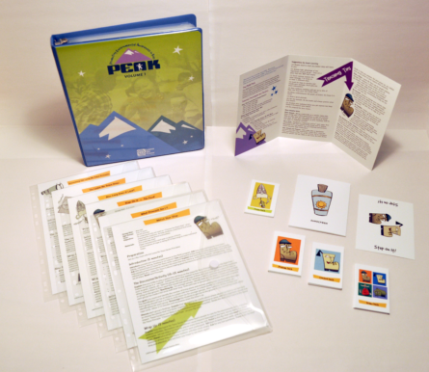

Leave No Trace
Peak Pack

Slide 11
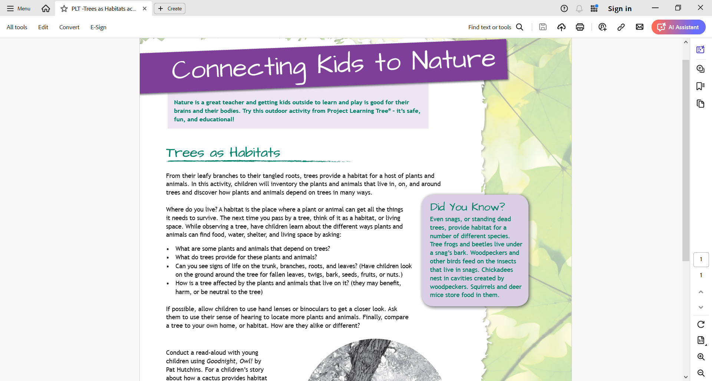
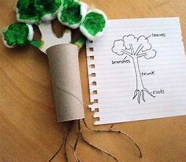
Project Learning Tree
https://www.plt.org/

Slide 12
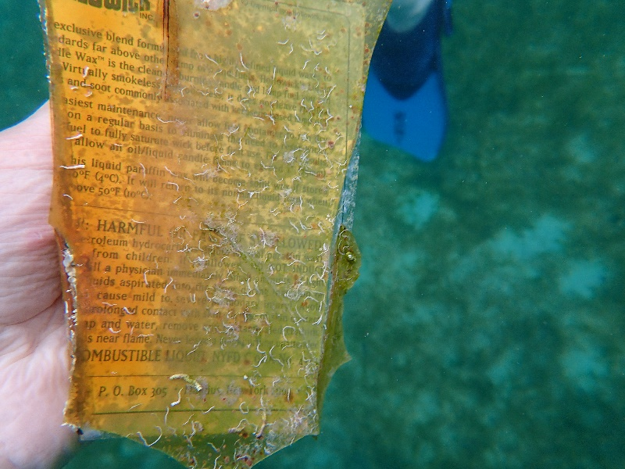
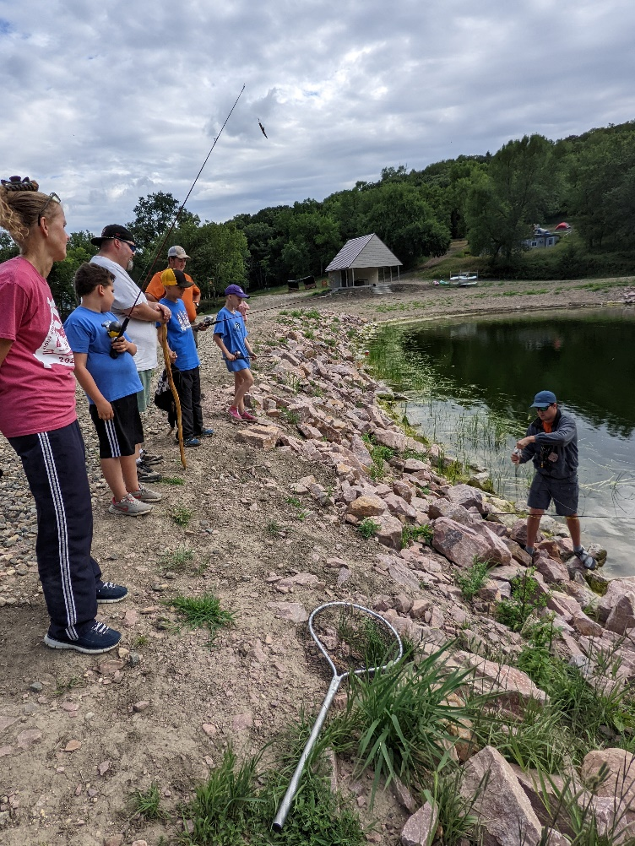

Using Edge
Experienced scouts
Outdoor Ethics Guide
Eagle Scouts
Camp Staff
Cleaning trash from the sea floor
Fishing ethics

Slide 13
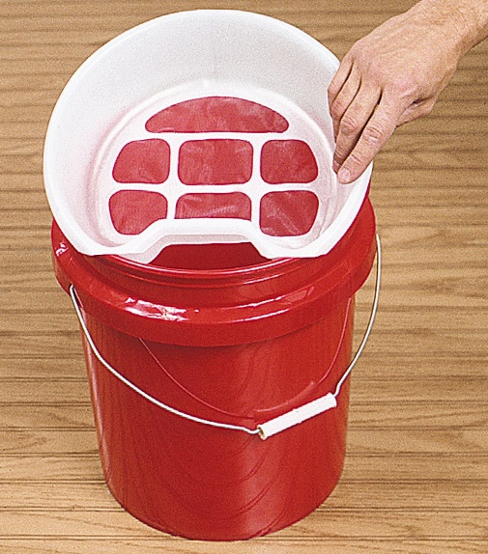
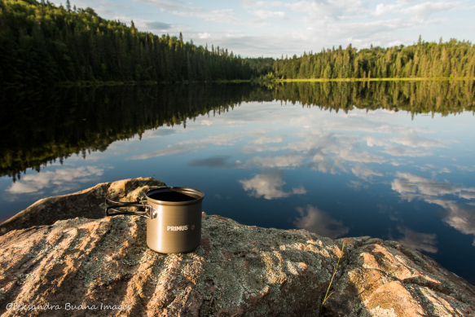
Solve a Problem
Social Media
How much waste
*Does your unit strain the wash buckets before broadcast spreading?
*On a campout, see how much waste your patrol makes. Strain the wash buckets to remove all food particles.
*Sustainability Merit Badge
Creative arts exercise - have participants
work in small groups to create a social
media campaign that educates users
about the potential negative impacts to
the outdoors, as well as the ways to be
proactive and responsible when sharing
content about the outdoors.

Slide 14
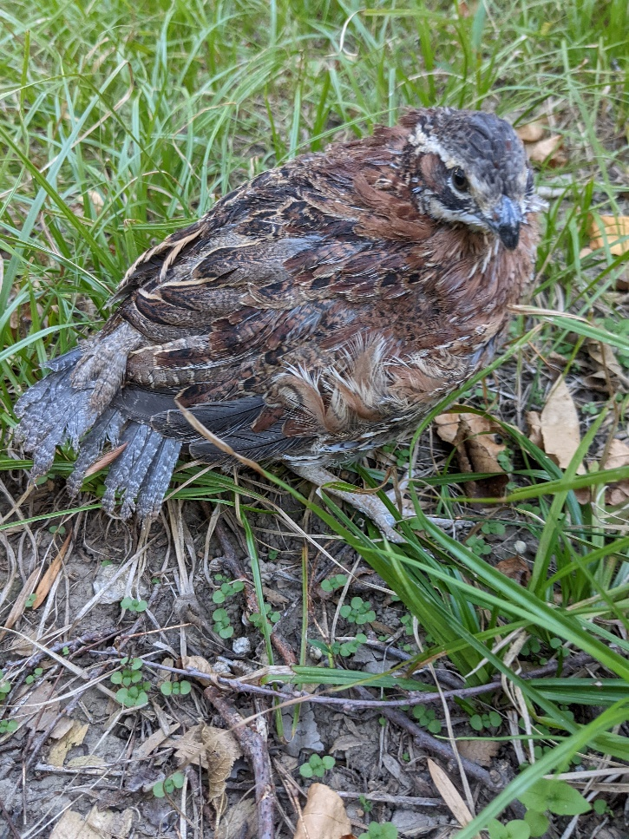
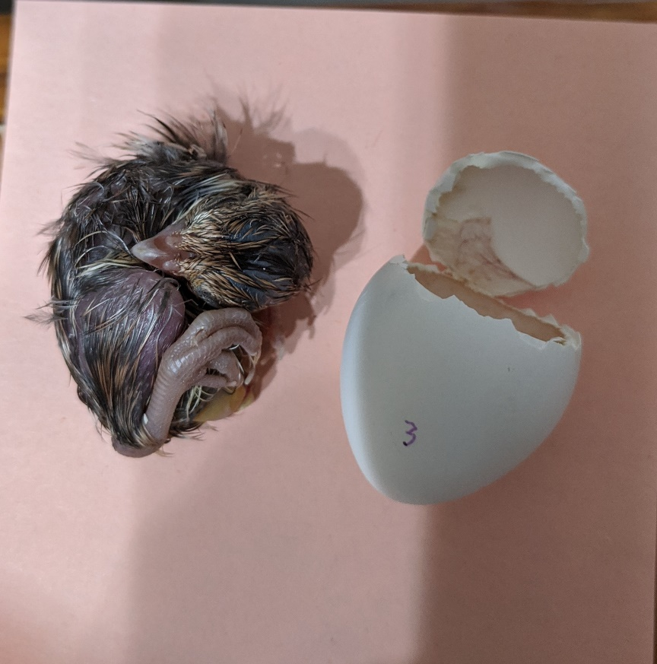
Encourage Interests
DCSA project
Quail reintroduction

