Slide 1

Council Outdoor Ethics Advocate Training
REPORTING
Mark Hammer
Paula Boothe
Michelle Bierstedt
John Gonering

Slide 2
Welcome
  Safety Moment
  Introduction
  Questions

Slide 3
COEA Job Description Highlights
Recruit
Train
Program Promotion
Outdoor Ethics Committee or Team
Reporting

Slide 4
Course Objectives
Understand when to report activities
Understand how reporting helps both Council and National Outdoor Ethics and Conservation

Slide 5
Why Reporting
Scouting America uses the various methods reporting to provide a measure of how well the they are accomplishing their mission
  Formerly Journey to Excelence
  Units, districts, councils and national
OEC uses the OEA reporting similarly
  COEA can see how their council is doing
    Provides feedback on their plan
  Team leads can see how their Council Service Territory is doing
  Division Managers can see how their division is doing

Slide 6
Reporting
  The COEA is responsible for collecting information about Outdoor Ethics programs conducted in the local council and Reporting to the National Outdoor Ethics Committee annually.
  The COEA also reports progress to the Outdoor Ethics and Conservation Team Lead as specified.
  The COEA oversees the proper reporting of training courses within the local council and keeps a data base of OE educators who become part of the Outdoor Ethics Committee or Team.
  The COEA also ensures that the listing of Leave No Trace Level 2 Instructors and Master Tread Trainers (outdoorethics-BSA.org/contacts) is up to date.

Slide 7
OEA Toolbox Overview
For Council and Area Outdoor Ethics Advocates
OutdoorEthics‐BSA.org website / database
COEA Opt‐In for Event Reporting, Registration
OutdoorEthics‐BSA.org/OEAtools

Slide 8
OEA Tools ‐ Functions
Council OEC Advocates:
  Contact info for your MEs and MTTs
                Verify/Remove
  Link to your Annual Report(s)
  Event Reporting
  Event Registration
OEC Team Leads:
  Contact info for your COEAs, MEs and MTTs.
  Links to Annual Reporting status overview and details for your Councils.

Slide 9
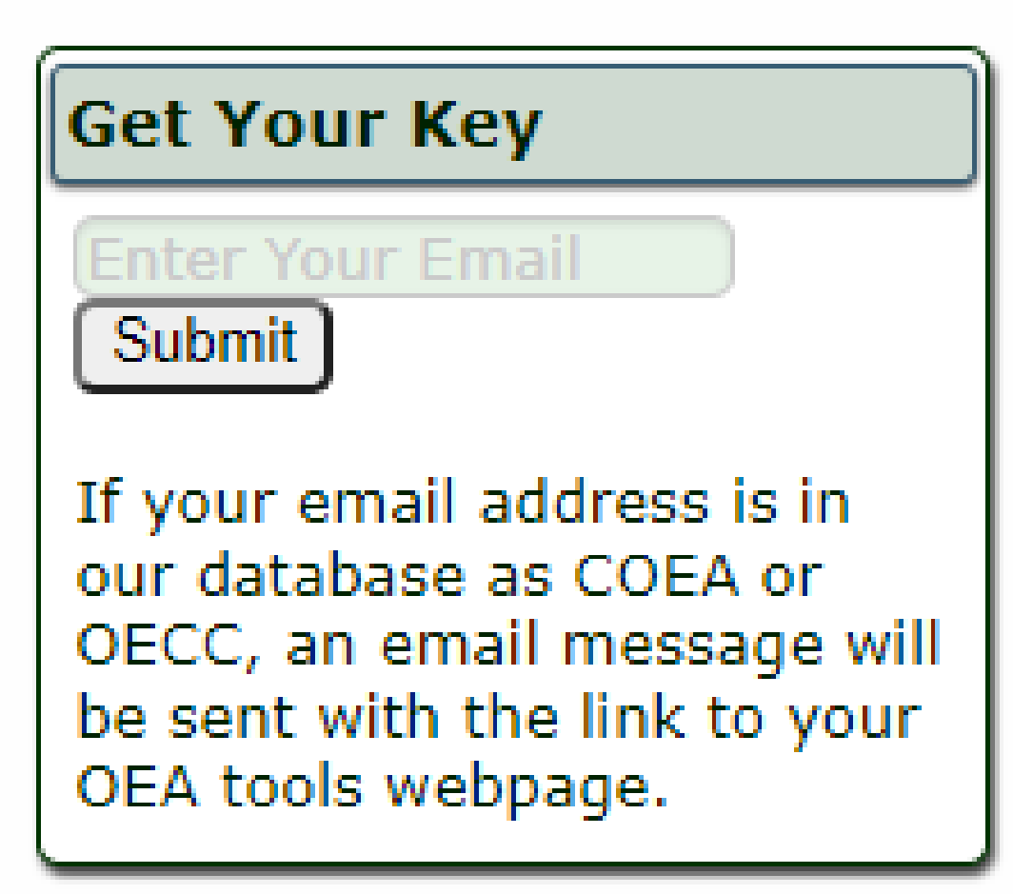
OEA Tools - Access
OutdoorEthics-BSA.org/OEAtools
Get your Key
  Use the form to request your key
  An email will be sent with the link.
  (Bookmark the page)

Slide 10
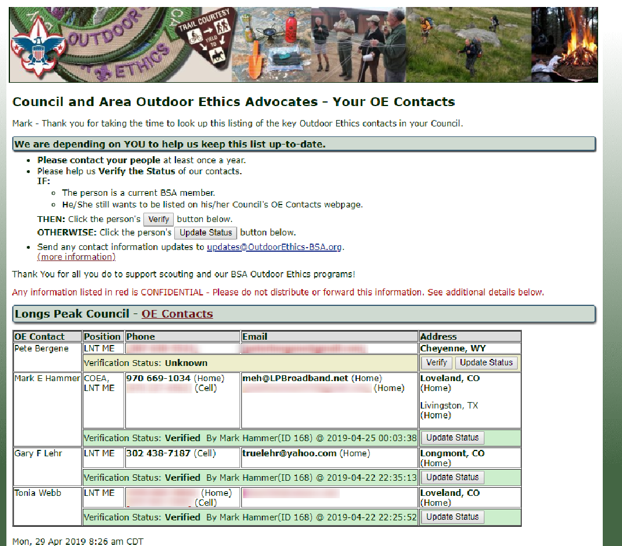
Your OE Contacts
Contact info for your Level 2 Instructors, MTTs
Maintain Confidentiality!
  Includes non-public emails, phones.
  (blurred for slide)

Slide 11
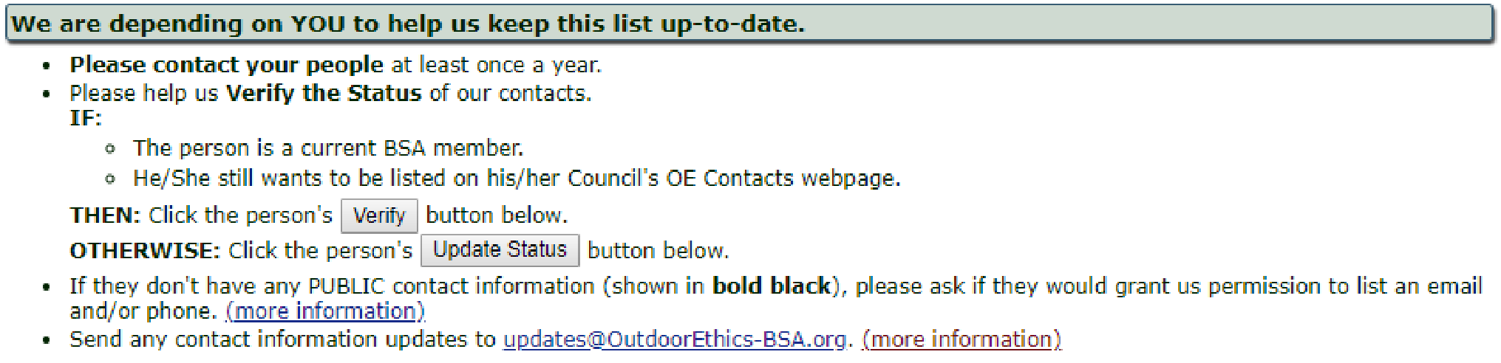
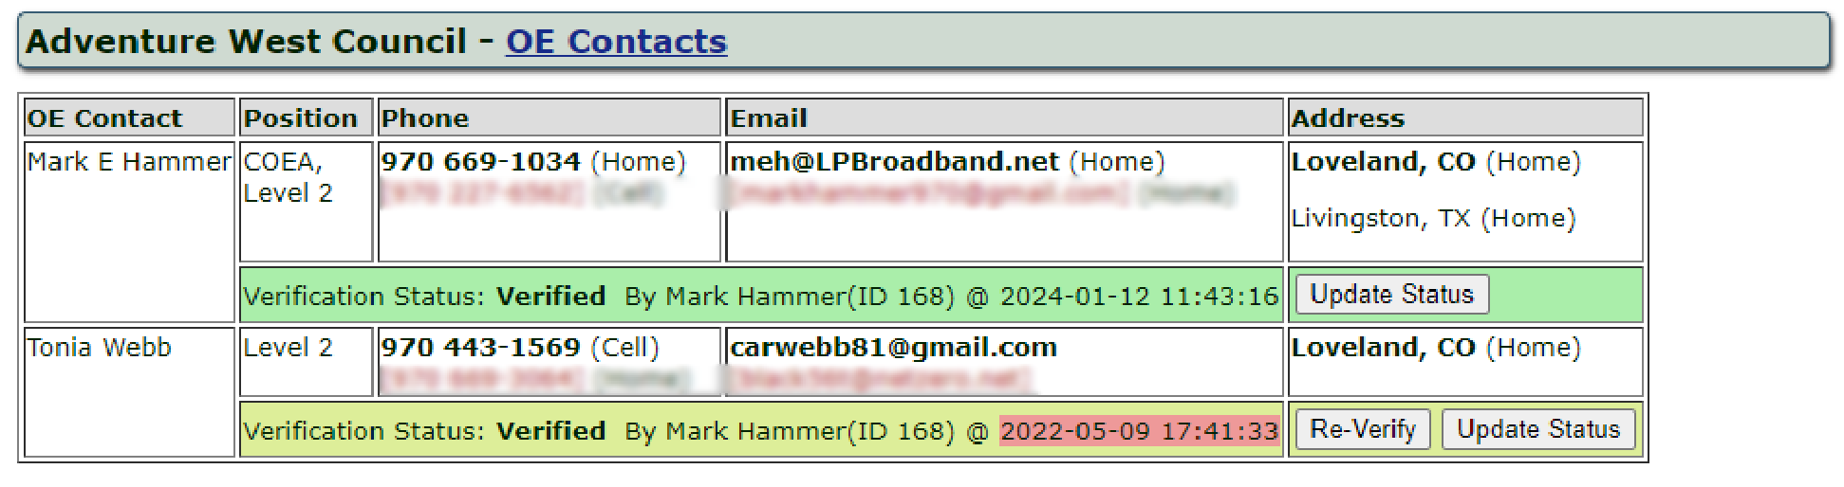
Verify Contact Status

Slide 12
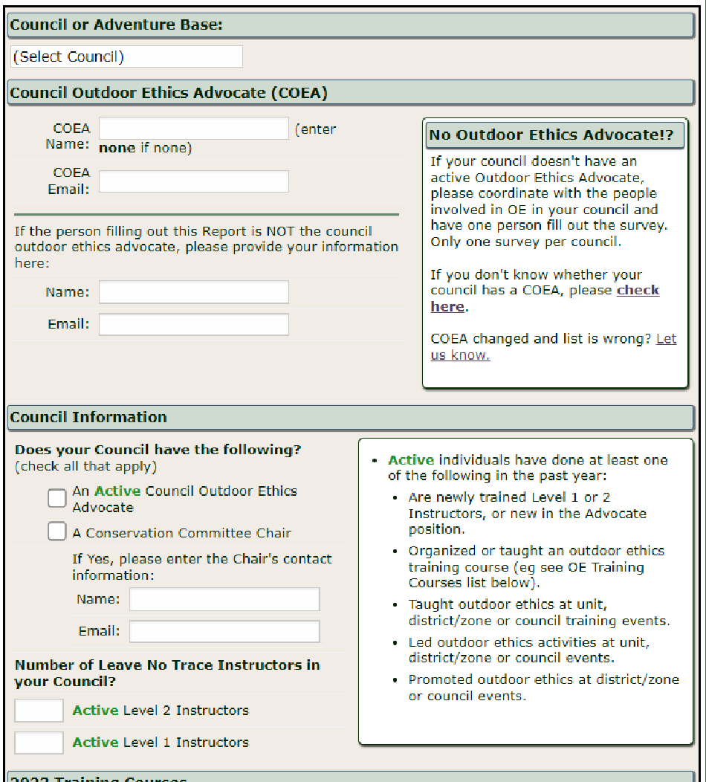
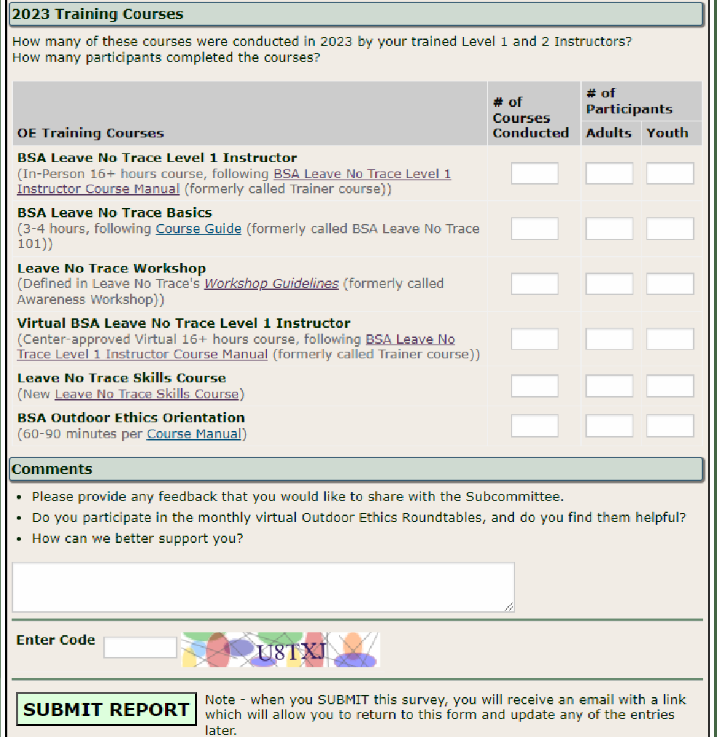
Annual Survey

Slide 13
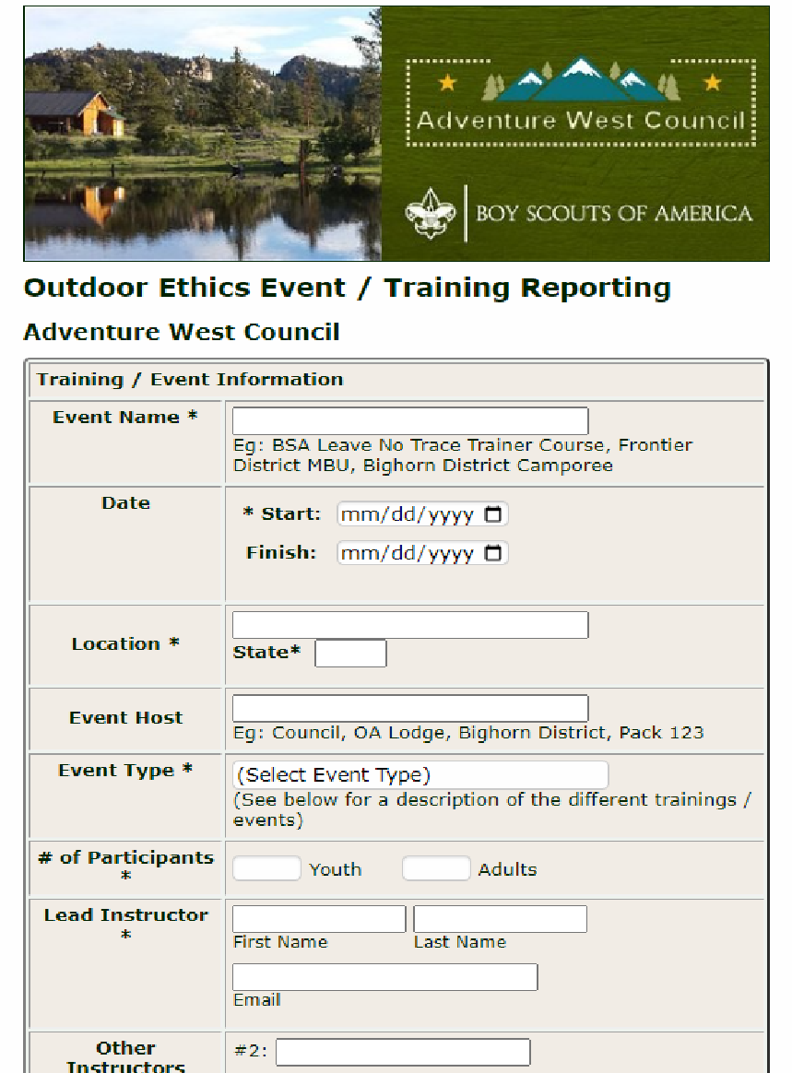
COEA Tools
Event Reporting
Waiting until the end of the year to gather “all that data” for your Annual Survey is challenging –
Have your Instructors report their events using your online form.
Collect data all year.

Slide 14
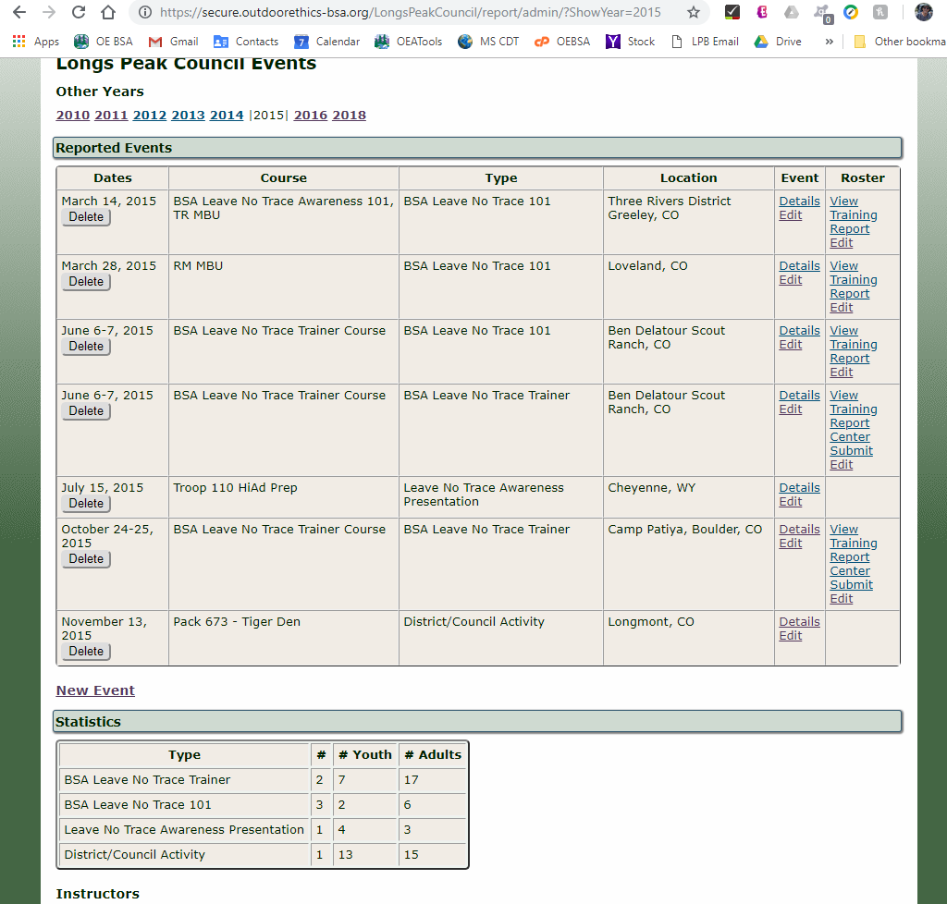
COEA - Event Summary
Reported Events, by Year
Summary for your Annual Survey
Link to create Training Attendance Reports
Link to pre-fill Level 1 Instructor course roster submission to Leave No Trace.
  (TBD – Workshop/Skills Reporting)

Slide 15
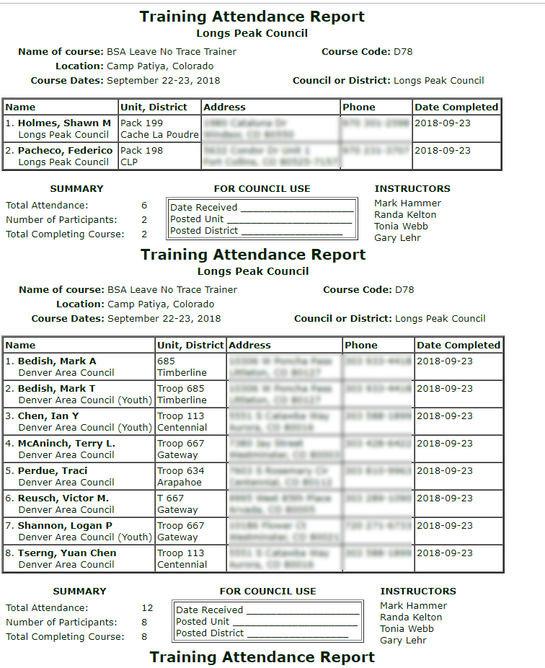
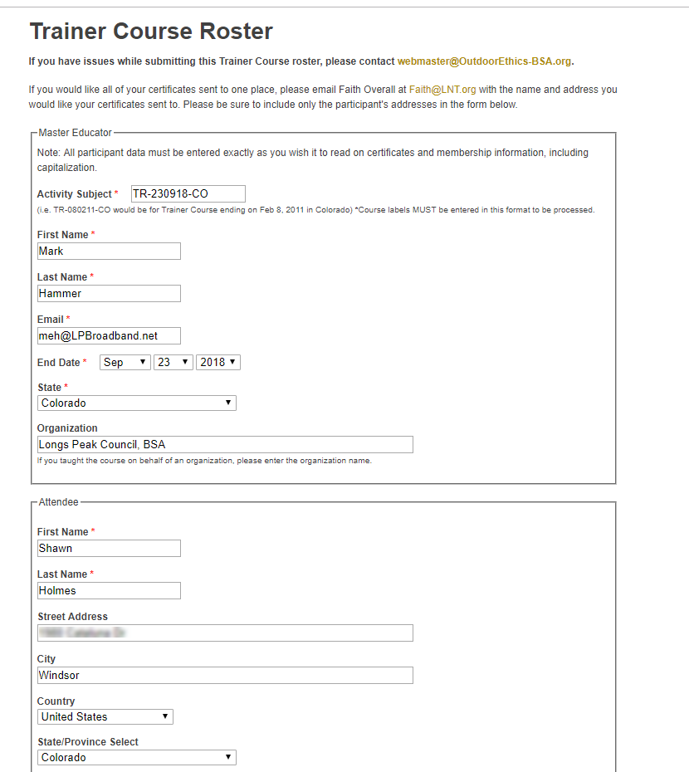
Event Reporting - Reports

Slide 16
Event Reporting Request
Event Reporting is optional and must be requested by COEA if you would like to use this tool for your council.
Contact:
  Mark Hammer
  webmaster@OutdoorEthics-BSA.org

Slide 17
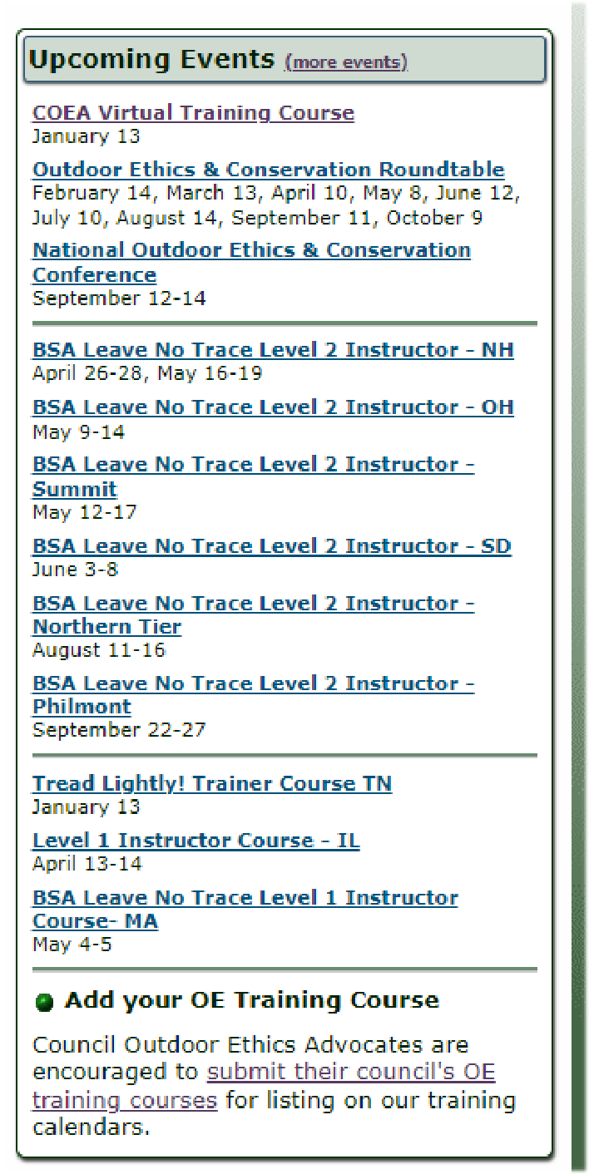


Your Courses on
BSA-OEC Calendar
scouting.org/outdoor-programs/outdoor-ethics/
( OutdoorEthics-BSA.org/calendar )
( OutdoorEthics-BSA.org/calendar/submitcourses.php )

Slide 18
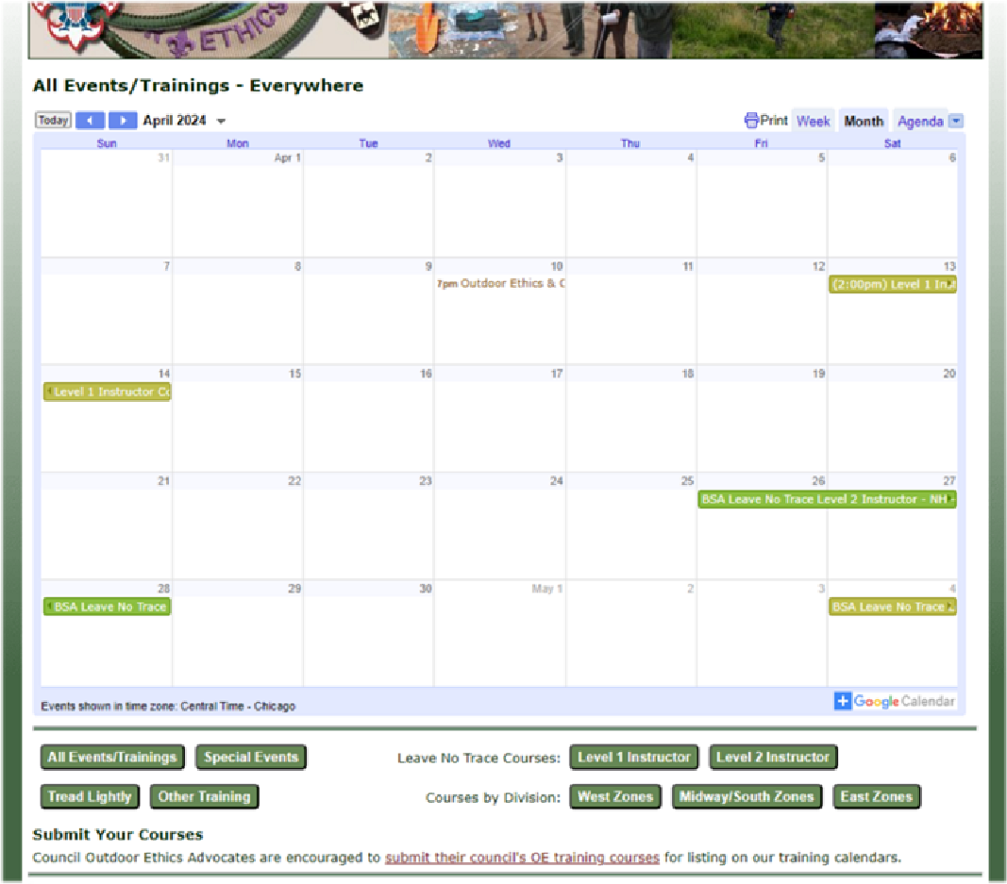
Your Courses on
BSA-OEC Calendar

Slide 19
Your Courses on
BSA-OEC Calendar Council
OutdoorEthics-BSA.org/calendar/submitcourses.php
Level 1 & 2 Instructor, TT/MTT, Zone/Region events
Check your course info, flyers, …
  (Current Terminology! / Brand Standards - next topic)
Email course info to your Division contact:
  East Division: eastcourses@outdoorethics-bsa.org
  Midway/South: midwaysouthcourses@outdoorethics-bsa.org
  West Division: westcourses@outdoorethics-bsa.org
Division Manger (+webmaster) will review, request updates if necessary, then post on Calendar

Slide 20

Course and Event Promotion
Training Promotion Guidelines
Leave No Trace’s Brand Standards Guide

Slide 21

Course and Event Promotion
Logos Page

Slide 22
COEA Tools
Tools are to Support YOU
Let us know if you have any issues, comments or suggestions.
Annual Survey:
  OutdoorEthics-BSA.org/AnnualSurvey/
OutdoorEthics-BSA.org/OEAtools
  OutdoorEthics-BSA.org/OEAtools/eventReporting.php

