Slide 1

Council Outdoor Ethics Advocate Training PROGRAM PROMOTION Michelle Bierstedt Paula Boothe John Gonering

Slide 2
Welcome
Safety Moment
Introduction
Questions

Slide 3
COEA Job Description Highlights
Recruit
Train
Program Promotion
Outdoor Ethics Committee or Team
Reporting

Slide 4
Course Objectives
Understand how effective program promotion impacts Outdoor Ethics activities
Understand opportunities for promoting OE activities
Understand how outdoor ethics programs support Cub Scouts, Scouts BSA, Venturing and Sea Scouts Advancement and Awards(unit)

Slide 6
Program Promotion
What Outdoor Ethics Training are you doing in your Council
Council Inventory Checklist
PSA Video
Tread Lightly! Keeps Your Access Open – YouTube
PLT Uses Forests to Teach All Kinds of Subjects – YouTube
Leave No Trace 7 Principles

Slide 7

Program Promotion
Rank Advancement contains OE opportunities
Awareness and Action Awards:
Available for scouts and scouters
Note: The Outdoor Ethics Awareness and Action Awards for Cub Scouts and leaders were retired in June 2016
Cub Scouts:
Project Learning Tree Correlations: https://www.plt.org/wp-content/uploads/pdf/PLT_CubScouts_PreK-8_2021.pdf
Leave No Trace Big Foot Playbook & online resources https://lnt.org/wp-content/uploads/2018/09/BFPB-Activity-Materials-Packet.pdf
2024-25 Cub Scout Program Changes: https://www.scouting.org/program-updates/cub-scout-program-updates-announced/

Slide 8
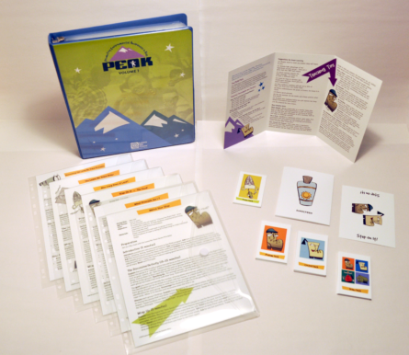
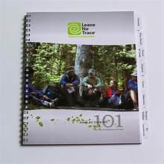

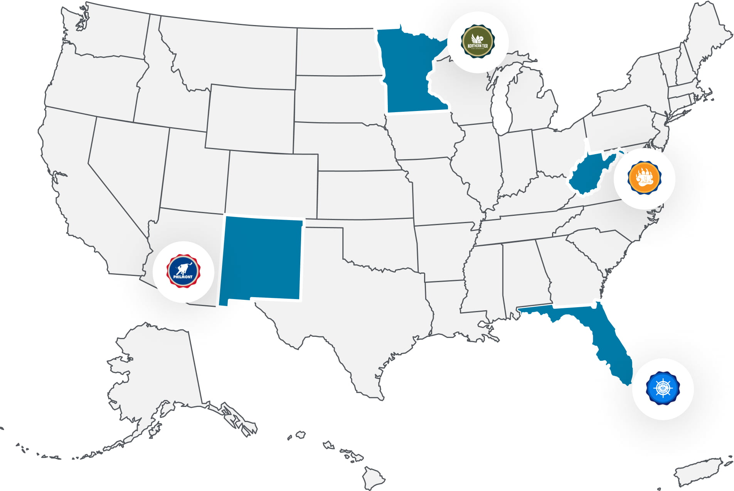
Program Promotion cont
Scouts BSA
Merit Badges: https://drive.google.com/file/d/0B6u13ZvNnll7dDJTekdLSFhPbzg/edit?resourcekey=0-fwf9RhFDICUwxIFl6XDcxQ
Special Awards
Distinguished Conservation Service Award (DCSA)
Training: Leave No Trace Skills Course (16 hours); Outdoor Ethics Guide
Resources: Leave No Trace Peak Pack; 101 Ways to Teach Leave No Trace
Leave No Trace Continuum from City to Backcountry camping
https://drive.google.com/file/d/0B6u13ZvNnll7cGhYdG9feUhOenc/edit?resourcekey=0-i0rMxiCtdPWthaewUNk86w
High Adventure Bases
Northern Tier
Philmont
Summit-Bechtel Reserve
Florida Sea Base

Slide 9
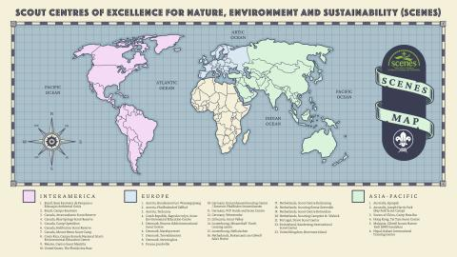
https://www.scout.org/SCENES

Slide 10
Program Promotion
What have you tried in your promotions?
Good results
Not so good results
Promotion Opportunities
University of Scouting
Council Calendar
OutdoorEthics-BSA.org
LNT.org
Wood Badge
Newsletter/Blog/Social Media
Monthly Outdoor Ethics Roundtable (courses)
Roundtables
Day Camps/Camporees/Jamborees/Summer Camp

Slide 11

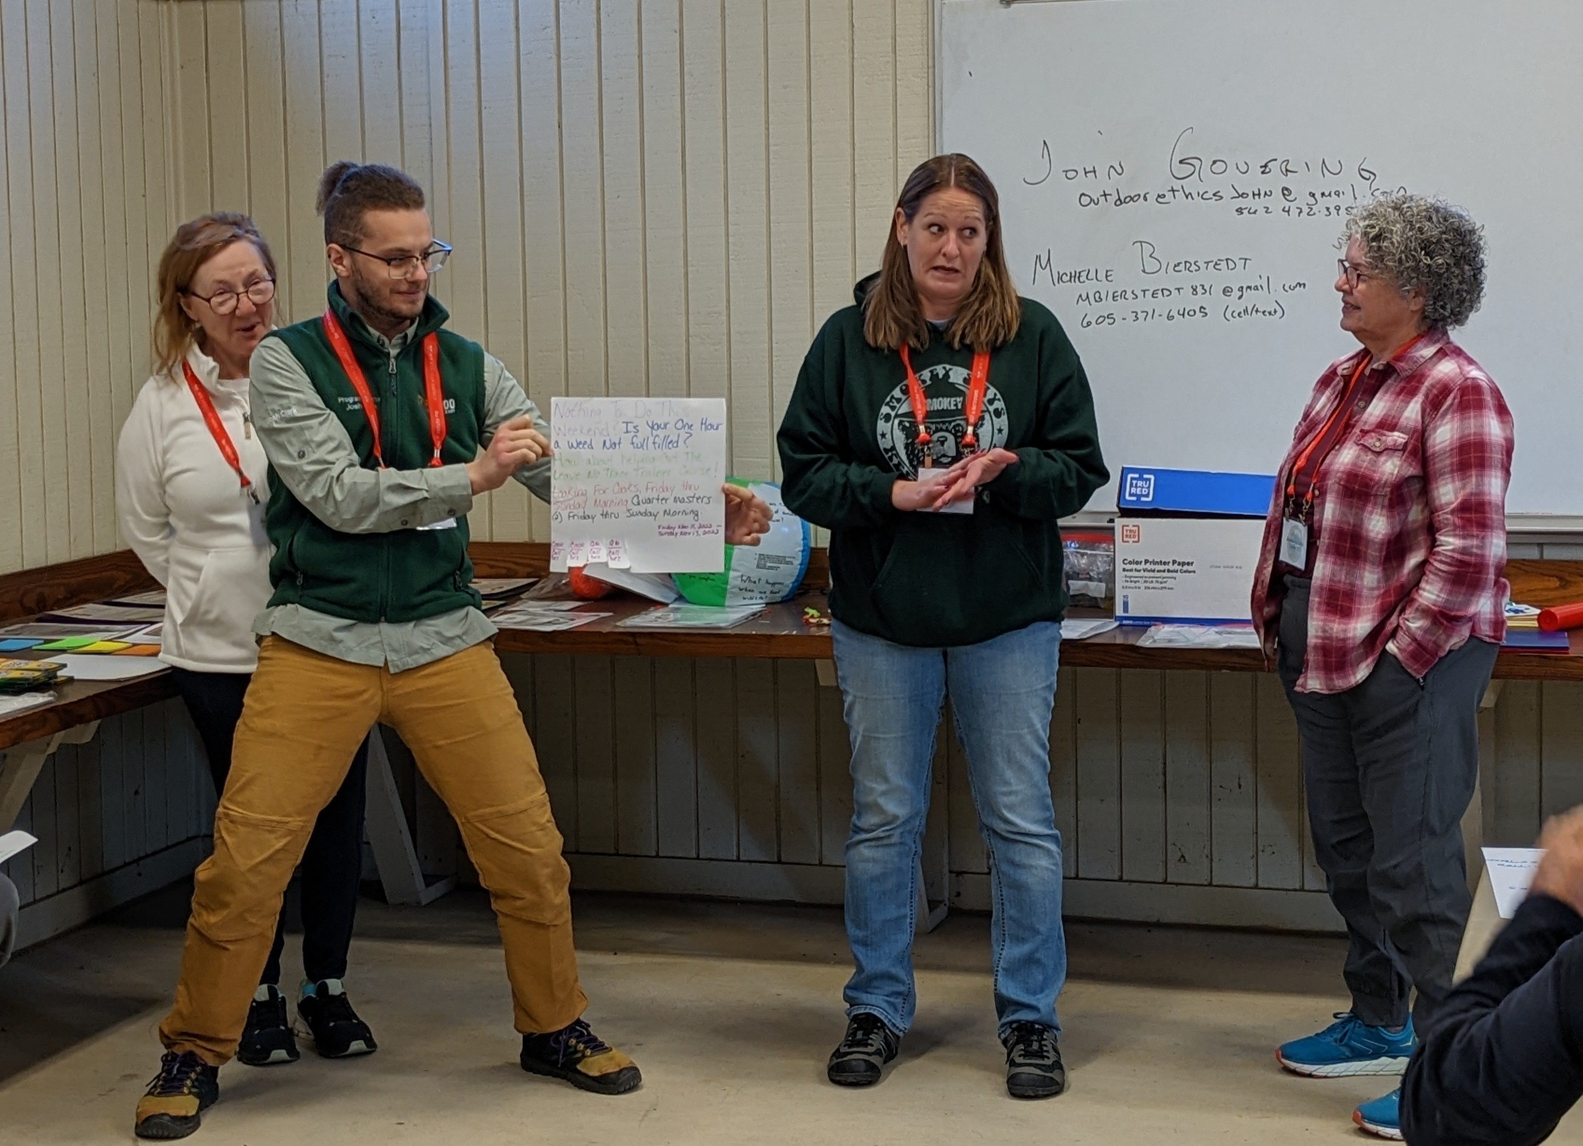
Examples
Games, Videos, Virtual
Adult Audiences
Add a game or video to your presentation to engage the audience in the topic
IOLS/Baloo; Level 1 and 2 Instructors; OE Guide Advisors; Distinguished Conservation Service Award Advisors; Woodbadge; OA Advisors; Conservation Committee; Roundtables.
Don’t be afraid to get adults to join in

Slide 12
Promotion Guidelines
Training Promotion Guidelines (outdoorethics-bsa.org)
http://outdoorethics-bsa.org/training/MistakesToAvoid.php
Check frequently to get the latest updates.
NEW - Don't use BSA Leave No Trace 101 Course
Our BSA Leave No Trace 101 course has been renamed BSA Leave No Trace Basics to avoid confusion with Leave No Trace's new online Leave No Trace 101 Course. Our course content has not changed.
(The older term may still be appropriate in historical references.)
NEW - Don't use Leave No Trace Trainer or Master Educator
These are now called Level 1 Instructor and Level 2 Instructor
(The older term may still be appropriate in historical references.)
NEW - Don't Recommend Level 1 Instructor courses for OE Guides
Leave No Trace's Minimum age for Level 1 Instructor courses is now 18.
NEW - Don't use Leave No Trace Awareness Workshop
This is now called just Leave No Trace Workshop, and there are new guidelines for the content.

Slide 13
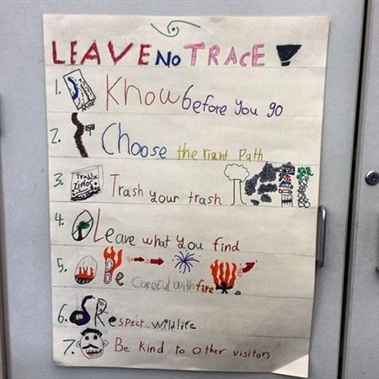
Breakout
Plan a promotion for:
Leave No Trace Skills Course or
Training at Summer Camp
The Council Camping committee has approached you about incorporating Leave No Trace into the summer camp program. While out on a walk-through, the committee noticed several areas that are of concern. Your task is to come up with a training or activity that will make scouting units more aware of the property and reduce their impacts.
Committee Notes
*On the wildlife cameras we spotted deer, turkey, raccoon, and black bear
*Some of the picnic tables have deep gouges and gnaw marks in them
*Toilet paper was caught in the hedges near 2 campsites
*Many trees near the campsites have gnaw marks near the base of the tree
*Cans and plastic containers are mixed in with the ash in campfire rings
*One of the campsites had a collection of deer skulls on the picnic table
*Down by the beach, a scout unit tagged one of the big rocks with the year and their names
*There were several Wilderness Survival shelters left up from last summer in the activity field.

Slide 14
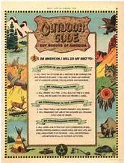






Wrap Up
Questions

