Slide 1

Council Outdoor Ethics Advocate Training INTRODUCTION Michelle Bierstedt John Gonering Paula Boothe

Slide 2
Welcome
Safety Moment
Introduction
Questions

Slide 3
Course Objectives
Understand what the Outdoor Ethics Program is, why needed and benefits of implementing
Understand the role of the Outdoor Ethics Advocate(COEA)
Understand how outdoor ethics programs support Cub Scouts, Scouts BSA and Venturing Advancement and Awards(unit)
Develop an understanding of how to use Outdoor Ethics(OE) as a springboard to a comprehensive outdoor program in the local council (District)

Slide 4
Course Objectives (cont)
Development of an Outdoor Ethics Committee, suggested characteristics and effective use of a Council Outdoor Ethics Advocate (council)
Understand how national, council service territory and local council committee structures support Outdoor Ethics program

Slide 5
Outdoor Ethics and Conservation Mission
Encourage, advise, and support our councils’ inclusion of outdoor ethics and conservation in Scouting programs and council property management.
Be the subject matter experts (SMEs) on all policies and procedures regarding the programs we offer.
Provide direct support to councils and, by extension, units and membership through our Council Outdoor Ethics Advocates (COEAs) and Council Conservation Committee Chairs.

Slide 6
Where Do You Fit In
Chair, Outdoor Ethics and Conservation
Professional Advisor
Professional Advisory Panel
Program Operations
Outdoor Ethics
Conservation
Special project work groups
Emeritus Members at Large
Division Managers
Northeast
Midway/South
West
Program Manager
Communication and Information Resources
Social Media
National Exhibits
Roundtables
Conferences
Curriculum
Lead Instructor Development
Outdoor Ethics Awards and Recognition
Land Management and Program Assets
Conservation Awards and Recognition
Troop OE Guide
Scouts for SDGs
OE & C in Sea Scouting

Slide 7
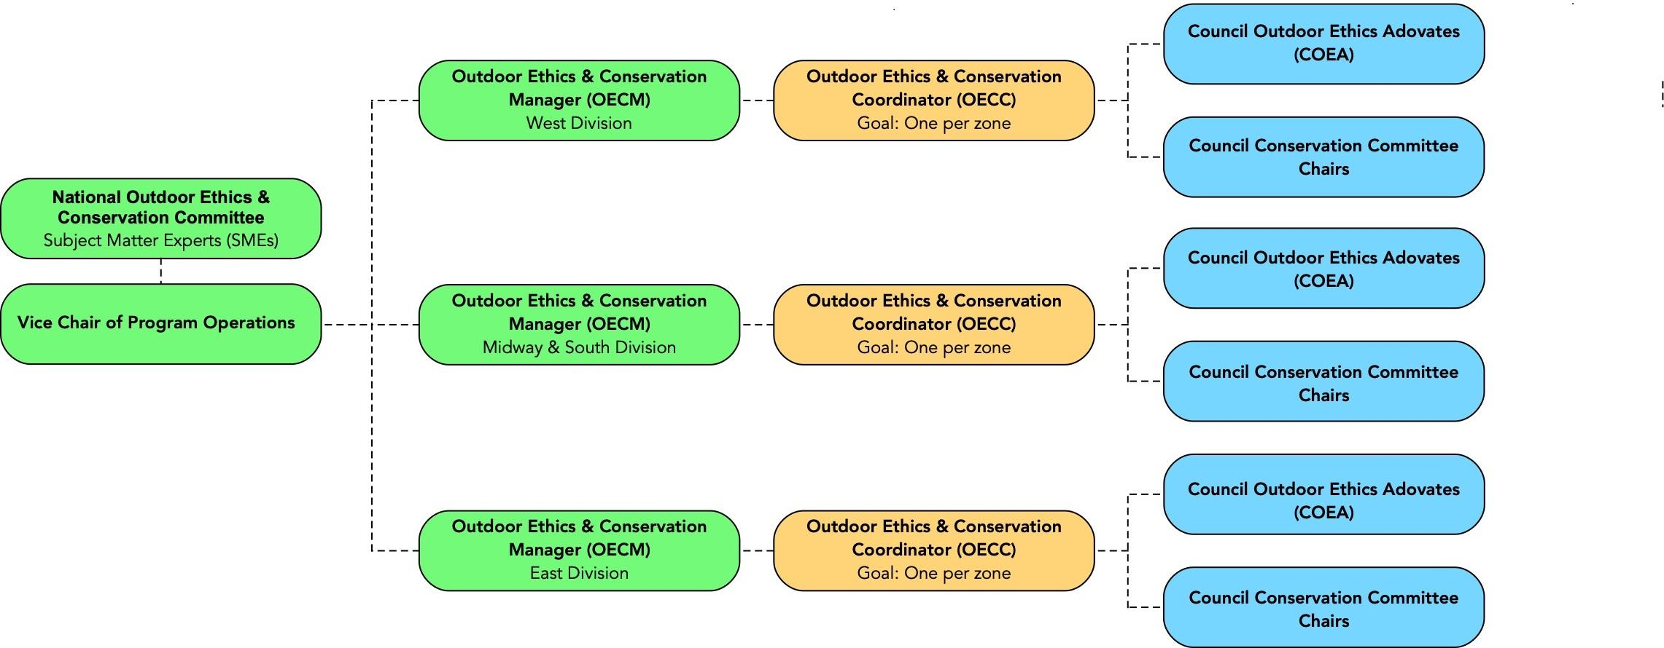
Where Do You Fit In

Slide 8
What Does a COEA Do
COEA Job Description Highlights
Recruit
Train
Program Promotion
Outdoor Ethics Committee or Team
Reporting

Slide 9
Your Vision
You have assumed the responsibilities of COEA
Now what?
You have taken an inventory of your Council’s program
Council Outdoor Ethics Inventory
What next?
Visualize what you want your Council’s OE program to be
Once you have a vision you need to how to accomplish it
Identify steps to achieve your vision
The steps to reach your vision become your Goals
SMART – Specific Measurable Attainable Relevant Timely
How do you reach your Goals?
Devise a Plan

Slide 10
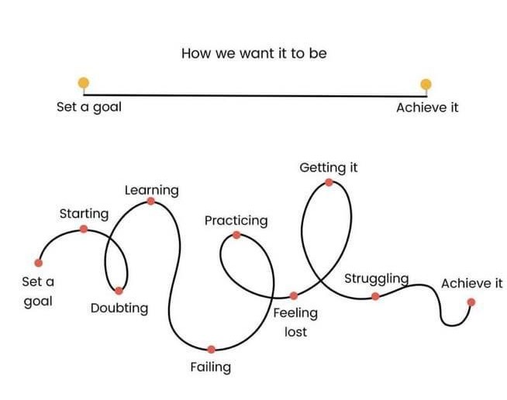
Don’t Give Up

Slide 11
Wrap Up
Questions

