Slide 1
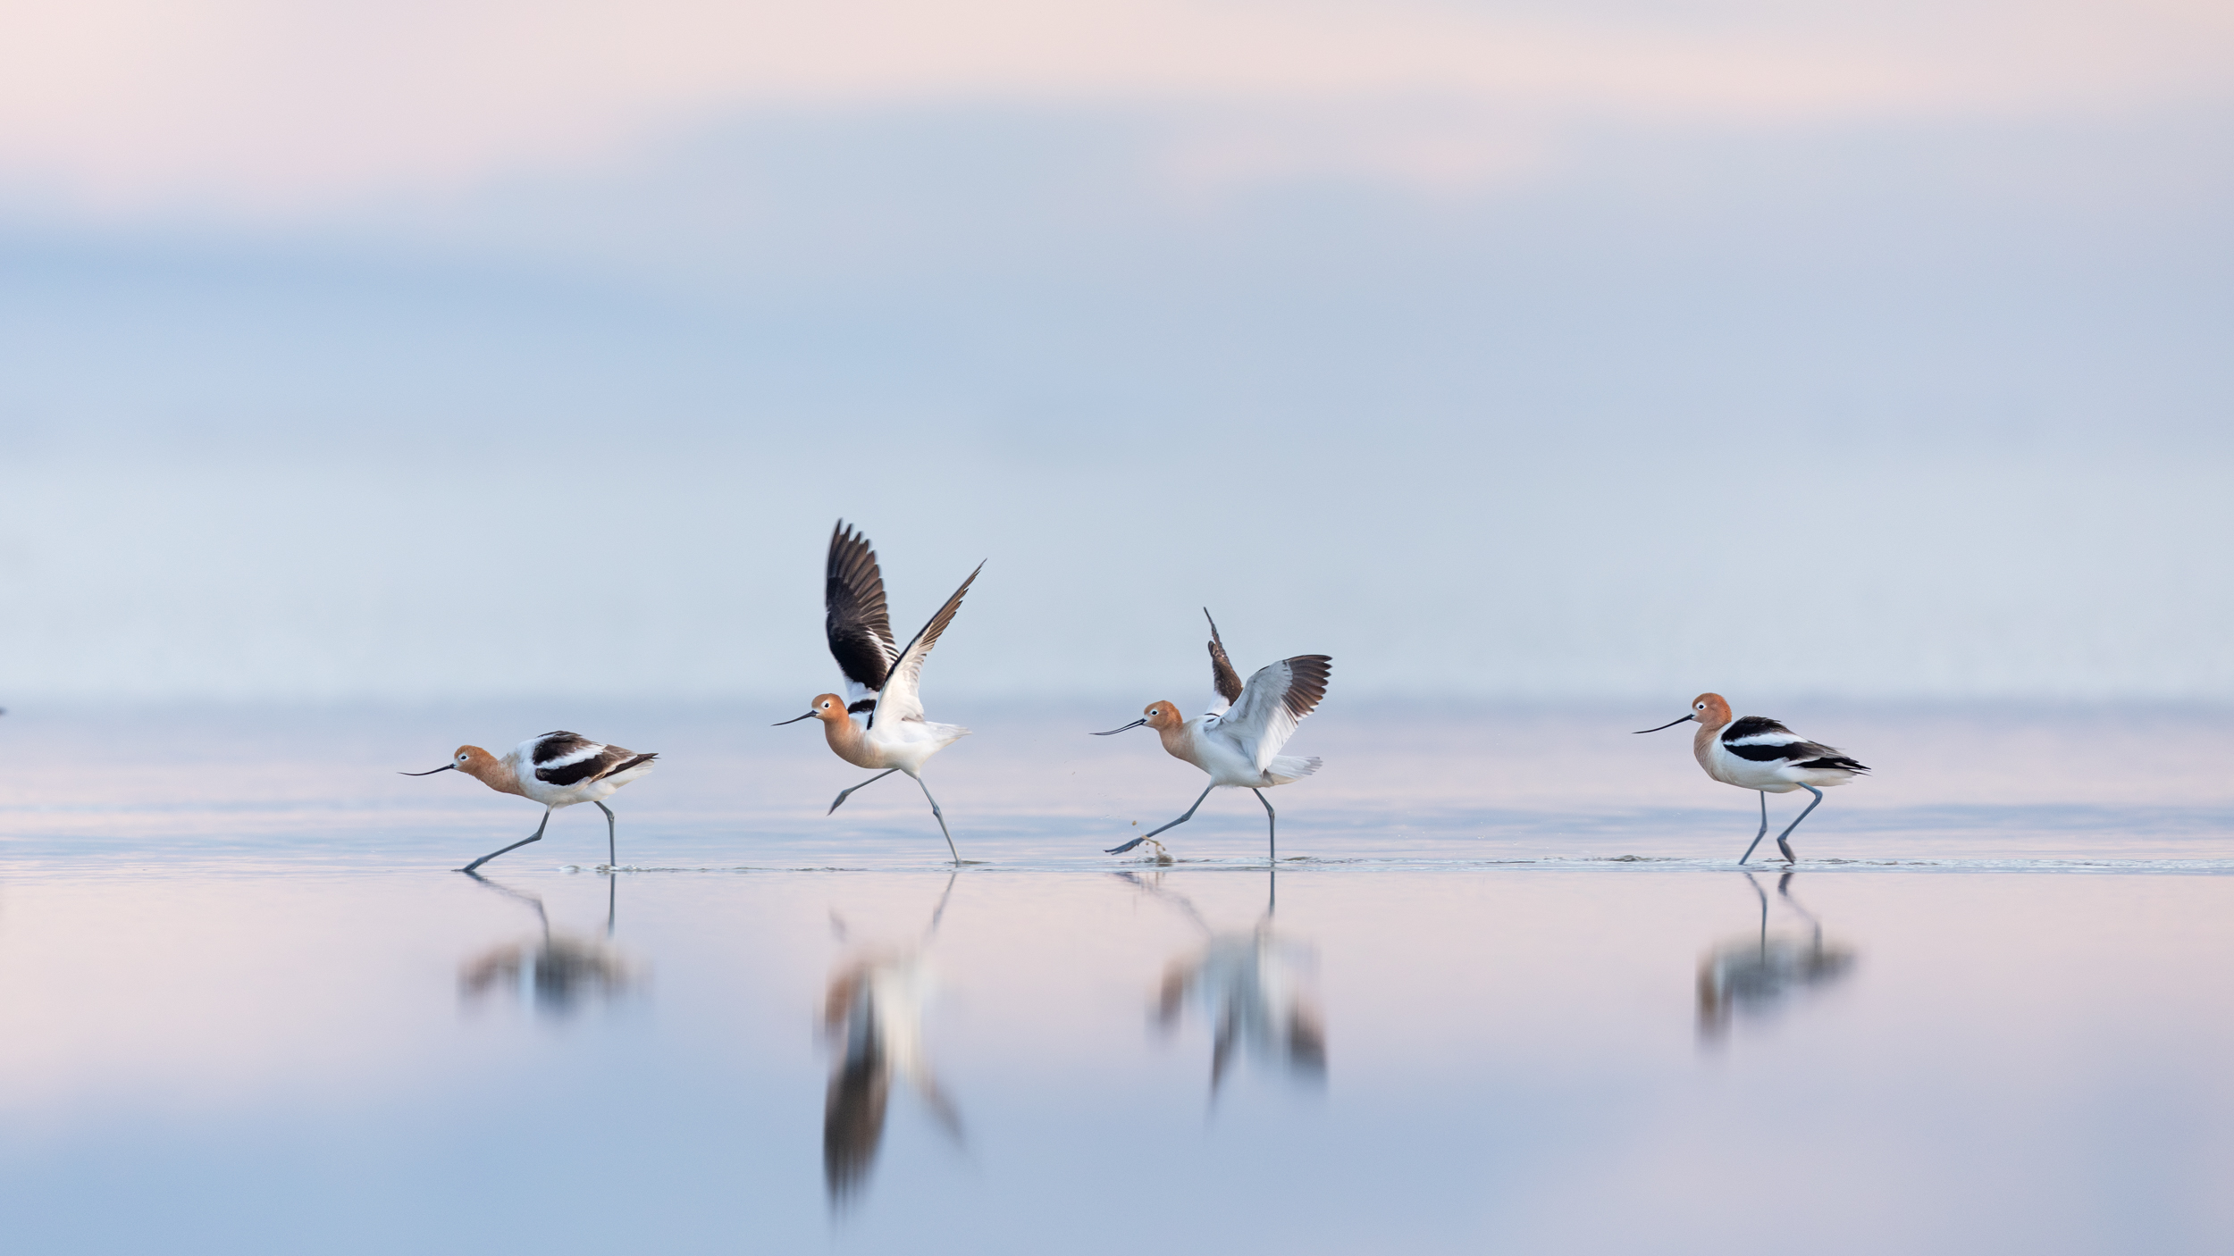
Living within our means:
Stewardship, water security, and the Great Salt Lake
Ben Abbott
growtheflowutah.org BSA National Outdoor Ethics and Conservation Conference
Mary Anne Karren

Slide 2
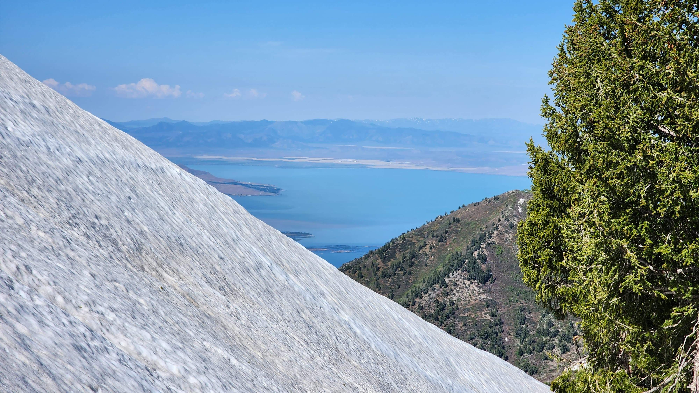
What is the most important environmental issue?

Slide 3
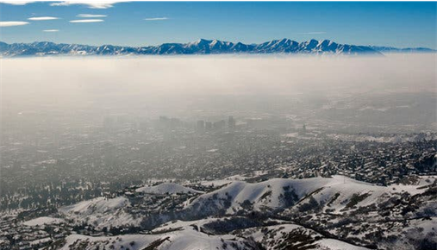
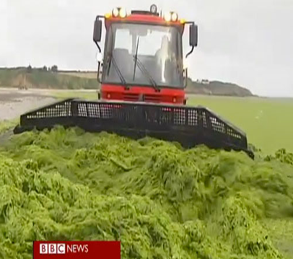
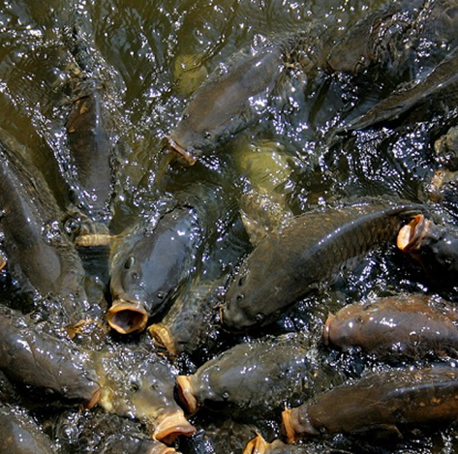
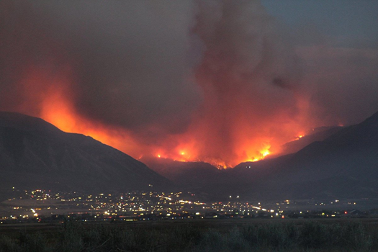
Prioritizing environmental problems
1. Harm to human wellbeing from environmental pollution
3. Disruption of Earth’s cycles
2. Decline of life on Earth
4. Climate change

Slide 4
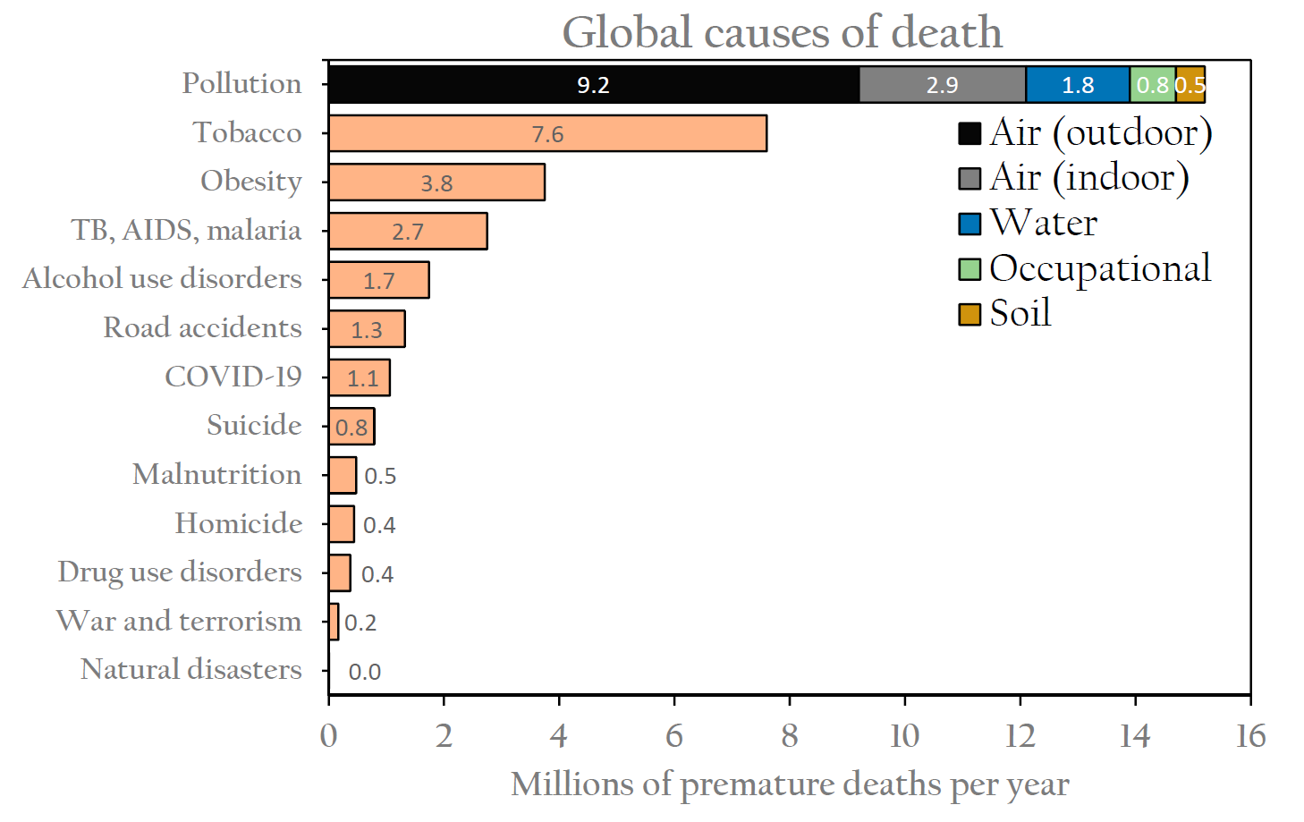
Pollution causes ~15 million premature deaths annually
More than all communicable diseases and nutritional disorders
10-times more than global violence
(Errigo et al. 2020; Vohra et al. 2021; Fuller et al. 2022)

Slide 5
What are the most important causes of these problems?

Slide 6
What is causing these crises?
Pollution
Life on Earth
Dirty energy
Unsustainable agriculture
Loss of proper relationship with each other and our home
Disrupted cycles
Climate change

Slide 7
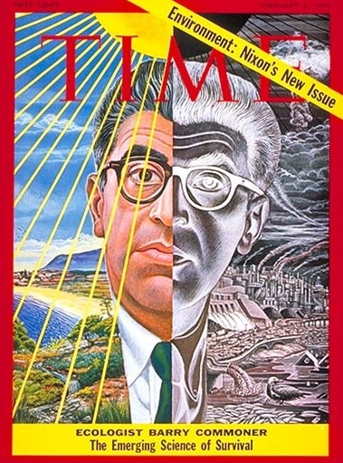
When any environmental issue is pursued to its origins, it reveals an inescapable truth – that the root cause of the crisis is not to be found in how men interact with nature, but in how they interact with each other – that, to solve the environmental crisis we must solve the problems of poverty, racial injustice and war.
-Barry Commoner, 1973

Slide 8
Competing interests view
Ecological view
Economy
Environment
The Earth system
Society
Human society
Economy

Slide 9
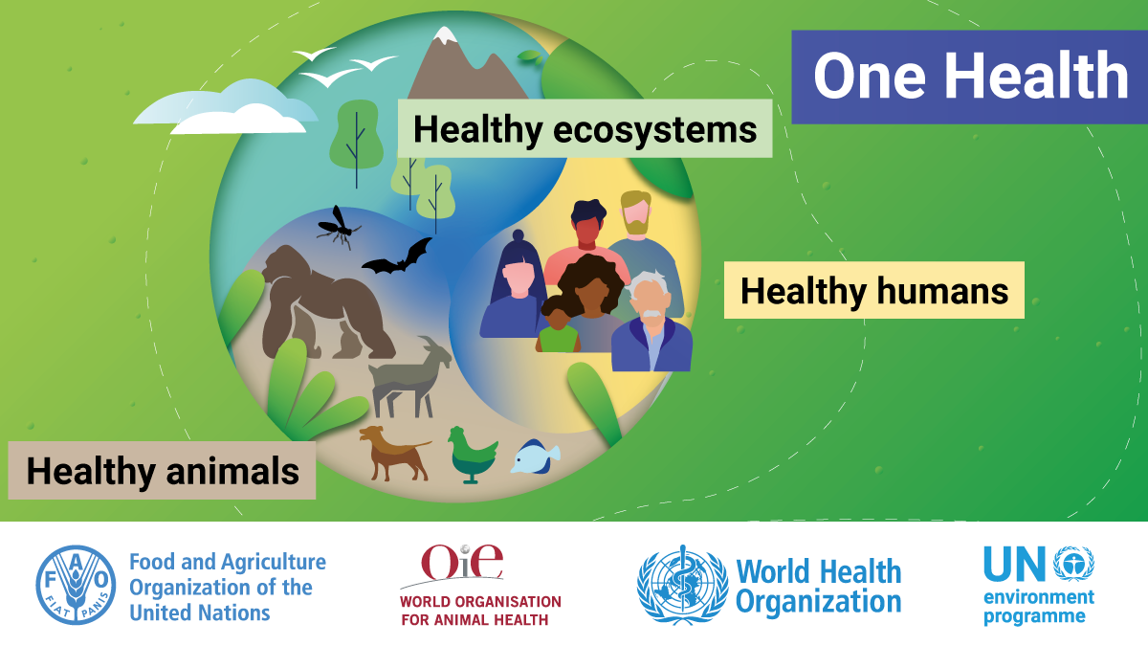

Slide 10
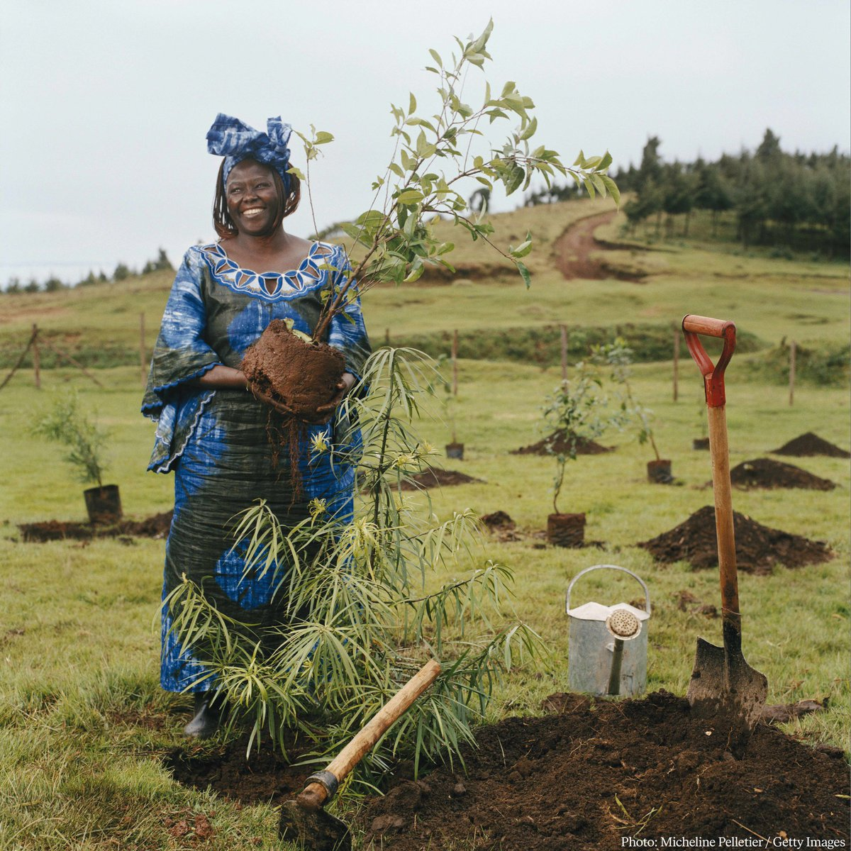
We are called to assist the Earth to heal her wounds and in the process heal our own – indeed, to embrace the whole creation in all its diversity, beauty and wonder. This will happen if we see the need to revive our sense of belonging to a larger family of life,
WANGARI MAATHAI 2004

Slide 11
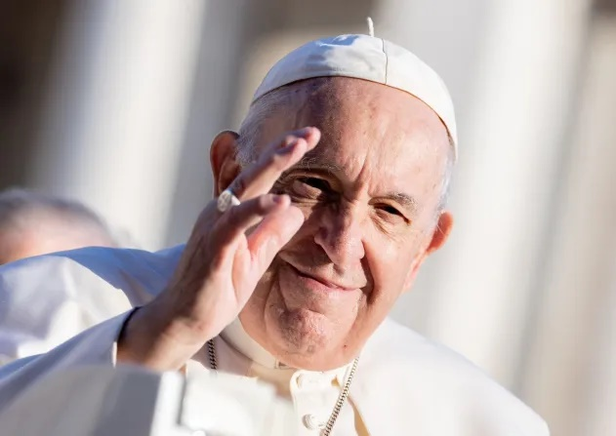
[God] shows us just how inseparable the bond is between concern for nature, justice for the poor, commitment to society, and interior peace.
-Pope Francis, 2015

Slide 12
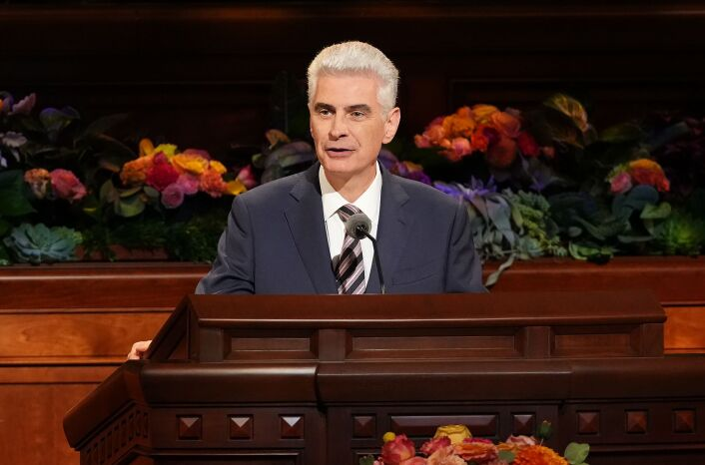
The care of the earth and of our natural environment is a sacred responsibility entrusted to us by God, which should fill us with a deep sense of duty and humility. It is also an integral component of our discipleship.
-Bishop Gérald Caussé, 2022

Slide 13
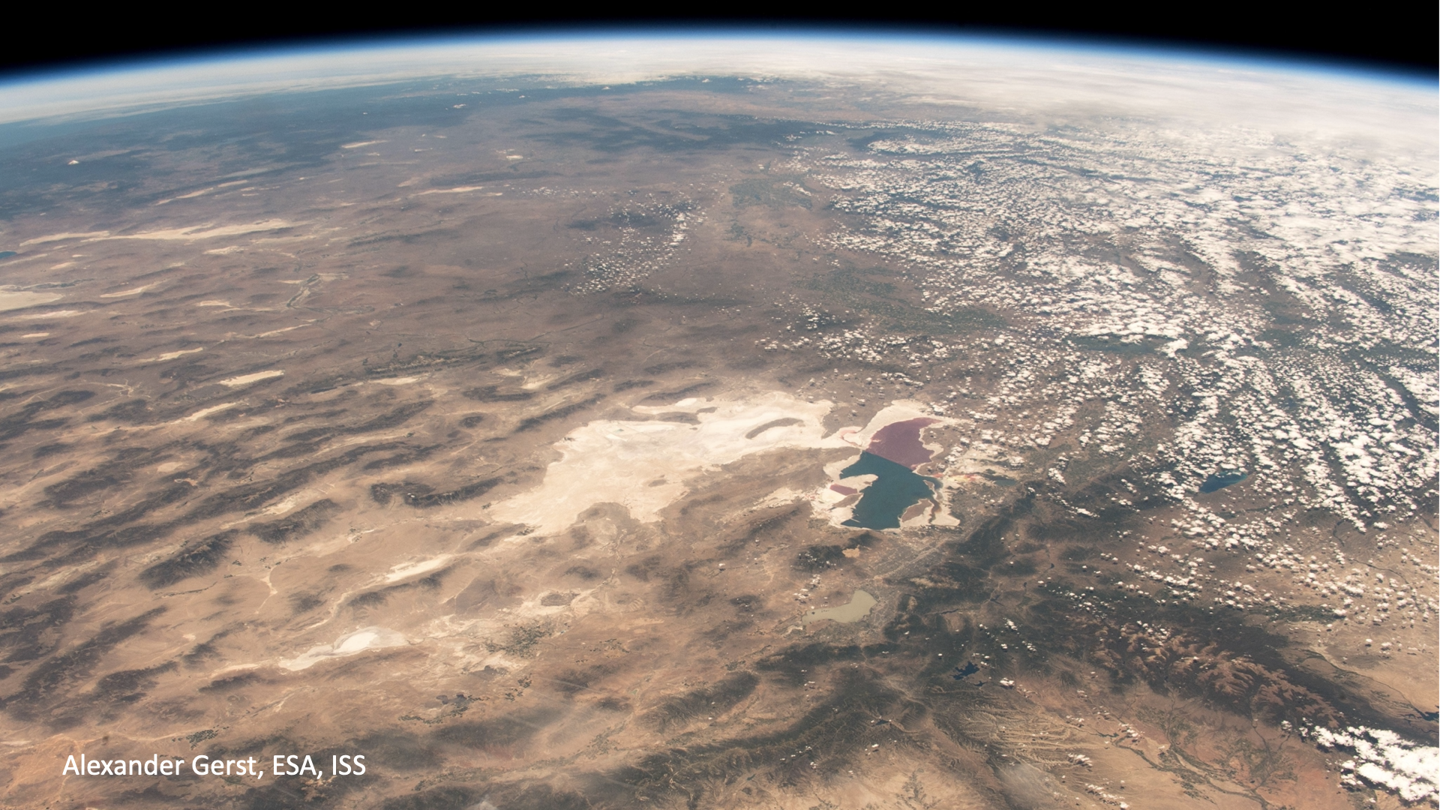

Slide 14
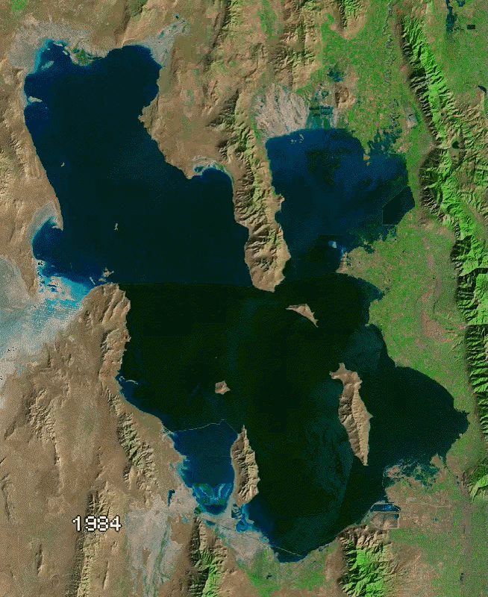
Surface area -60%
Water volume -74%
Collapse within 5 years

Slide 15
What is the largest cause of the decline?
Irrigated agriculture
Urban expansion
Climate change
Drought
Hydraulic fracturing (fracking)

Slide 16
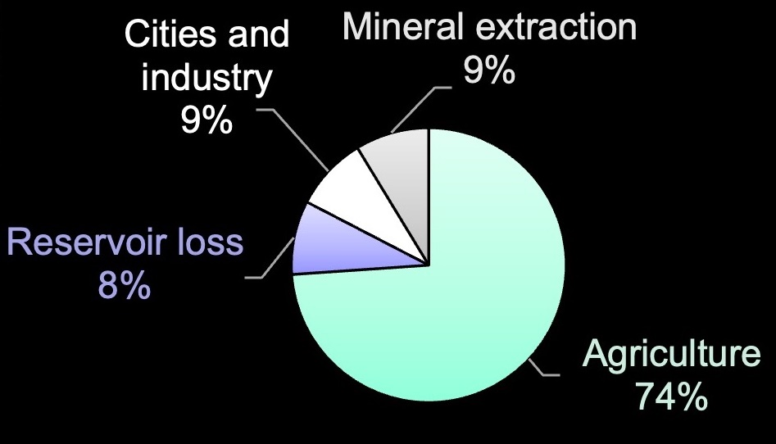
The lake needs one million acre-feet more/year
30-50% decrease in consumptive water use.

Slide 17
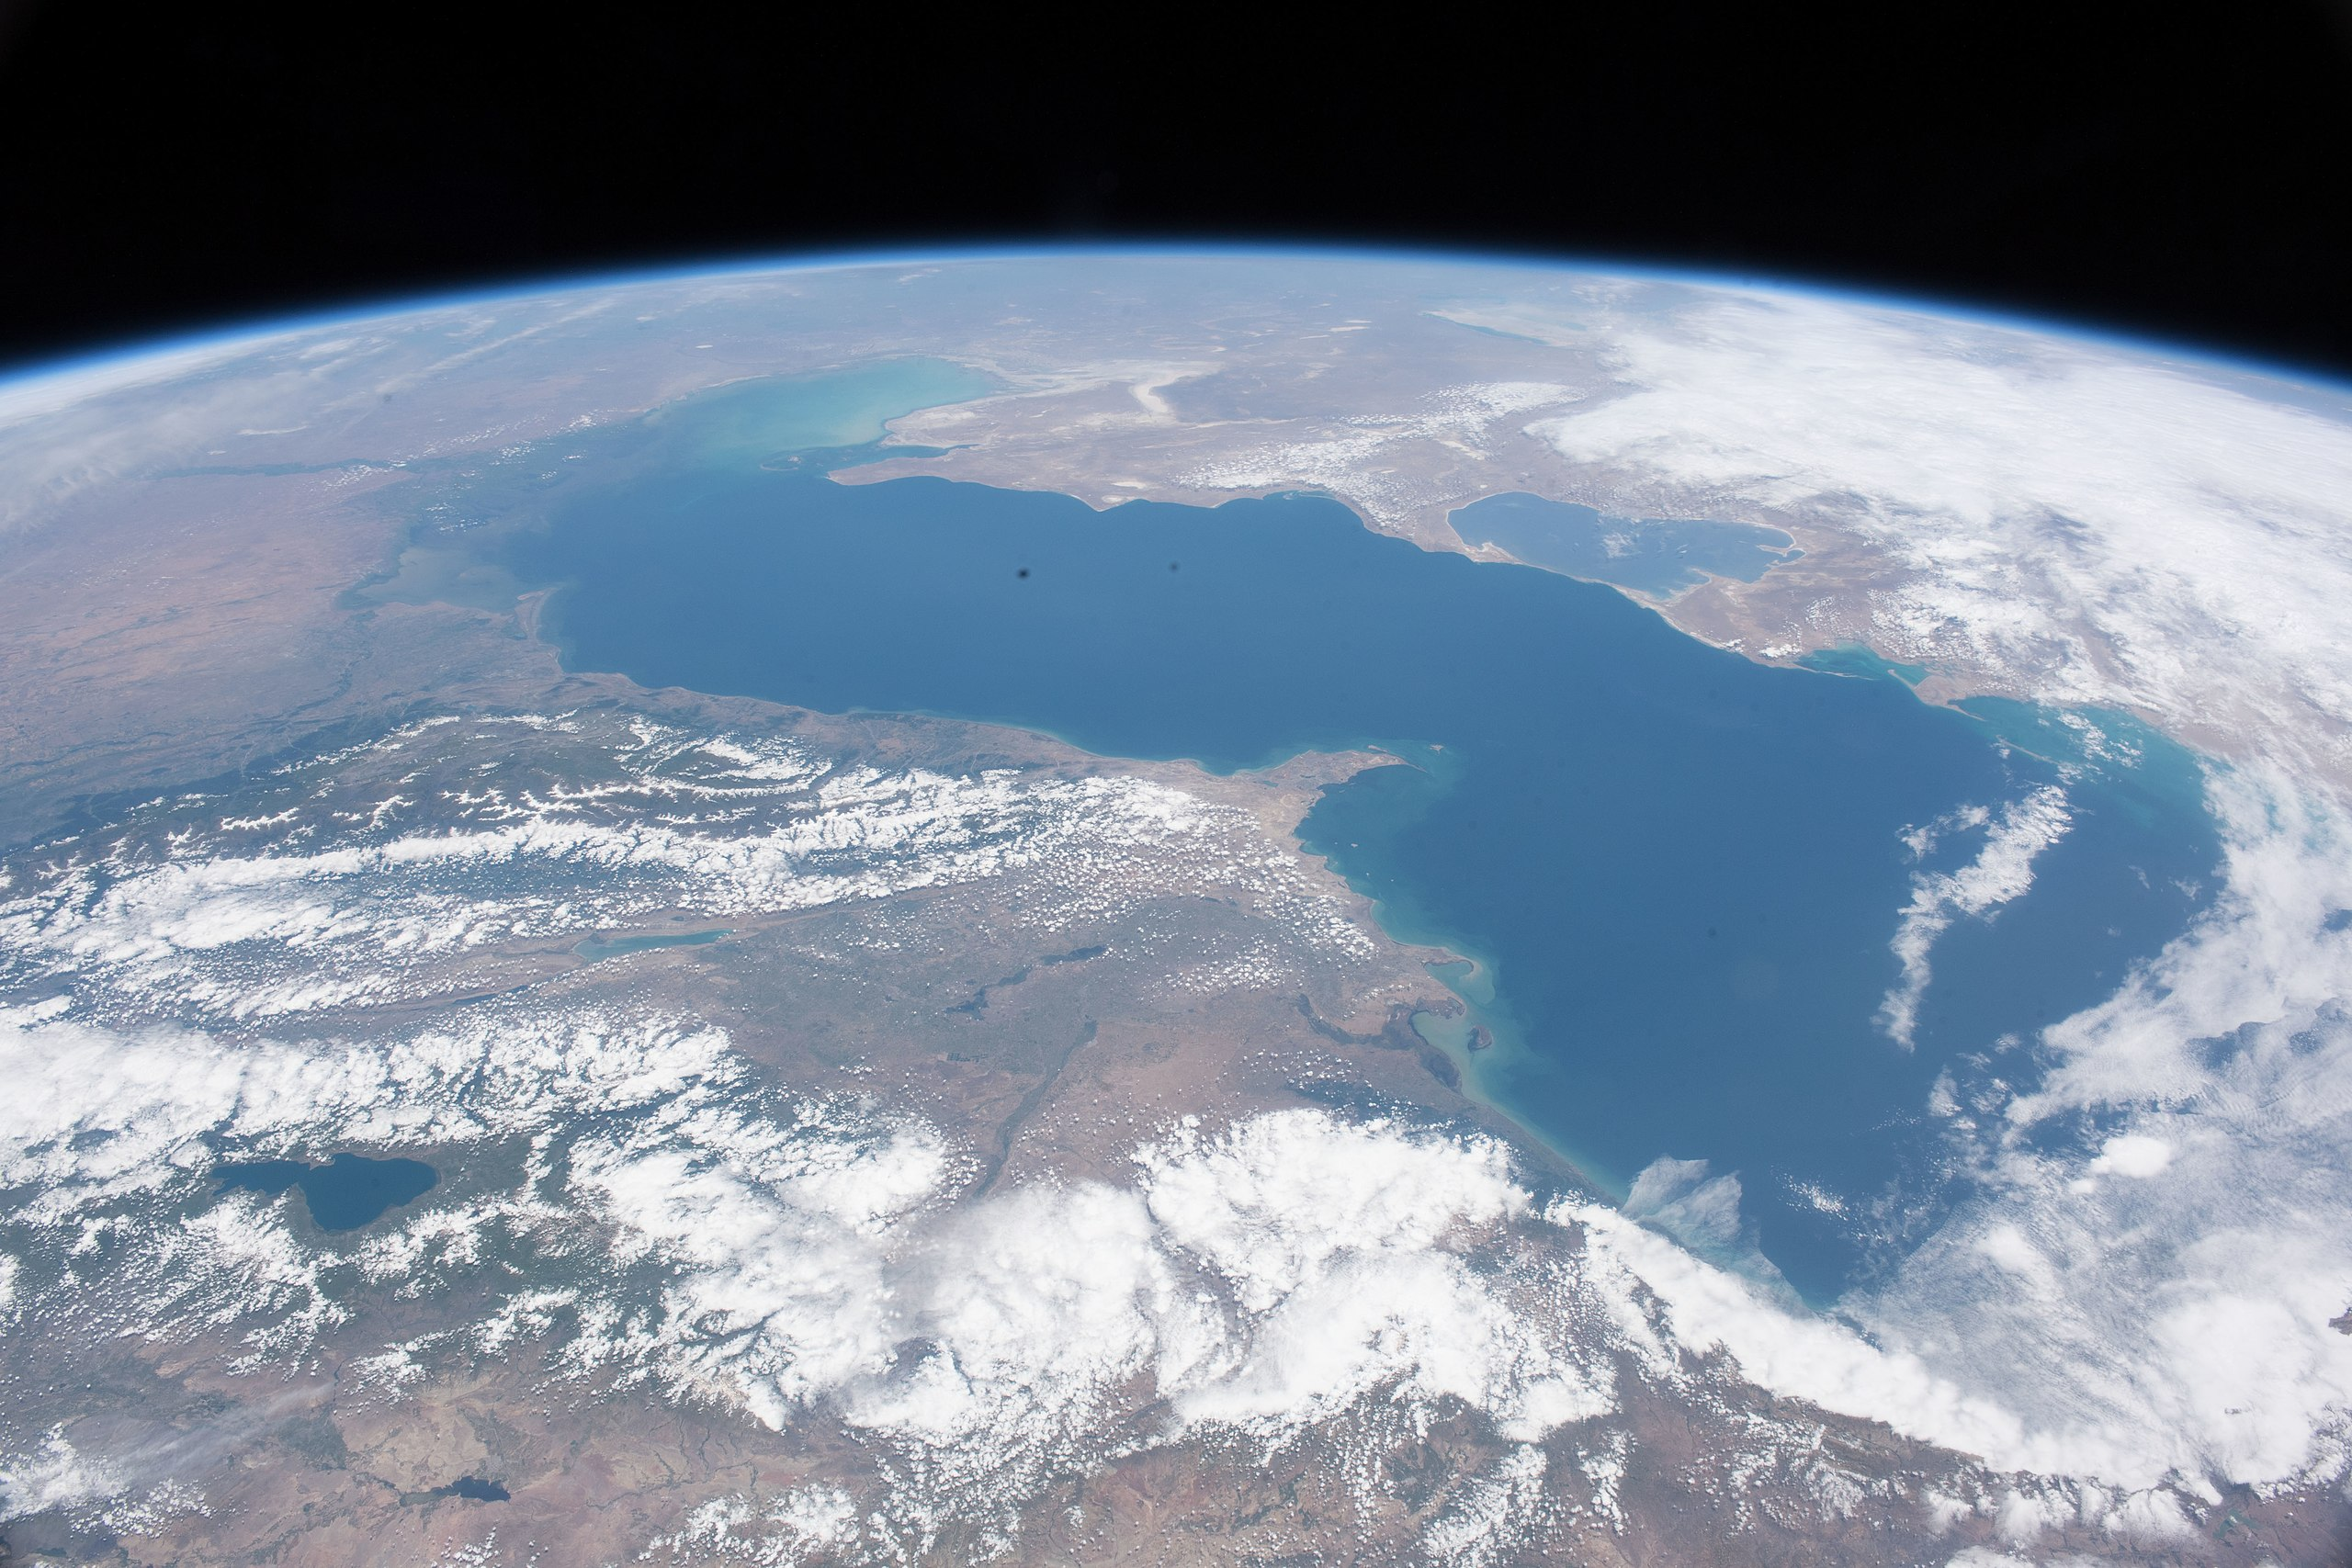
What has worked elsewhere?

Slide 18
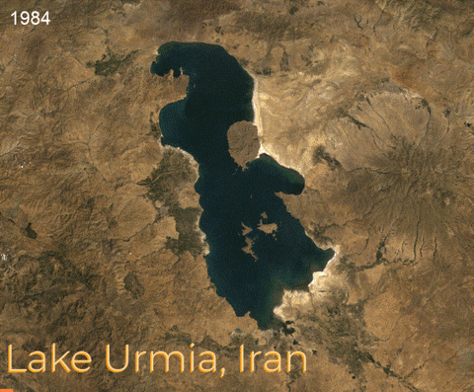
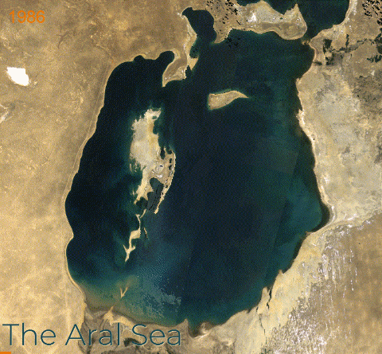

Slide 19
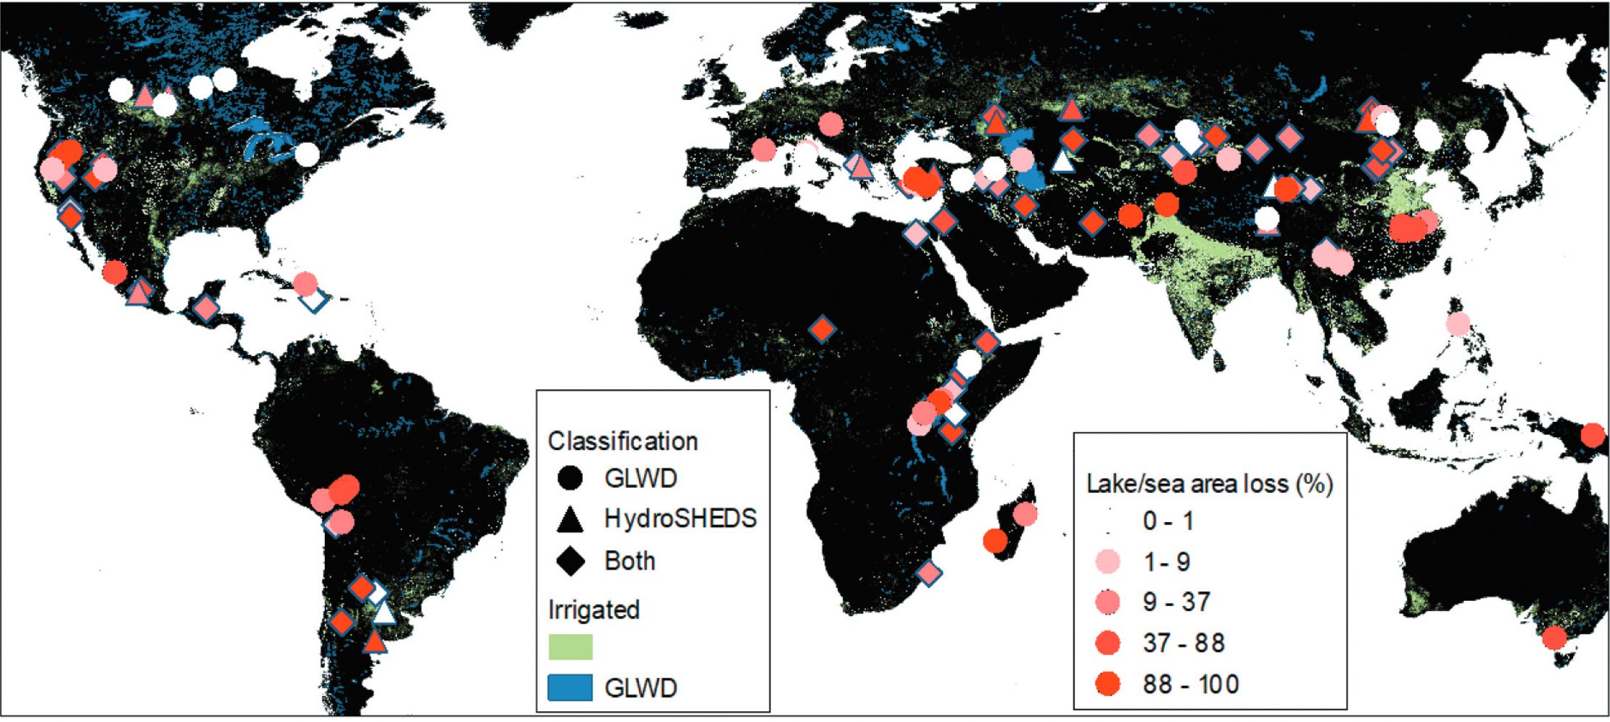
60% loss of saline lake area globally
(Wine 2022)

Slide 20
Which of the following has not been caused by the decline of saline lakes?
Rebound of the Earth’s crust
Increase in global sea level
Change in the tilt of the Earth
Destruction of agriculture
Degradation of public health
Extinction of bird, fish, mammal, and plant species

Slide 21
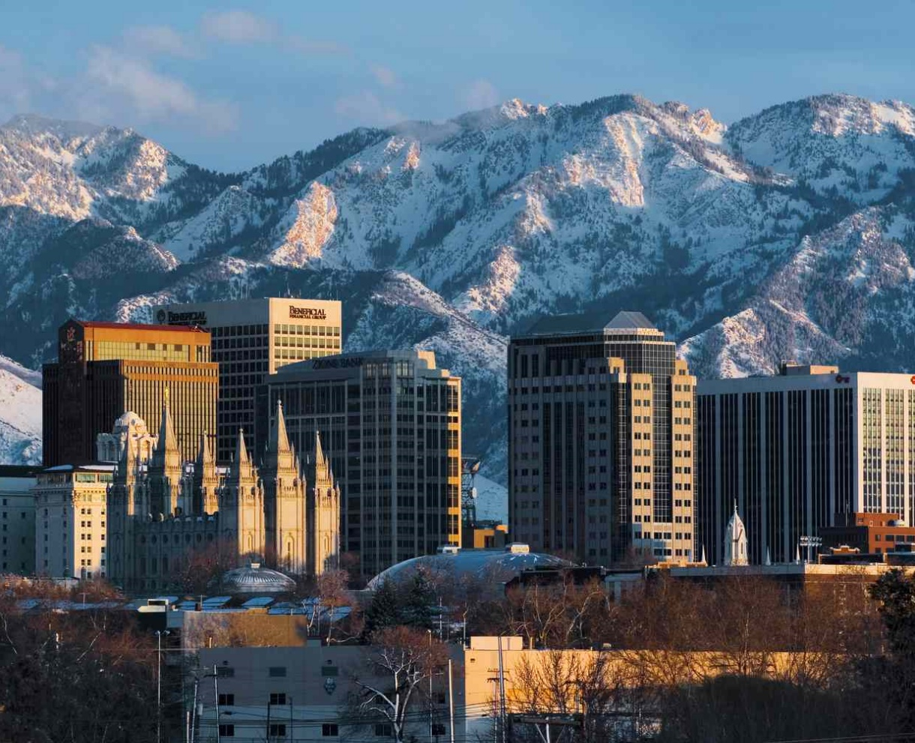
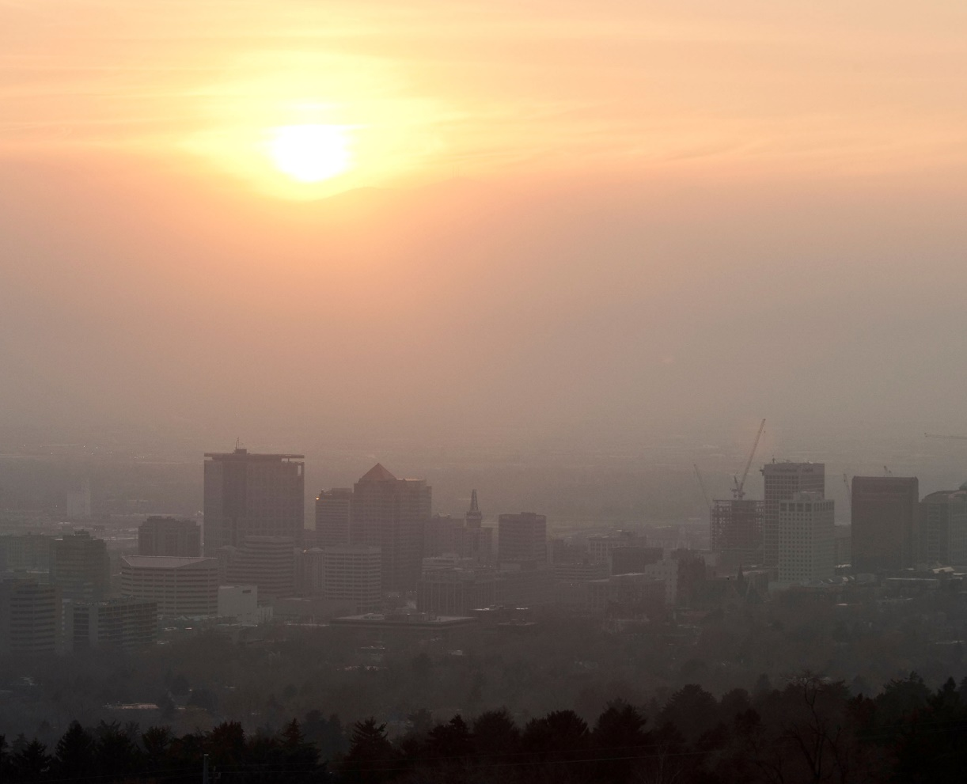
human health, biosphere integrity, economy

Slide 22
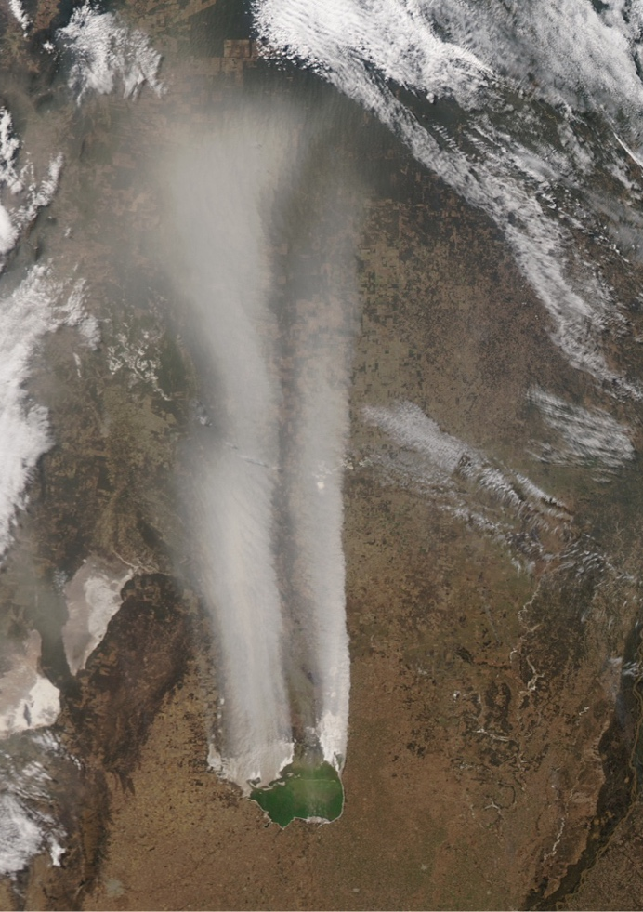
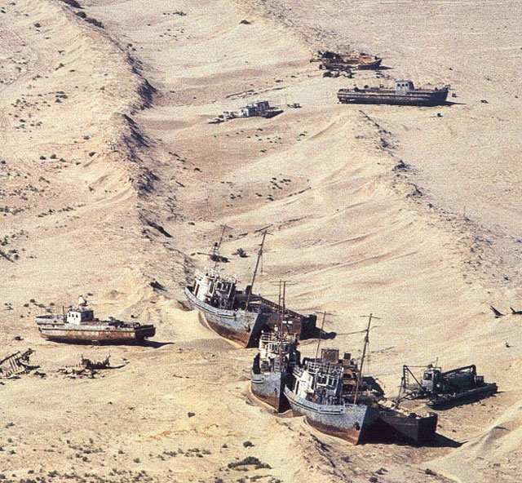

Slide 23
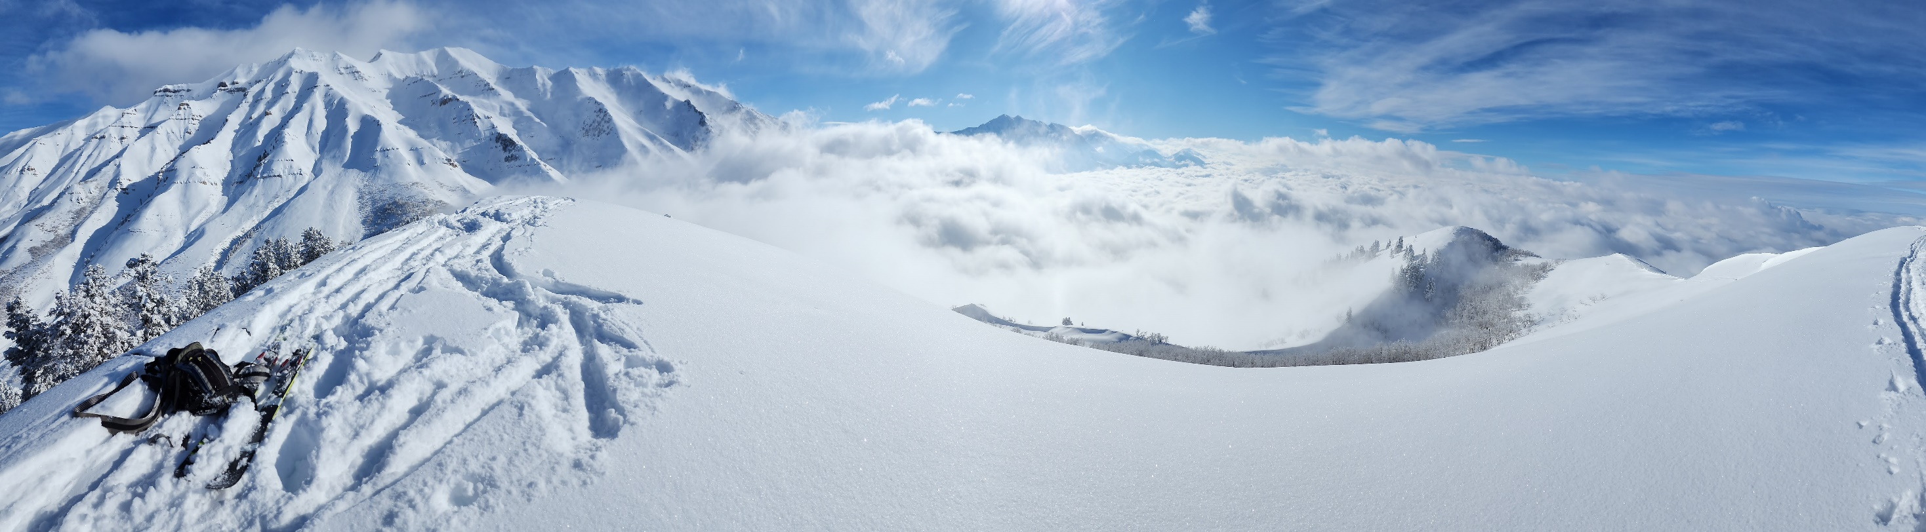
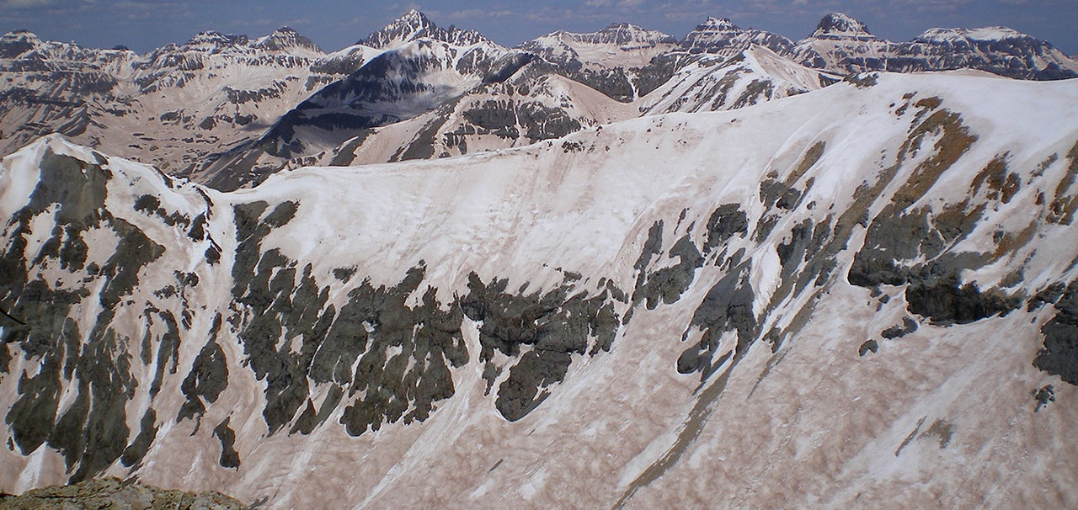
McKinzie Skiles

Slide 24
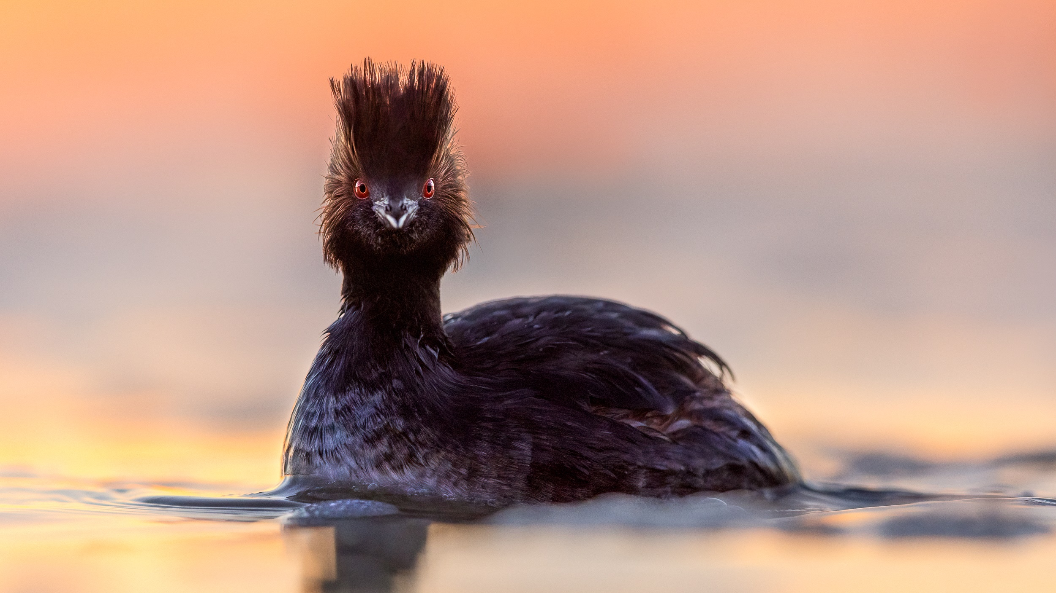
Mary Anne Karren

Slide 25
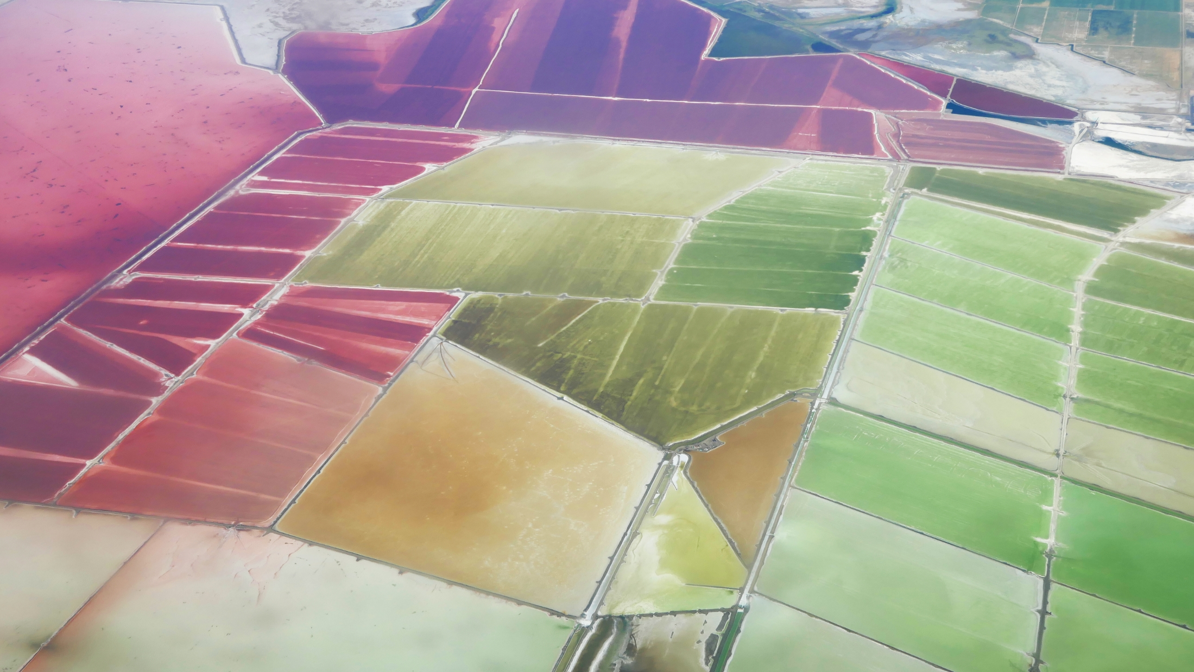
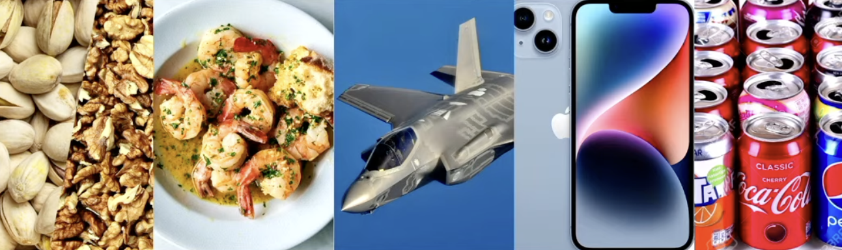

Slide 26
Are terminal lakes terminal?

Slide 27
For God hath not given us the spirit of fear;
but of power, and of love, and of a sound mind.
2 Timothy 1:7

Slide 28
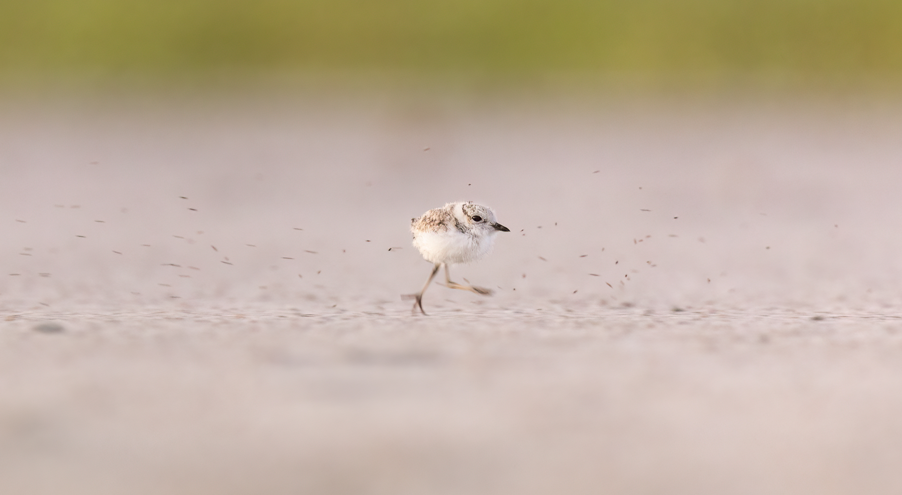
How can we grow the flow by a million acre-feet in time?
Mary Anne Karren; Western Snowy Plover (Charadrius alexandrinus nivosus)

Slide 29
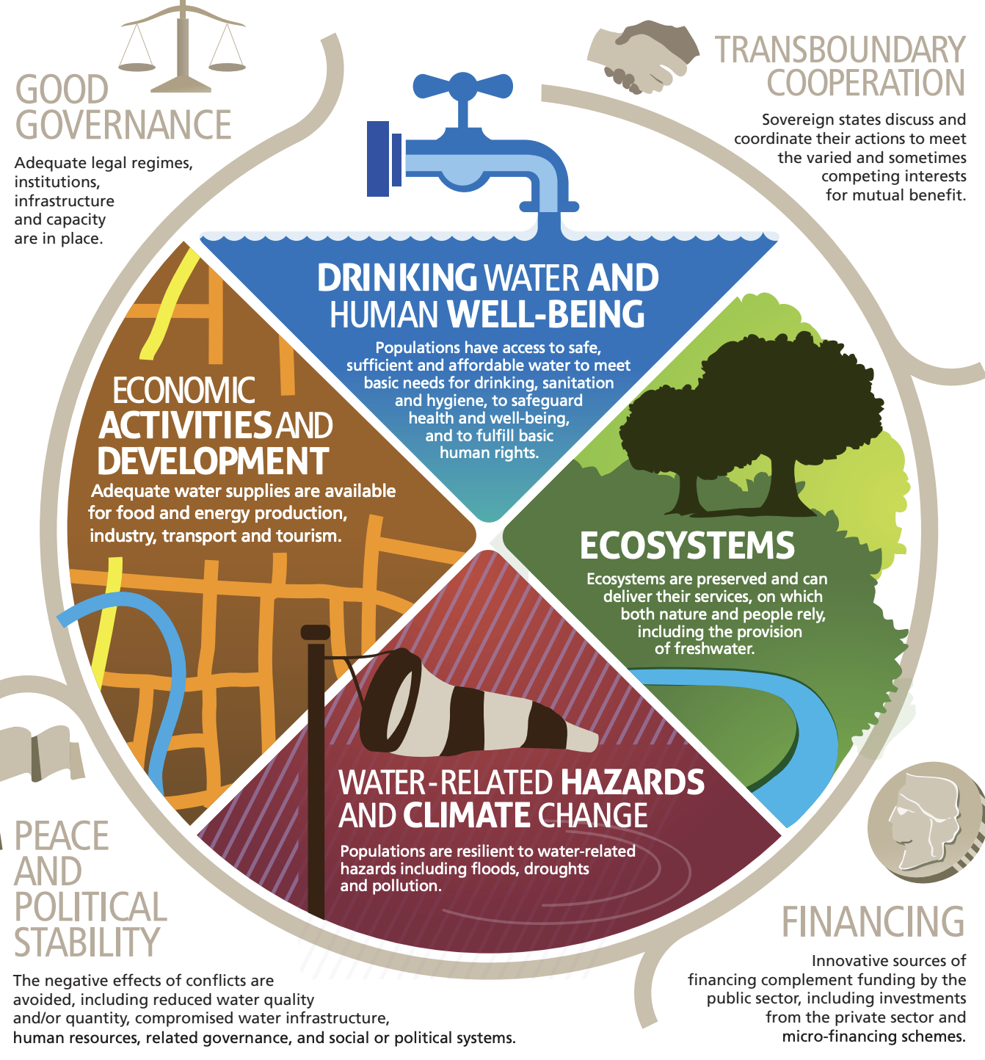
“The capacity of a population to safeguard sustainable access to adequate quantities of acceptable quality water for sustaining livelihoods, human well-being, and socio-economic development, for ensuring protection against water-borne pollution and water-related disasters, and for preserving ecosystems in a climate of peace and political stability.”
UN Water, 2013

Slide 30
Supply > Demand

Slide 31
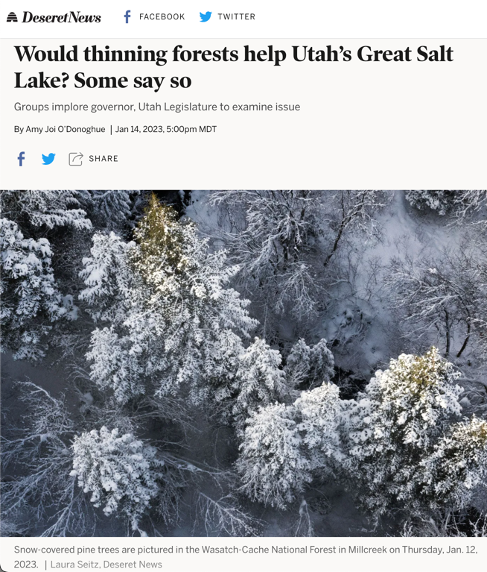
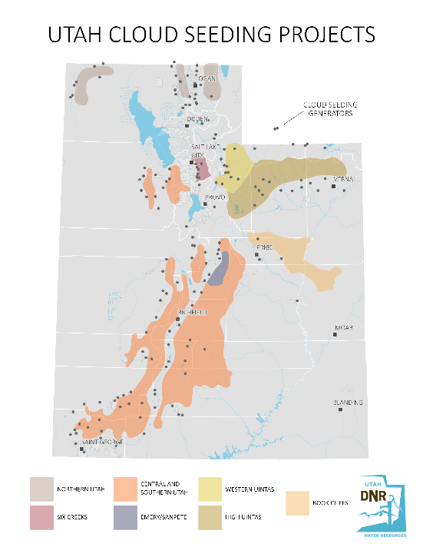
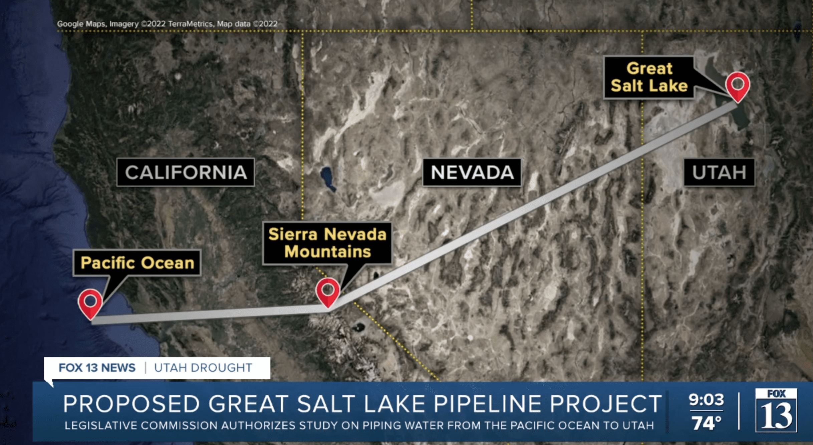
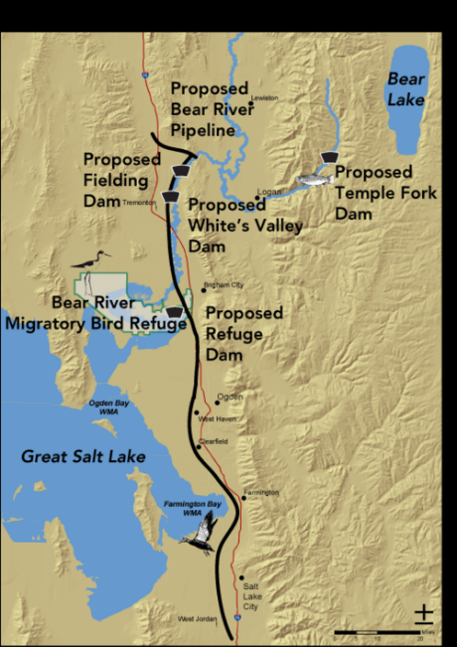
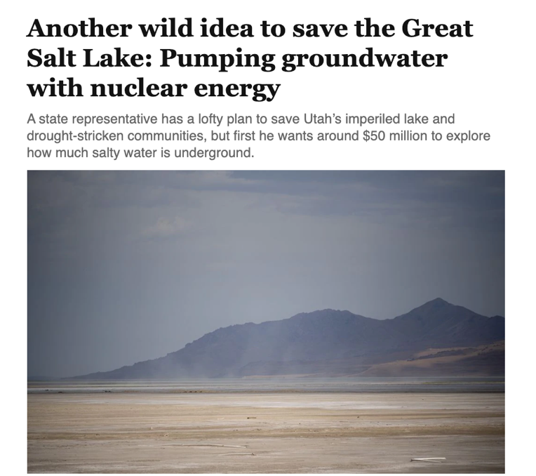
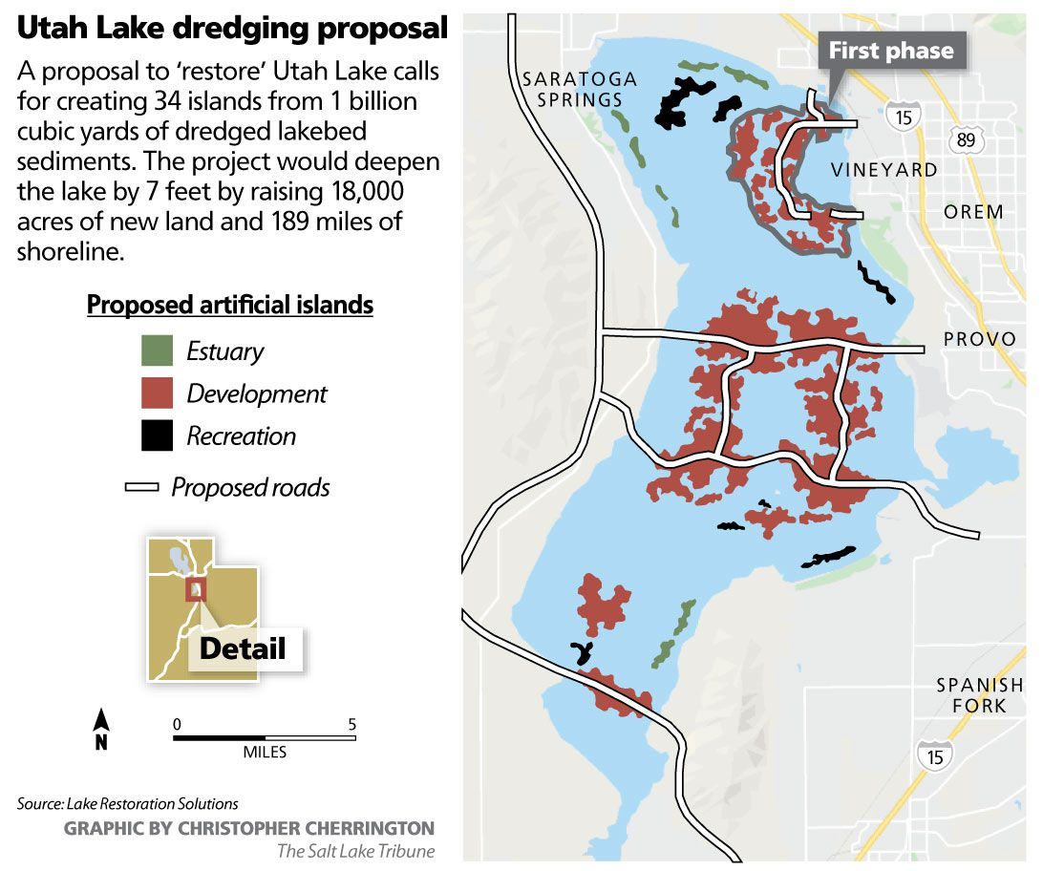
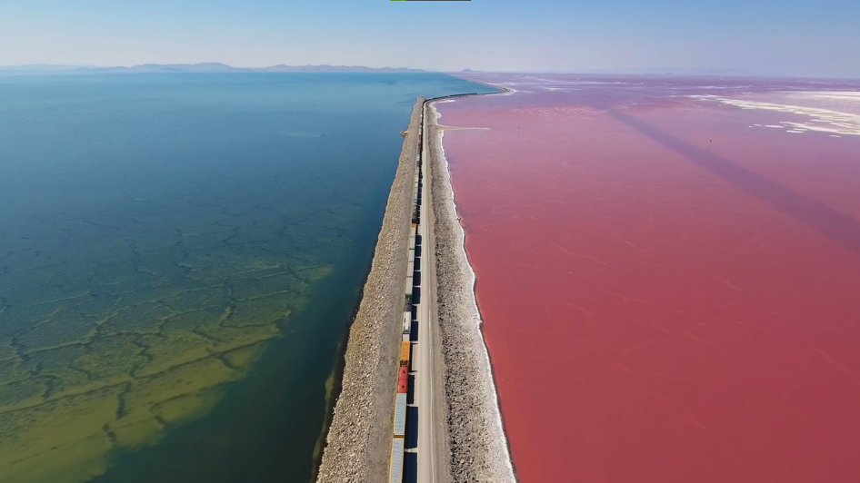
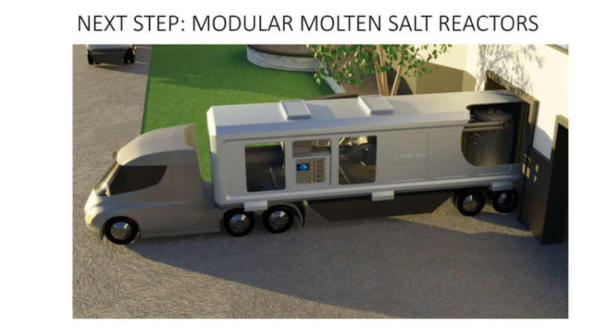
Water augmentation solutions?

Slide 32
Demand < Supply

Slide 33
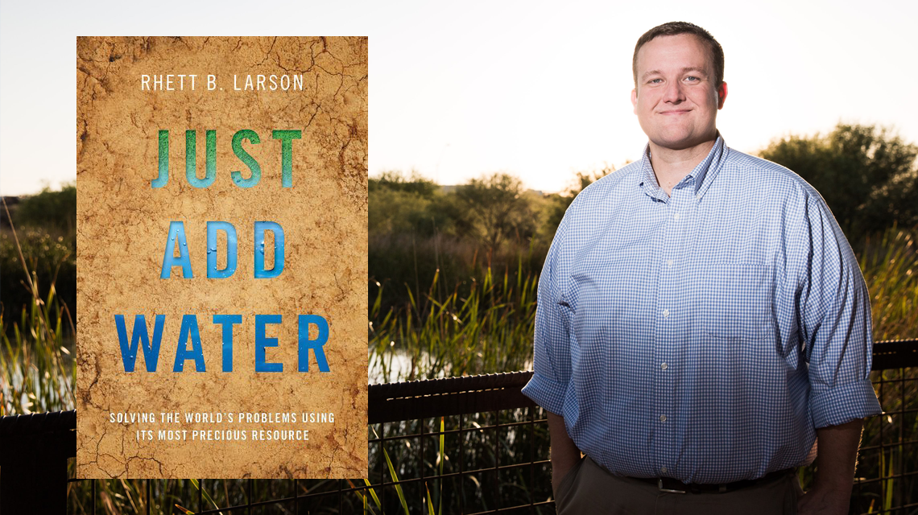
Preventative, scalable, efficient, resilient, cobenefits
Understand water
Conserve water
Augment water
Reactive, less reliable, more costly, often counterproductive, more tradeoffs

Slide 34
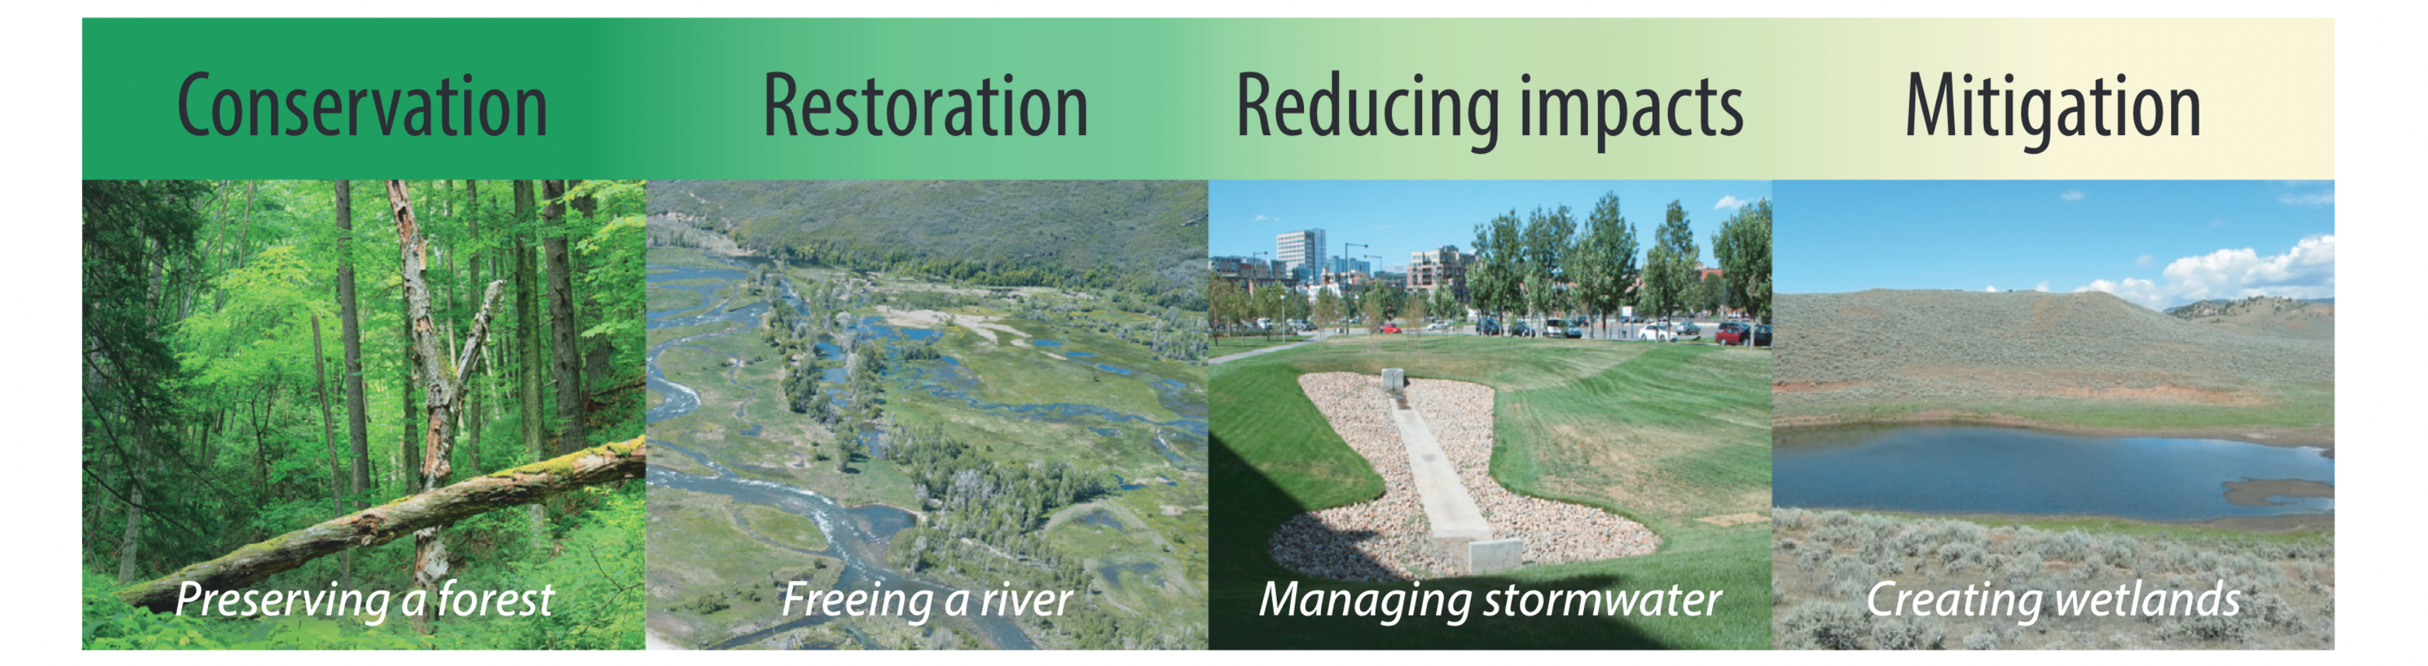
Palmer and Stewart 2020
Less effort and more likely to succeed
More effort and less likely to succeed
Change society
Control nature

Slide 35
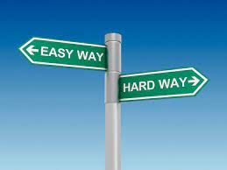
Cooperative and compensated transition to low-water agriculture
Pro-active participation in water markets
Everyone doing their part
Denial and blaming
Belief in silver bullet miracle cures
Federal intervention
HARD WAY
HARDER WAY

Slide 36
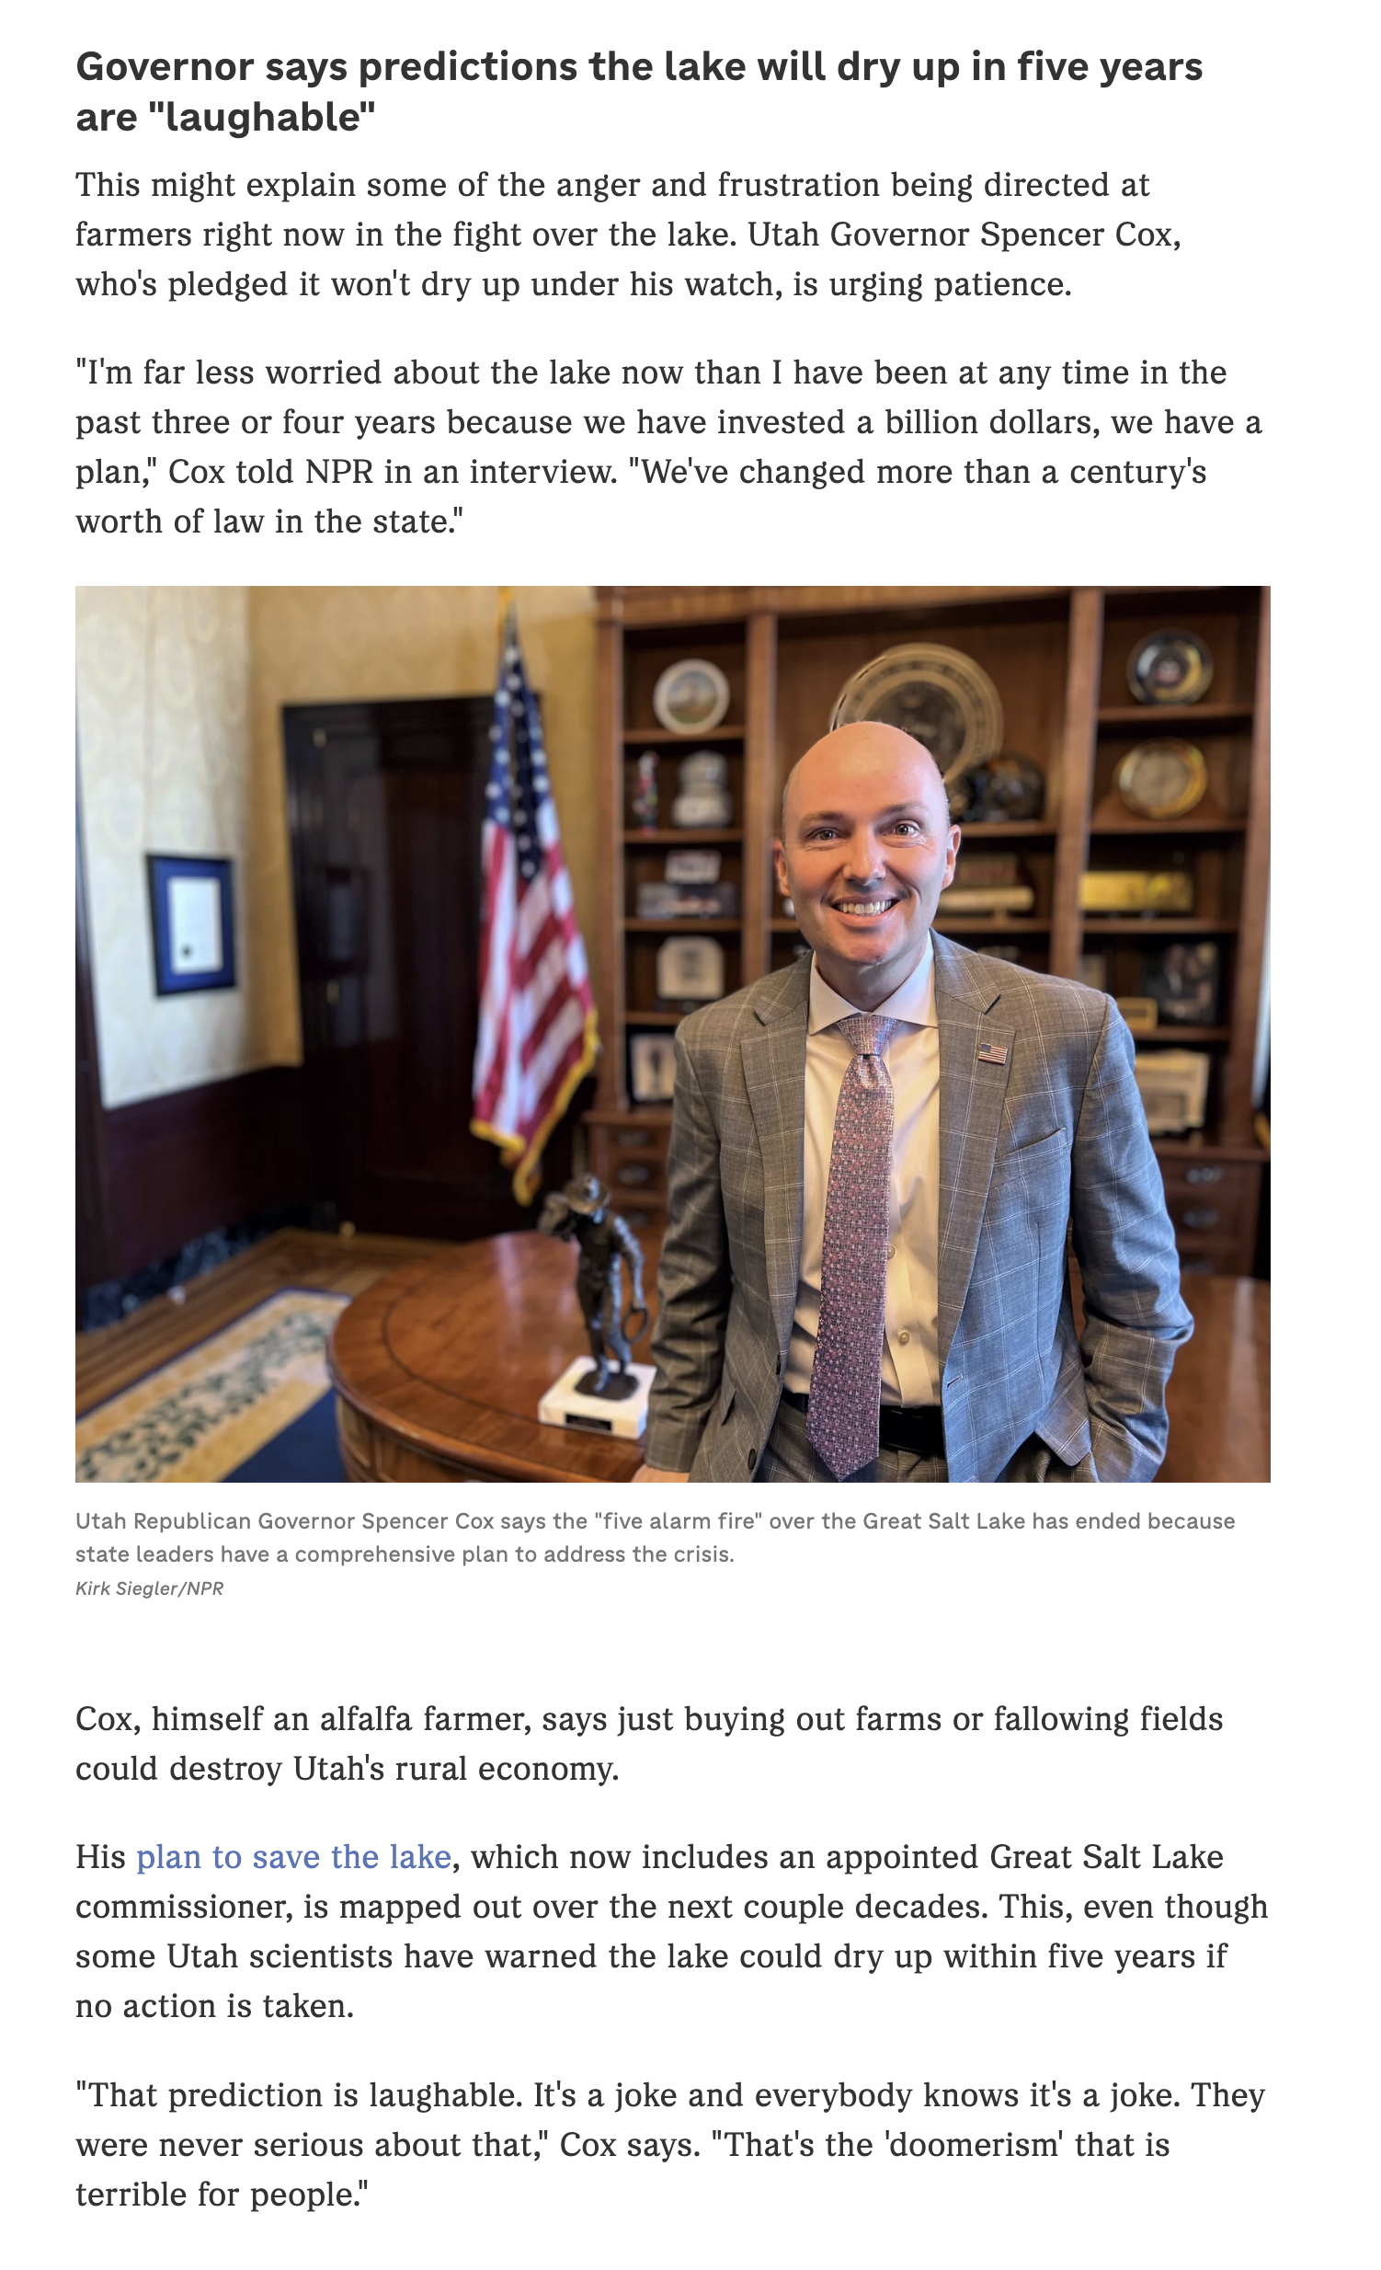
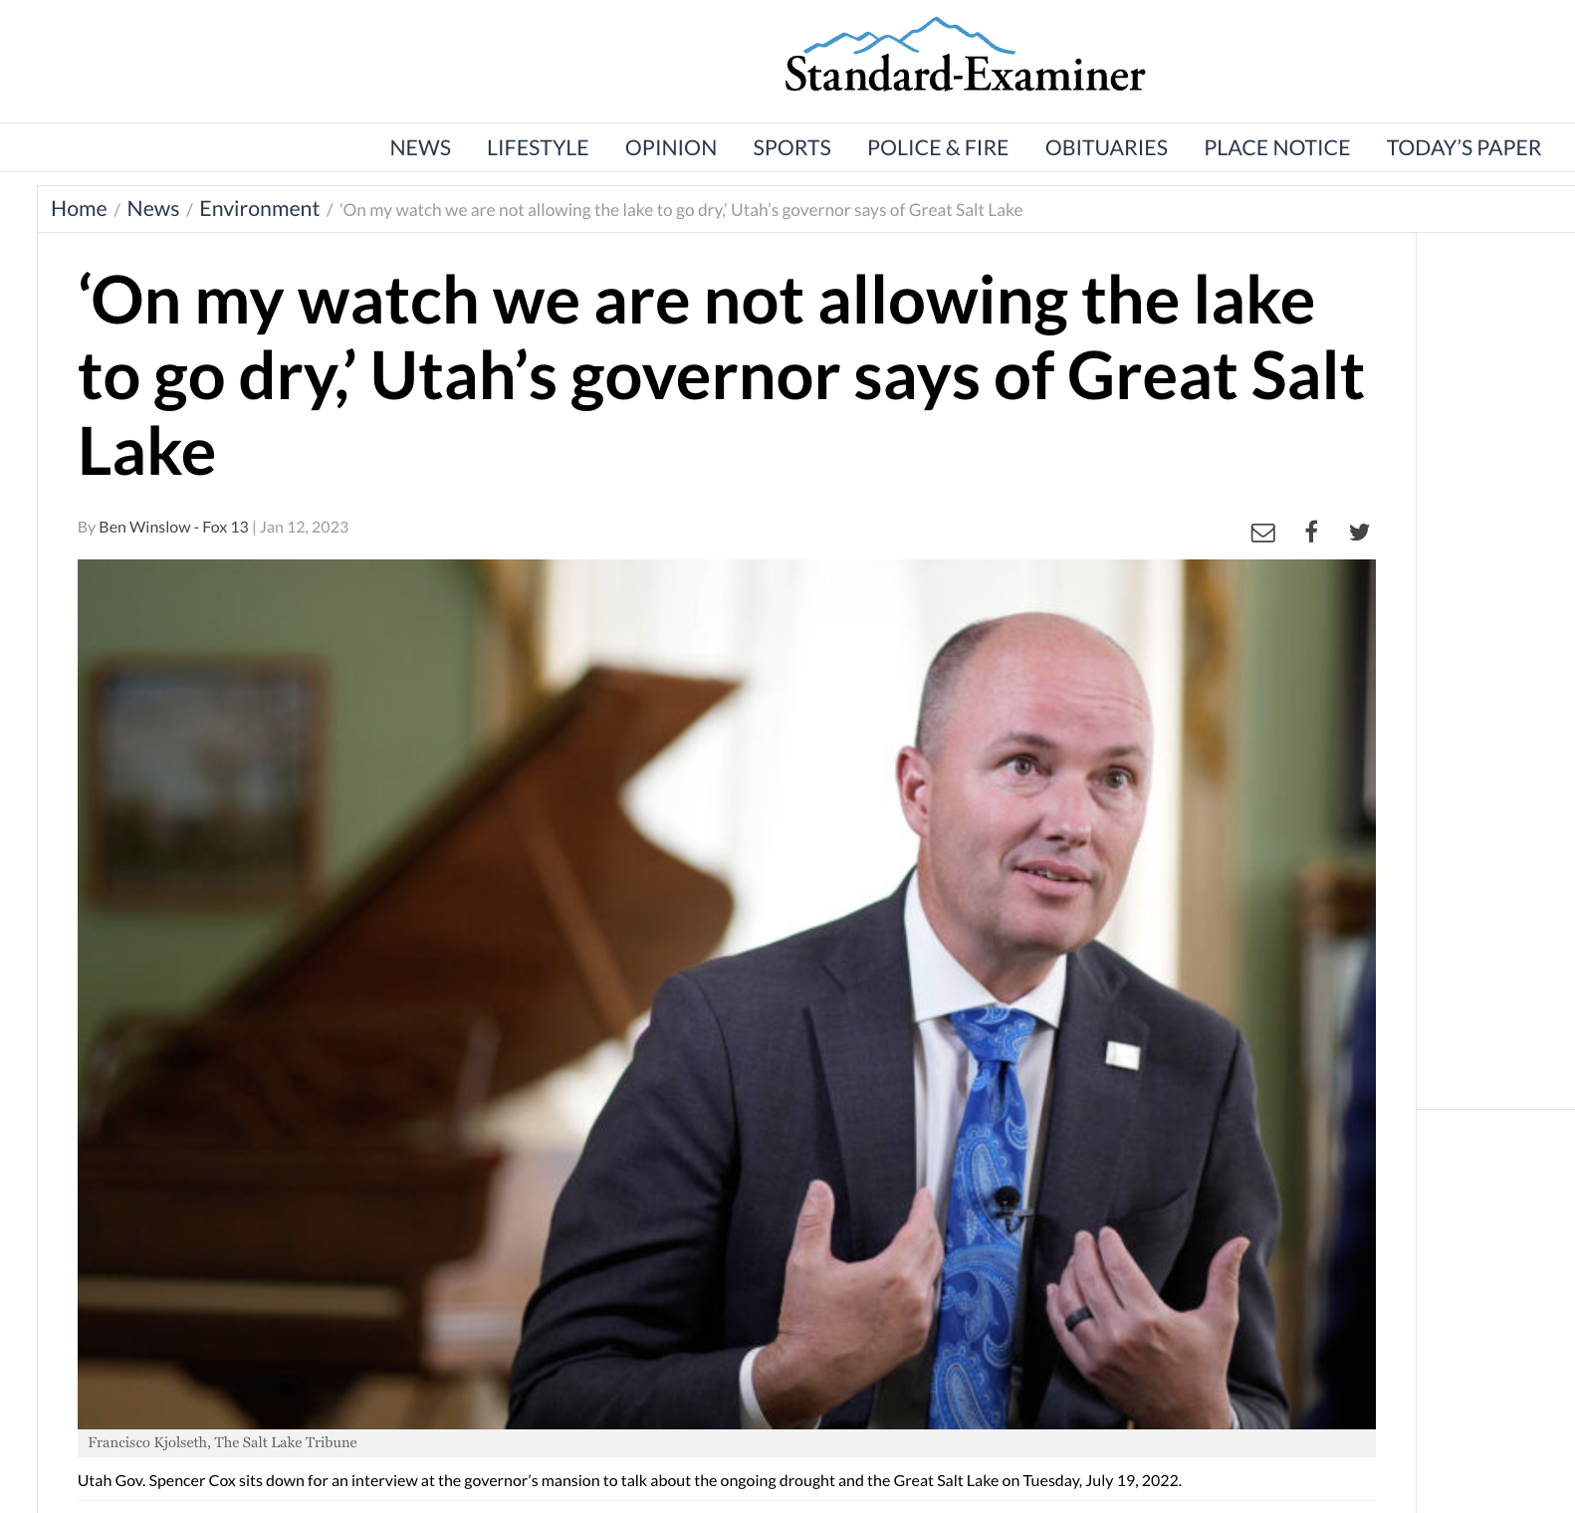

Slide 37
Evidence
Policy
Progress

Slide 38
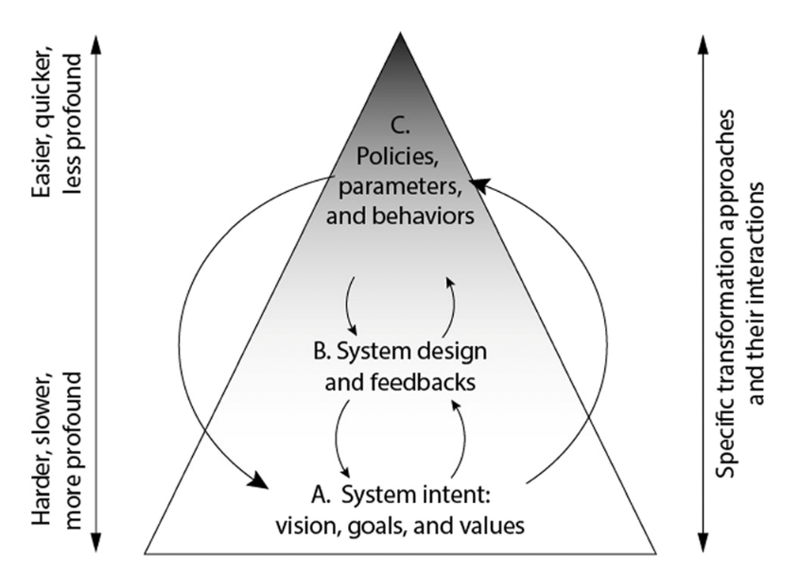
Chapin et al. 2022

Slide 39
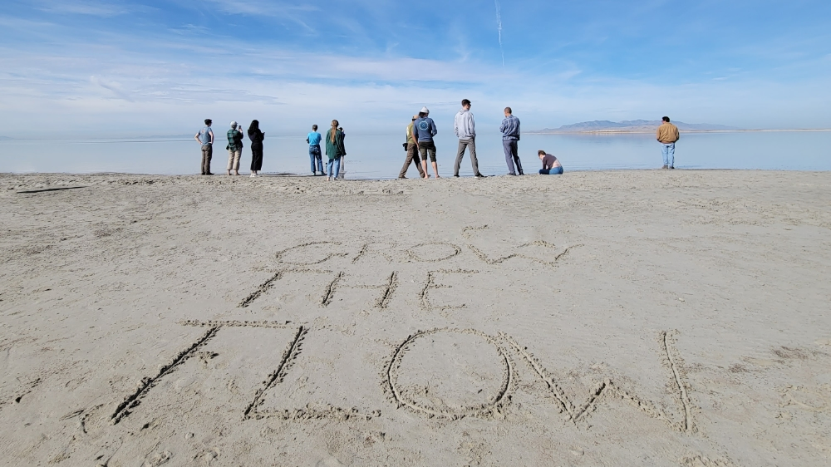

Slide 40
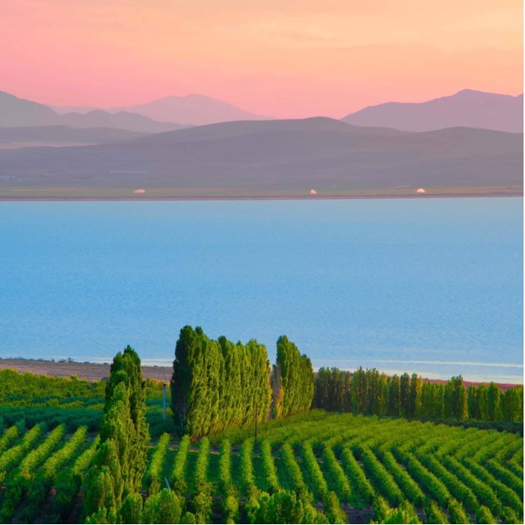








































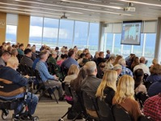





Industry
Farmers
State Government
ACCELERATE CONSERVATION
COORDINATE SUPPORT
State Agencies
Business
Academia
Federal Delegation
Local Government
Faith & Ethics
Environmental
Federal Agencies
Law
Tribal Government
Media
Water Distributors
Public
Water Users
BUILD TRUST

Slide 41
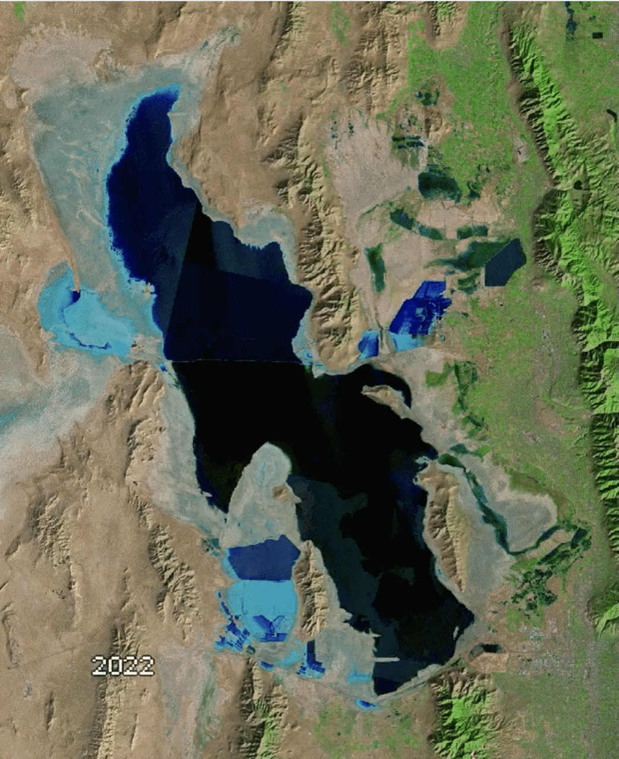


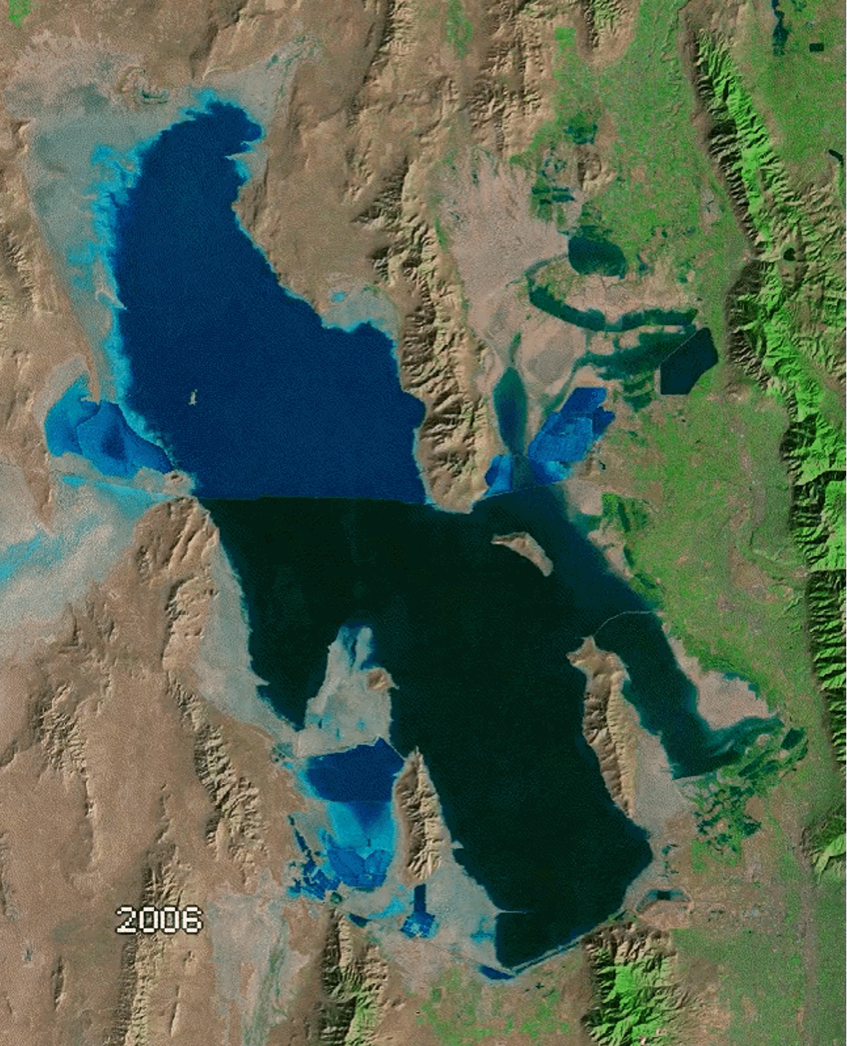
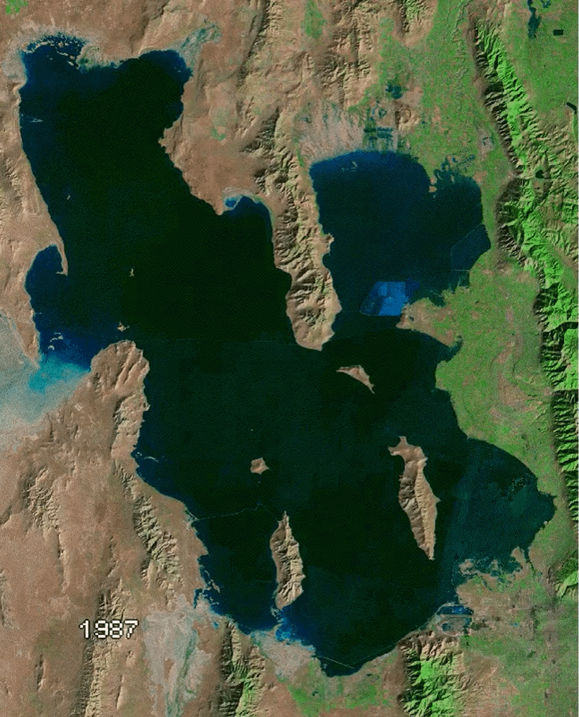

Stabilize (2023-2026)
Reservoir releases
Split-season leasing, temporary fallowing
Comprehensive lake rescue legislation
Groundwork for distributed public network
Enhanced local-state-federal coordination
Refill (2027-2030)
Activation of public action network
Continued lake restoration legislation
Federal rescue package
Water conservation, dedication, delivery
Agricultural support campaign
Solidify (2031-2033)
Lake level triggers and permanent rights
Refine long-term water security policies
Cultural and infrastructure changes
International cross pollination
Climate change adaptation
growtheflowutah.org
Ben Abbott

